Slide 1
ECSC 325.200
Web Server Administration
Spring 2025 – Week 1-1 – January 14th, 2025
Introduction and overview

Slide 2

Objectives
Info & About
Syllabus
Attendance
Book Info
Class Expectations
Lab Hours
Tentative Class Schedule
Servers
Server Specifications
Server Administrators
Internet and the World Wide Web
Database Management Systems
User Administration & Access Control
IP Addressing
Internet Protocol Suite
Networking
Data & Storage
Application Protocols
DNS Lookup
Operating Systems

Slide 3

Weekly Info
“Happiness is not something ready made. It comes from your own actions” – Dalai Lama
Recently discovered planet, being called “Proxima b”
  4.22 light years away, 1.3x size of earth, red dwarf star Proxima Centuri
  Within local star’s habitable zone (possibility of liquid water)
  Orbits local star in 11.2 days (Proxima b year)
Attendance
Good of the Class
Preferred method of communication is E-Mail.
Email is a best effort (typically daily)
“If you don’t have influence, you will never be able to lead others”
- John C. Maxwell

Slide 4

Recap and Review
Review of topics from last class
Corrections, updates, etc.
Review of previous assignments
Questions from previous classes
Assignments due?
Etc…

Slide 5
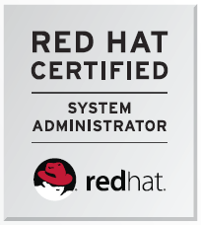
About Me
20+ Years professional systems administration
  Small business
  University
  Enterprise
Linux, Unix, Windows
  Red Hat Certified System Administrator
    2016-08-12 – Certificate Number: 160-170-197
  CentOS
  Raspbian
Networking
  IPv6
Virtualization & Cloud
Website
  http://jpatalon.cs.edinboro.edu
  Office Hours
  Contact Info
  Assignments and files
  Class Schedule & Info
D2L
  Grades
  Assignment submissions
  Office Hours
  Contact Info
  Assignments and files
  Class Schedule & Info

Slide 6

Syllabus
ECSC 325.200 202520 Syllabus
Available at
  http://jpatalon.cs.edinboro.edu
  http://jpatalon.ultrastuff.net
  D2L
    Redundancy!
About the class
  Virtual Machines
  Read, discuss, walkthrough, implement, check, test
  CentOS 8 Linux Operating System?
    CentOS is based off of Red Hat Enterprise Linux 8…
  Assignments can include written documentation
  and technical configuration implementations

Slide 7
Attendance
Regular and punctual attendance is expected. This course will follow attendance guidelines set forth in the Class Attendance Policy and Procedure section of the university catalog. Any in-class exercises must be done in class and are not available for make-up.
University Class Attendance Policy
ATTENDANCE POINT/GRADE SUMMARY
3 Points per class – 28 class periods – 84 points total (6% of total grade)

Slide 8
Class Expectations
Regular and punctual attendance is expected.
Disruptive behaviors, including but not limited to excessive talking, arriving late, sleeping, or using unauthorized electronic devices during class is not permitted.
There is no tolerance for cheating or plagiarism.
Turn in all homework on time. Late homework assignment submissions are not accepted.
Assignments are due by the end of the day of the specified due date
All exams must be taken during the scheduled class time, unless prior approval is given from the instructor.
Inform the instructor of any special needs or arrangements, including university sport or disability requirements, at the beginning of the semester!

Slide 9
Book Info
Required:
  Linux Administration: A Beginners Guide – 7th Edition
  Wade Soyinka
  McGraw Hill 2016
  ISBN: 978-0071845366
  https://www.amazon.com/Linux-Administration-Beginners-Guide-Seventh/dp/0071845364
Optional:
  The Practice of System and Network Administration – 3rd Edition
  Limoncelli, Hogan, Chalup
  Addison-Wesley 2016
  ISBN: 978-0321919168
  https://www.amazon.com/Practice-System-Network-Administration-Enterprise/dp/0321919165

Slide 10
Lab Hours
Library Hours
Ross Hall Labs
  Ross 137 – Math & CS Computer Lab – For CS majors, 24-hour access with passcode
    Also room Ross 138 with ID swipe
Contact IT Help Desk for additional computer lab locations and availability
  (814) 732-2111

Slide 11
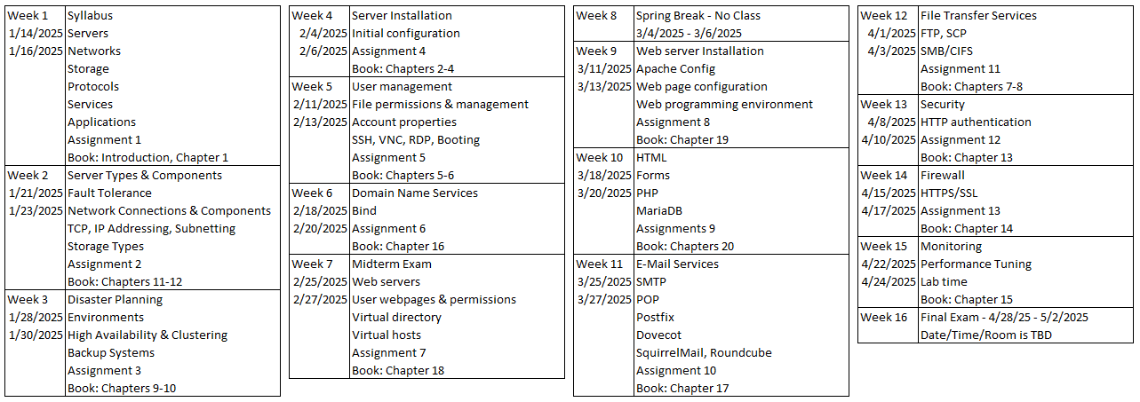
Tentative Class Schedule
Notes:
On the syllabus

Slide 12

Servers
A server is both a running instance of some software that is capable of accepting requests from clients, and the computer hardware that executes such software.
Provide underlying services for email, websites, and cloud storage
Server operating systems
  Windows Server 2025
  Red Hat Enterprise Linux 10
Extra redundancy
Higher Power and More Reliable Components
Combination of services
Separation of duties
Specialized editions
Notes:
serv·er
/ˈsərvər/
Noun
A person or thing that provides a service or commodity
2. A computer or computer program that manages access to a centralized resource or service in a network.
https://techterms.com/definition/server

Slide 13
Server Considerations
CPU
  Single or Multiple CPU socket’s
  Number of cores and Hyper-threading
  Features
Memory
  Size
  Speed
  Type (motherboard)
Connections
  Network Connections
  Storage Connections
  Power
Disk
  Capacity
  Onboard
  Storage Area Network (SAN)
  Network Accessible Storage (NAS)
Redundancy
  RAID ability
  Multiple connections
Licensing
  Restrictions on CPU count
  Virtual vs. Physical server
  OS Edition
Notes:
Redundancy!

Slide 14
Server Considerations
Out Of Band Access (OOB)
  Access to the console interface of the device, sometimes through a separate, independent network. *JetKVM.com*
Clustering
  Storage clusters provide large and redundant data storage options.
  High availability clusters eliminate single points of failure in specified systems.
  Load balancing clusters separate load among nodes, allowing for growth on the fly.
  High performance compute clusters perform many simultaneous calculations.
Fault Domains (weak link)
Bandwidth
  The rate of available or consumed capacity
Appliances
  Specific hardware configuration
  Specific infrastructure connections
  Physical or virtual
Converged Devices
  Provide multiple functions
  Virtualize functions
  Ex: Converged Network Adapter (CNA)
    Fiber Channel (FC) Host Bus Adapter (HBA)
    TCP/IP Ethernet NIC

Slide 15
Types of Servers
Application Server
  Host applications allowing users to run
Catalog Server
  Maintains index of information
Communications Server
  Maintains environment necessary for end to end communications
Compute Server
  Provides CPU and memory resources
Database Server
  Maintains and shares a database
File Server
  Shares files and folders over the network
Game Server
  Hosts game services allowing multiplayer connectivity
Mail Server
  Processes email communications
Proxy Server
  Acts as an intermediary between a client and a server, redirecting traffic from a source to a target
Web Server
  Hosts web pages and associated necessary software

Slide 16

Web Servers
Internet Information Services (IIS)
  Microsoft Windows Web Server
  Supports HTTP/HTTPS, FTP/FTPS, SMTP, NNTP
    Hyper Text Transfer Protocol, File Transfer Protocol, Simple Mail Transport Protocol, Network News Transfer Protocol
Apache HTTP Server
  Windows, Linux, OS X
  Worlds most used web server software
Tomcat
  Provides “Pure Java” HTTP web server environment
Nginx (Engine-X)
  Focus on high concurrency, performance, and low memory usage

Slide 17
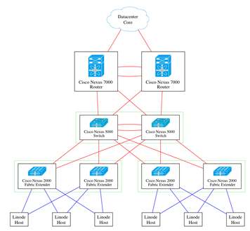
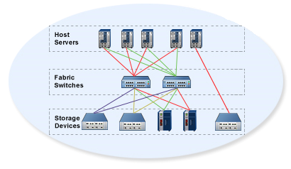
Server Connections
Ethernet Network
  Multiple interfaces provide redundancy
  Active/Backup or Active/Active
  1-10+ GBps
Storage Area Network
  Separate physical network
  Redundancy
  Connection between server and disk
  4-8+ GBps

Slide 18
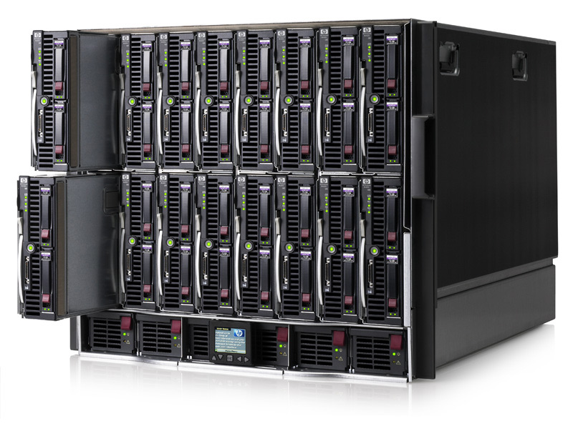
Types of Server Hardware
Towers
  Shaped similar to a desktop tower
  Increased space within server for extra devices
Rackmount Servers
  Long, thin, boxes
    Similar shape to a pizza box
  Allow increased rack space usage
Blades
  Share common blade enclosure
    Many contain converged network/storage devices
  Often the best option for rack space usage
Hyper-Converged Infrastructure
  Combine multiple technologies into a single package with special software

Slide 19
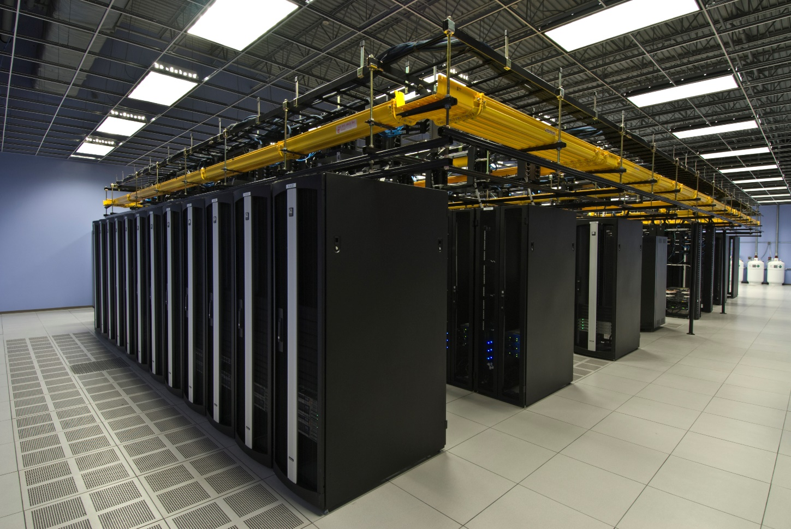
Server Environment
Multiple servers
Rackmount environment
Secure access
Heating/Cooling/Humidity Controls
Raised floor design
Redundant connections
Cabling designs
Hot/Cold Aisles
Separation of Duties

Slide 20
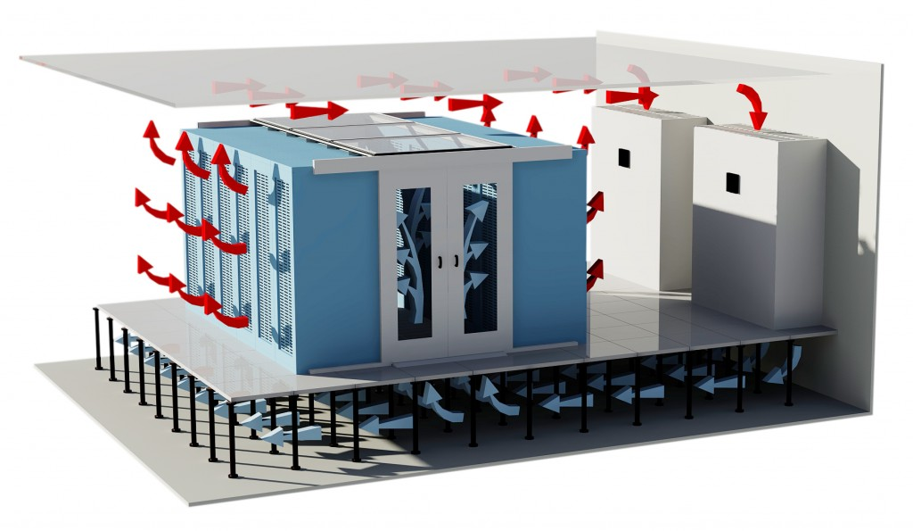
Web Hosting Solutions
Shared Hosting
  No administrative access
  Many websites reside on a single server sharing resources
    IP, RAM, CPU, Disk IO, etc.
Dedicated Host
  Entire server leased to single customer
  Administrative access
VPS
  Virtual Private Server (VM)
  Administrative access
  Dedicated or shared server resources
    CPU, RAM, Disk I/O, etc.
Co-Location
  Your server hardware located within providers facility
  Redundancy
Notes:
Drawbacks
Shared hosting in general
If file permissions have been improperly configured, then shared file systems might give other (compromised) users or processes system-wide access to these files.
System performance may suffer on heavily-loaded systems.
Because of the lack of root access, user-installed services cannot listen on well-known ports below 1024
Name-based virtual hosts
They will not work with very old HTTP/1.0 browsers that do not send the hostname as part of requests. Since the "Host" header is mandatory in HTTP/1.1, which was issued in 1999 as RFC 2616, this is not a common issue.
By default, they do not properly support secure websites using HTTPS. All name-based virtual hosts using the same IP address must share the same digital certificate because the SSL/TLS handshake takes place before the hostname is sent to the server. While there are solutions to this such as Server Name Indication, it is not yet widely implemented.
If the Domain Name System is malfunctioning, or DNS changes haven't propagated to all ISPs' resolvers, it is not possible to fall back to using the IP address to contact the system. Some web hosting companies may offer alternative URLs to provide access in such cases.

Slide 21
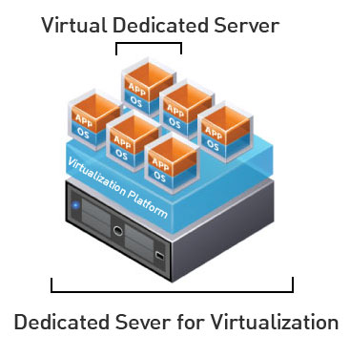
Virtual Machines (VM)
Virtual Private Server (VPS)
Emulates a computer system through specialized software
May provide virtualization of a full system or single process
Allows for greater use of resources
Increased flexibility
Hypervisors and guests
Examples
  Qemu
  VirtualBox
  VMWare

Slide 22
Server Administrators
A server administrator, or admin has the overall control of a server. This is usually in the context of a business organization, where a server administrator oversees the performance and condition of multiple servers in the business, or it can be in the context of a single person running a game server.
The Server Administrator's role is to design, install, administer, and optimize company servers and related components to achieve high performance of the various business functions supported by the servers as necessary. This includes ensuring the availability of client/server applications, configuring all new implementations, and developing processes and procedures for ongoing management of the server environment. Where applicable, the Server Administrator will assist in overseeing the physical security, integrity, and safety of the data center/server farm.
Wikipedia

Slide 23
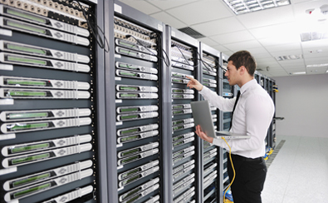
Server Administrators
Provide access to software and services
  Software Installation
  General Troubleshooting
Provide a reliable and consistent environment
  Maintain consistency across environments
  Ensure proper design and connectivity, redundancy
Minimize the harm that users can do to the environment
  Elevate or restrict permissions as necessary
Manage specific server functionality
  Website, Database, DNS, etc.
Work with vendors and providers to build systems and create connections

Slide 24
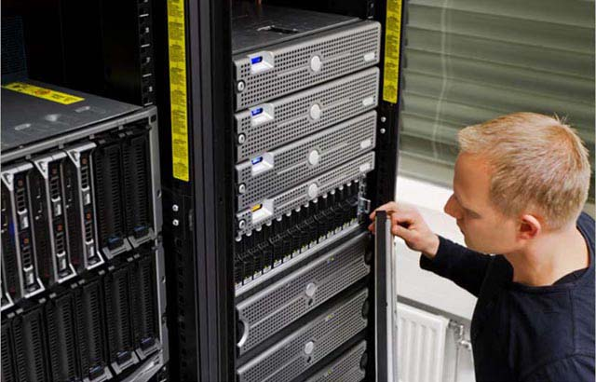
Server Administrators
Common Tasks
  Specifying, purchasing, and installing physical hardware
    Necessary levels of redundancy, storage, memory, wiring, etc.
  Managing device firmware levels, configuring integrated systems such as BIOS or firmware
  Configuring operating systems and server hardware
    Drive layouts and specifications
    Network or storage connection configurations
    Operating system configuration and maintenance
  Configure, maintain, and test Backups
    Disaster Recovery
  Maintain and monitor system security and integrity
  Interface with other business areas
  Documentation

Slide 25
Server Administrators
Database Administrator
  Maintains a database system and is responsible for the integrity of the data.
Network Administrator
  Maintains network infrastructure such as switches, routers, and various interconnecting devices.
Security Administrator
  Maintain security policies and administer security devices such as firewalls and security appliances.
Web Administrator
  Maintain services related to providing web site access and configuration.
OS Administrator
  Maintain operating system installation and upkeep; may include hardware, patching, and system consistency.
Storage Administrator
  Maintain a storage infrastructure and related devices, such as a SAN or NAS.

Slide 26

Server Administrators
Web Server Administrators
  Install and maintain web service software
  Install additional programming environments to support webpage environment
    PHP, ASP, .NET, Perl, C++, etc.
  Java Configurations
  Specify and maintain web server hardware
  Provide other access as necessary
OS Administrators
  Install Operating System
  Maintain OS Patching
  Configure physical servers
  Maintain virtual hosting environment

Slide 27
Server Administrators
E-Mail Server Administrators
  Manage email server software
  Provide antivirus and antispam email scanning functions
  Manage email accounts, group accounts, distribution lists
Additional Tasks may be dependent on size of the organization
  Web page development
  Database design
  Programming
  Scripting
  Security
Roles may be more general or more specific
depending on organization

Slide 28
ECSC 325.200
Web Server Administration
Spring 2025 – Week 1-2 – January 16th, 2025
Introduction and overview Continued

Slide 29
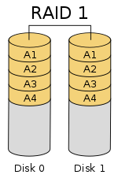
Storage
Spinning or solid state physical storage
  Solid state is faster but more expensive
  Spinning is physically denser
Redundant Array of Independent Disks (RAID)
  Raid 0 vs Raid 1
  Multi-Level Raid (10)
  Raid 5 vs Raid 6
Raid 0 – Striping – Zero redundancy
Raid 1 – Mirroring – Redundancy
Raid 5 – Striping with one parity disk
Raid 6 – Striping with two parity disks
Notes:
"RAID 01" by Wheart, based on image File:RAID 0.svg by Cburnett - Own work. Licensed under CC BY-SA 3.0 via Commons - https://commons.wikimedia.org/wiki/File:RAID_01.svg#/media/File:RAID_01.svg

Slide 30
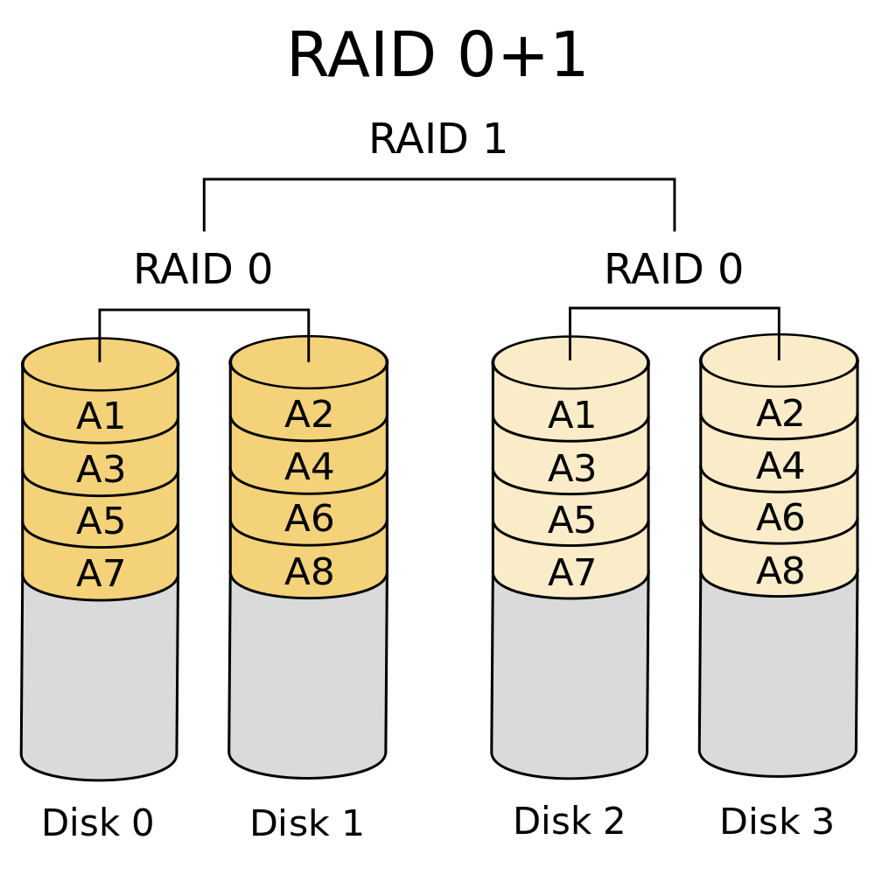
Storage
Spinning or solid state physical storage
  Solid state is faster but more expensive
  Spinning is physically denser
Redundant Array of Independent Disks (RAID)
  Raid 0 vs Raid 1
  Multi-Level Raid (10)
  Raid 5 vs Raid 6
Raid 0 – Striping – Zero redundancy
Raid 1 – Mirroring – Redundancy
Raid 5 – Striping with one parity disk
Raid 6 – Striping with two parity disks
Notes:
"RAID 01" by Wheart, based on image File:RAID 0.svg by Cburnett - Own work. Licensed under CC BY-SA 3.0 via Commons - https://commons.wikimedia.org/wiki/File:RAID_01.svg#/media/File:RAID_01.svg

Slide 31
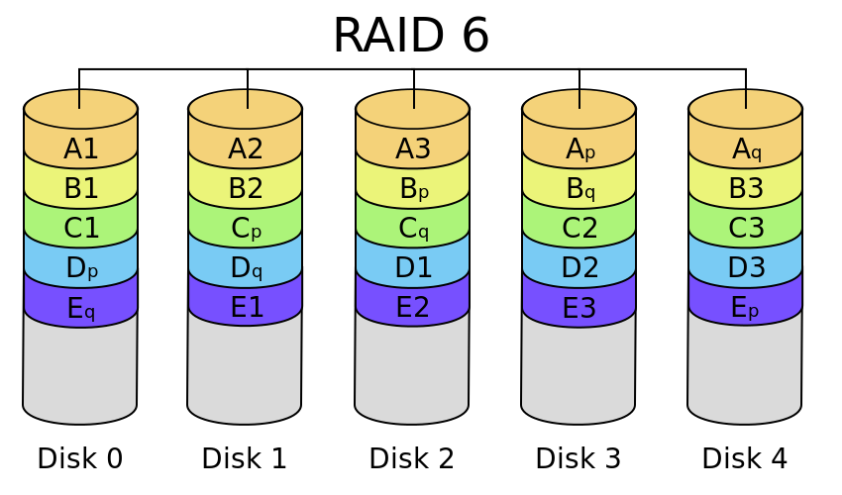
Storage
Spinning or solid state physical storage
  Solid state is faster but more expensive
  Spinning is physically denser
Redundant Array of Independent Disks (RAID)
  Raid 0 vs Raid 1
  Multi-Level Raid (10)
  Raid 5 vs Raid 6
Raid 0 – Striping – Zero redundancy
Raid 1 – Mirroring – Redundancy
Raid 5 – Striping with one parity disk
Raid 6 – Striping with two parity disks
Notes:
"RAID 6" by en:User:Cburnett - Own workThis vector image was created with Inkscape.. Licensed under CC BY-SA 3.0 via Commons - https://commons.wikimedia.org/wiki/File:RAID_6.svg#/media/File:RAID_6.svg

Slide 32
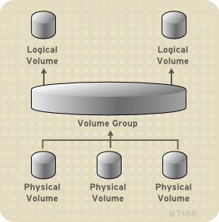
Storage
Disks
  Physical devices storing data
  Can be RAID devices
Partitions
  Separate regions of disks
Volume groups
  Groups of disks or partitions
Logical volumes
  Individual volumes within a volume group
File systems
  Specifies how data is stored and organized

Slide 33
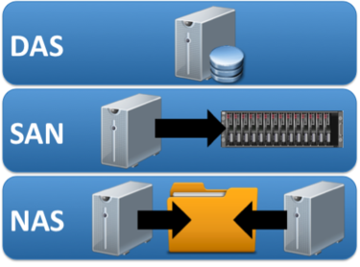
Storage
Direct Attached Storage (DAS)
  Storage devices connected directly to server hardware
Storage Area Network (SAN)
  Separate network for storage traffic
  Typically fiber-optic connections
  Gigabit speeds (8Gbit/s+)
  Replaces internal server storage
  Provides redundant access to large storage devices
Network Attached Storage (NAS)
  Storage available across traditional Ethernet (TCP/IP) network
  Intended for serving shared files to multiple clients
  Appears as network shares

Slide 34
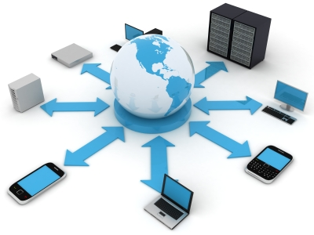
The Internet and the World Wide Web
1961 – Planning begins for internet communications
  Packet-switching technology first discussed
1969 – Origin of the Internet
  ARPANET carries its first packets
1982 – TCP/IP protocol suite formalized
  SMTP/DNS shortly afterwards
1985 – First .COM domain name registered
1988 – OSI Model Introduced
1989-91 – WWW Introduced
1995 – Commercialization and privatization
  New internet architecture developed
  Very high-speed Backbone Network Service

Slide 35
The Internet and the World Wide Web
The Internet – A worldwide network of networks
Protocols govern how devices communicate
Uses TCP/IP – “The Language of the Internet”
  Transmission Control Protocol/Internet Protocol
  IP Addresses provide unique identification on a network
World Wide Web - An open information space where documents and other web resources can be accessed via the Internet.
The Internet is not centrally controlled

Slide 36
The Internet and the World Wide Web
Internet Backbones:
A principal data route between large, strategically interconnected networks and core routers on the Internet.
Requires high-speed bandwidth connections and high-performance servers/routers.
Primarily owned by commercial, educational, government and military entities.
UUNET, AT&T, GTE, Sprint/Nextel
Connections like T1, T3, OC1, OC3 or OC48.

Slide 37

Data
Pieces of information
Represented as bits (0 or 1) on a medium
8 bits make a byte
1 byte can represent up to 256 unique values
Bit 7 | Bit 6 | Bit 5 | Bit 4 | Bit 3 | Bit 2 | Bit 1 | Bit 0
2⁷ | 2⁶ | 2⁵ | 2⁴ | 2³ | 2² | 2¹ | 2⁰
128 | 64 | 32 | 16 | 8 | 4 | 2 | 1

Slide 38
Data
Bit 7 | Bit 6 | Bit 5 | Bit 4 | Bit 3 | Bit 2 | Bit 1 | Bit 0
2⁷ | 2⁶ | 2⁵ | 2⁴ | 2³ | 2² | 2¹ | 2⁰
128 | 64 | 32 | 16 | 8 | 4 | 2 | 1
1 | 0 | 1 | 1 | 0 | 0 | 0 | 1
128 | 0 | 32 | 16 | 0 | 0 | 0 | 1
Binary Value: 10110001
Decimal Value: 2⁷ + 2⁵ + 2⁴ + 2⁰
  128 + 32 + 16 + 1
Final Value: 177

Slide 39
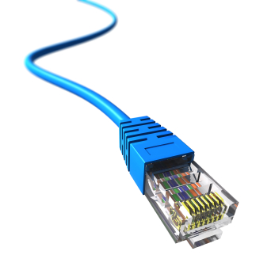
Physical Layer – Layer 1
Ethernet – Family of computer networking technologies
  Wired or wireless
  Coax cable, twisted pair, fiber optic
  Speeds of 10Mbit/s to 100Gbit/s or more
  Cable, Plug, Pinout specifications
    10BASE-T, 100BASE-TX, 1000BASE-T
    8 pin - 8 conductor (8P8C)
OSI Model

Slide 40
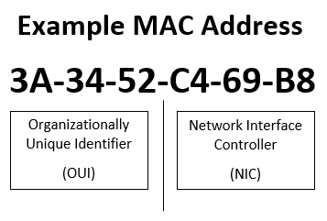
Media Access Control (MAC) Address
Unique address assigned to the hardware interface
Allows for communication at Data Link Layer (Layer 2)
May be assigned by the manufacturer
  Burned In Address (BIA)
Also called Hardware Address
12 Hexadecimal digits
  0 – F
First half typically identifies manufacturer
  Online databases
Can often be manually changed

Slide 41
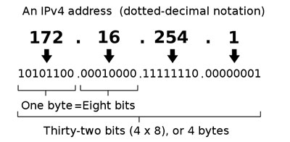
IP Addresses
IPv4 – Dotted decimal notation
  172.16.254.1/14
  2^32 addresses (4,294,967,296)
  Four 8-bit integers (32-bit)
  Private ranges
    10.0.0.0/8
      10.0.0.0-10.255.255.255
    172.16.0.0/12
      172.16.0.0-172.31.255.255
    192.168.0.0/16
      192.168.0.0-192.168.255.255
  Additional special and reserved ranges
Layer 3!
Notes:
172.16.254.1/14
10101100.00010000.11111110.00000001
netmask
11111111.11111100.00000000.00000000
255.252.0.0
first 14 bits are the network
10101100.000100
Remaining 18 (32-14) bits are host
00.11111110.00000001
binary range:
10101100.00010000.00000000.00000000
10101100.00010011.11111111.11111111
decimal range:
172.16.0.0-172.19.255.255

Slide 42
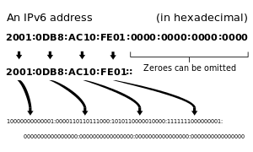
IP Addresses
IPv6 – Hexadecimal notation
  2001:0000:0000:0001:0000:7a11:a1e:cafe/32 (2001::1:0:7a11:a1e:cafe/32)
  2^128 addresses (340,282,366,920,938,463,463,374,607,431,768,211,456)
  Eight groups of four hexadecimal digits (128-bit)
  Values between 0-F
  One set of concurrent zeros can be compressed
    Leading zeros can also be reduced
  Make funny words?!
    FACE
    BEEF
    C0DE
Notes:
This is also Layer 3
“Different phone number” analogy

Slide 43
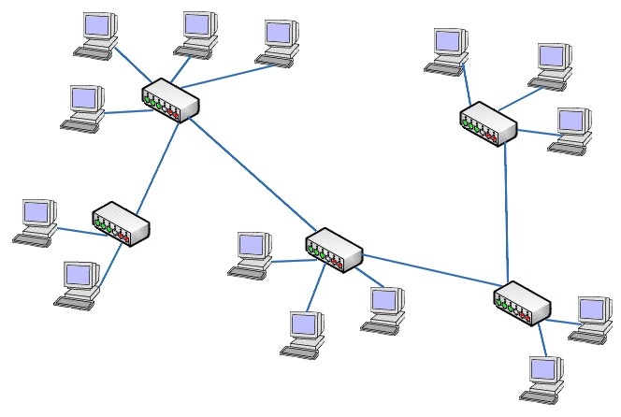
Network Connectivity
Hubs – Connects networked devices in to a single network segment.
  Layer 1 device, essentially just forwarding all information (repeater)
  One combined network connection segment for all devices
  Collision detection
  Obsolete rubbish
Switches – Connects networked devices using packet switching technology.
  Operate at layer 2, using hardware addresses to direct packets
  Separate each single network connection segment
Routers – Forwards data packets between computer networks.
  Layer 3 device, operates using layer 3 information (IP address)
    Linux route command

Slide 44
Network Connectivity
Switches – Connects networked devices using packet switching technology.
  Layer 2 protocol
  Clients get a single connection, servers get redundant connections
  Provide access to a specific physical wire connection
  ARP Cache (MAC Table)
    MAC Address to IP Address
    Poisoning?
  No routing; only within subnet
  Separate each single network connection segment
    VLANs & Vswitches & Vrouters, oh my!
Routers – Forwards data packets between computer networks.
  Layer 3 device, operates using layer 3 information (IP address)
    Traffic between different subnets
    Linux route command

Slide 45
Internet Protocol Suite
Commonly known as TCP/IP Model
  Transmission Control Protocol / Internet Protocol Model
Provides end to end connectivity specifying how data should be packetized, addressed, transmitted, routed, and received.
Encapsulation is used to provide data transportation.
Four Layers (practical)
  Link Layer – Defines networking methods within the scope of the link
  Internet Layer – Exchanges datagrams across networks and provides addressing mechanisms
  Transport Layer – Performs host-to-host communications using UDP or TCP protocols
    UDP is a basic datagram service, providing no reliability
    TCP provides flow-control, connection establishment, and reliable data transmission
  Application Layer – Contains data and information for higher application level protocols (HTTP, SSH, etc.)
Notes:
TCP/IP Model vs. OSI Model
TCP/IP Model layers are named
OSI Model layers are numbered

Slide 46
Network Fundamentals
OSI Model – 1988
  A conceptual model that standardizes the communication functions of a computing system
TCP/IP Model
  The computer networking model and protocols used on the Internet
OSI Model |  |  |  |  |  |  | TCP/IP Model
 | Layer | OSI Name |  | Example Protocols | Functions |  | TCP/IP Name | Layer
Host Layers | 7 | Application Layer |  | HTTP, FTP, DNS, SNMP, SSH | Network Process to Application |  | Application Layer | 4 | Host Layers
 | 6 | Presentation Layer |  | SSL, TLS | Data Representation and Encryption
 | 5 | Session Layer |  | NetBIOS, PPTP | Interhost Communication
 | 4 | Transport Layer |  | TCP, UDP | End to End Connections and Reliability |  | Transport Layer | 3
Media Layers | 3 | Network Layer |  | IP, ARP, ICMP, IPSec | Path and IP (Logical Addressing) |  | Internet Layer | 2 | Media Layers
 | 2 | Data Link Layer |  | PPP, ATM, Ethernet | MAC and LLC (Physical Addressing) |  | Network Interface Layer | 1
 | 1 | Physical Layer |  | Ethernet, USB, Bluetooth, 802.11 | Media, Signal, Binary Transmission

Slide 47
TCP and UDP
TCP
  Transport Control Protocol
  Provides reliable, ordered, error-checked delivery of data
  Datagram sequencing
  Data acknowledgement
  Retransmission of lost packets
  Checksum parameters
  Congestion Control
  Suitable for file transfers
    Downloads, streaming (not conferencing) video, music
UDP
  User Datagram Protocol
  Connectionless transmission model
    No verification of receipt, ordering, checking
  Minimum protocol overhead or service
    Less resource usage for faster speeds
  Checksums provided for data integrity
  No guarantee of delivery, ordering, or duplication
  Suitable for time-sensitive applications
    Live video-conferencing, voice communication, gaming
  Recommended for VPN’s
  Additional necessary error checking can be provided within the application

Slide 48
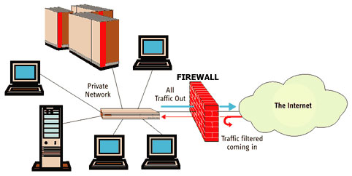
Network Connectivity
Modem – Modulator-demodulator
  Modulates carrier wave signals to encode digital information
CSU/DSU – Channel Service Unit/Data Service Unit
  Connects digital equipment to digital communication lines.
Firewalls
  Protect servers from unauthorized inbound connections
  Restrict outbound connections
  Related Connections
Optical Network Terminal (ONT)
  Translates fiber optic signals to CATV,
  Ethernet, telephone, etc.

Slide 49
Carrier Connection Types
Fractional T1 64 Kbit/s channels
  24 lines to split among voice/data
T1 1.544 Mbit/s (24 * 64k)
T3 44.736 Mbit/s
OC-1 51.84 Mbit/s
OC-24 1244.16 Mbit/s
OC-48 2488.32 Mbit/s
  Common carrier connection type used for many regional ISPs
OC-192 9953.28 Mbit/s
Dial-Up Modem 56Kbps
DSL 1-10Mbps
Satellite 1Mbps-15Mbps
Cable 5-50Mbps
Fiber to the Home 10-1000Mbps
Power-Line Internet 20-500Mbps
Wi-Fi 50Mbps-4Gbps
ATM and Frame Relay 10Mbps-10Gbps

Slide 50
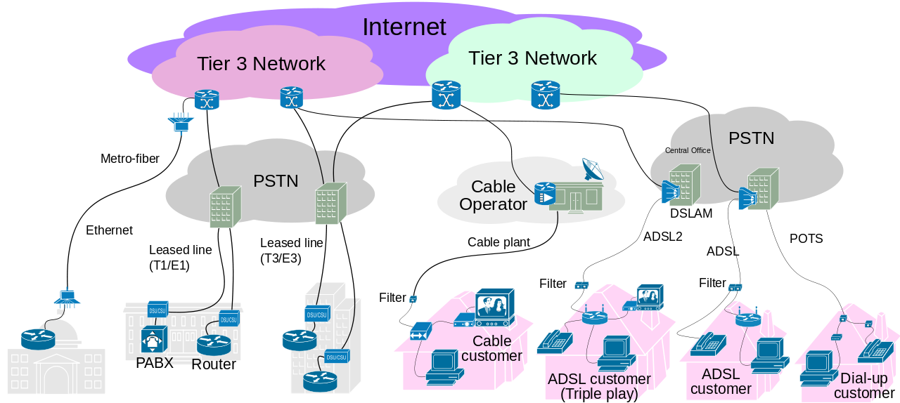
ISP Connectivity
Notes:
DSLAM: Digital Subscriber Line Access Multiplexer
POTS: Plain Old Telephone Service
ADSL: Asynchronous Digital Subscriber Line
PABX: Private Automatic Branch Exchange
PTSN: Public Switched Telephone Network

Slide 51
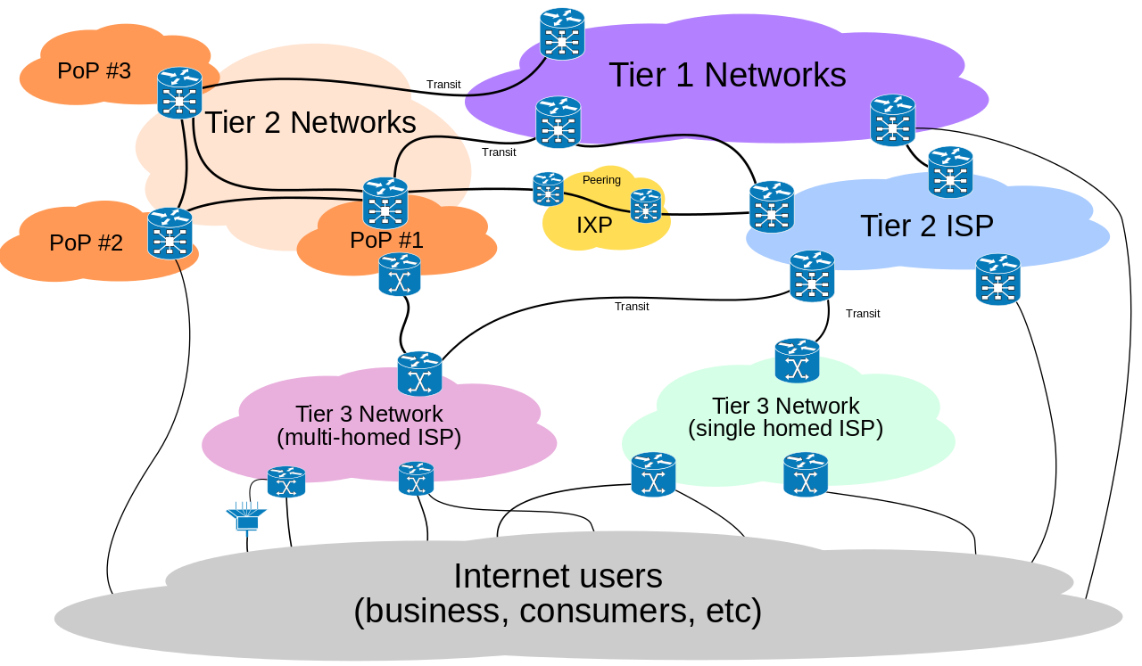
ISP Tiering
Tier 1
  Generally only peers with other Tier 1
  Internet Backbones
  Generally global
    “Regional” Tier 1
  AT&T, Level 3, Hurricane Electric, etc.
Tier 2
  Needs connection to backbone
  May peer with other Tier 2
  Provide access to Tier 3
Tier 3
  Purchases connectivity from higher tier
  May peer with other Tier 3
  Provide access to consumers

Slide 52
NAPs and IXPs
Network Access Point (NAP)
  A public network exchange facility where Internet Service Providers (ISPs) connected with one another in peering arrangements.
  Often points of considerable Internet congestion.
  Originally 4 NAPs.
  Paved the way for new Internet Exchange Points (IXPs)
Internet Exchange Points (IXPs)
  A physical infrastructure through which ISPs and Content Delivery Networks (CDNs) exchange traffic.
  The primary purpose is to allow networks to interconnect directly, rather than through one or more third-party networks.
  Reduces cost, reduces latency, and better utilizes bandwidth.

Slide 53
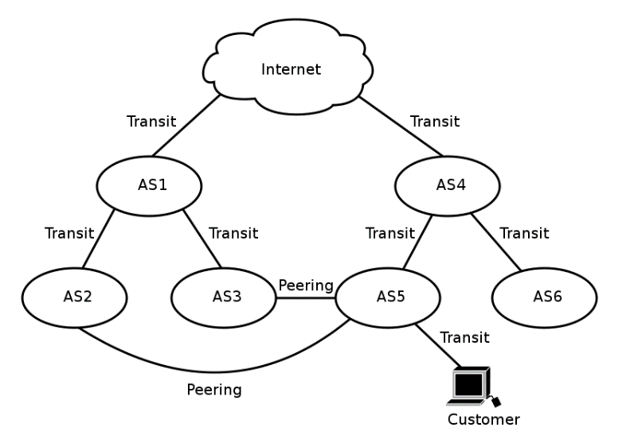
Peering
A voluntary interconnection of administratively separate Internet networks for the purpose of exchanging traffic freely with each other for mutual benefit.
Peering may consist of:
  Exchange of routing information through the Border Gateway Protocol (BGP) routing protocol
  Physical interconnection of the networks
  A formalized contractual document (0.5%)
Benefits of peering:
  Reduced costs
  Increased redundancy
  Increased capacity
  Improved performance

Slide 54
Application Protocols
HTTP(S)
  Hyper Text Transfer Protocol – Website Communication
  “S” on the end indicates secure encrypted connection
  S-HTTP – Only portion of data is encrypted
FTP
  File Transfer Protocol – Simply transferring files
  Multiple types of security (SFTP or FTPS)
    FTPS adds SSL or TLS protocols to FTP
SSH
  Secure Shell
  Allows for additional secure network services
  SFTP is actually SSH FTP!
POP3
  Post Office Protocol version 3
  Used tor retrieving e-mail messages from a mail server
  Messages downloaded off of server
IMAP
  Internet Message Access Protocol
  Used for viewing e-mail messages on a mail server
  Messages remain on server
SMTP
  Simple Mail Transfer Protocol
  Used for sending e-mail
  Used for communication between mail servers

Slide 55
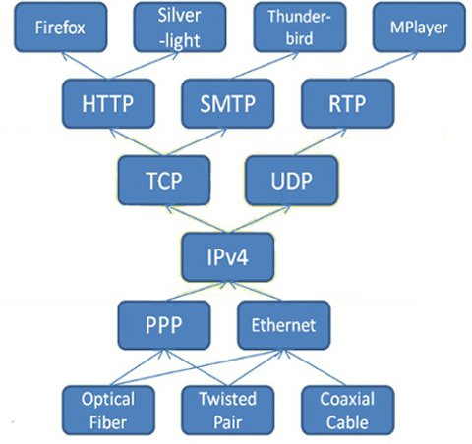
Application Protocols
DNS
  Domain Name Services
  Provides Name/IP address lookup services
  Fundamental to proper internet functionality
DHCP
  Dynamic Host Configuration Protocol
  Used to provide IP address services to hosts automatically
NTP
  Network Time Protocol
  Used to keep time consistent across the network

Slide 56
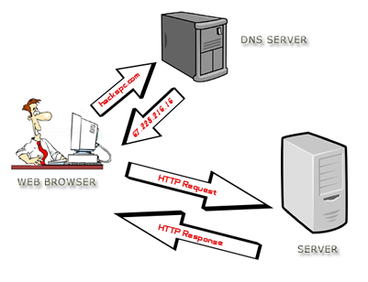
DNS Lookup
User types in a webpage request
Client device requests IP lookup from DNS Server
DNS Server returns IP address to client
Client device requests content from IP address
IP address returns content
nslookup command
  Linux and Windows
dig command on Linux

Slide 57
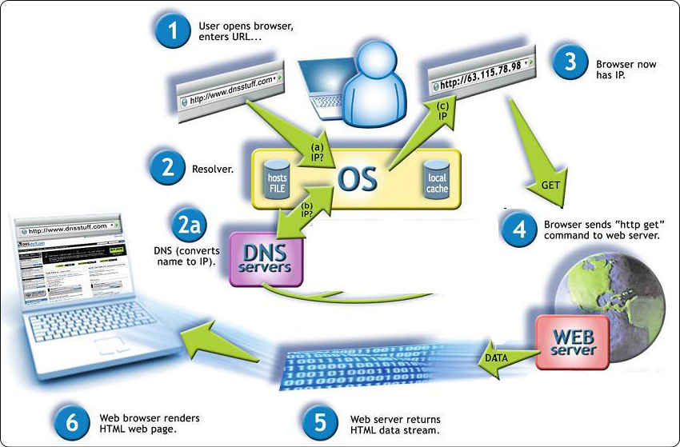
Webpage Resolution
User enters URL in web browser
OS Looks up IP address
  If locally cached, return cached content
Lookup request to DNS server
Response received from DNS server
OS returns IP address to web browser
Web browser queries IP address for content
Content is returned to web browser and rendered as a web page

Slide 58

Operating Systems
Microsoft Windows
  Windows 1.0 Introduced in 1985
  Closed source
  Server, Desktop, Mobile editions
Unix
  Development started in 1969, published in 1973
Linux
  Introduced in 1991
  Source code freely available
  Multiple distributions
    Red Hat, Ubuntu, Gentoo

Slide 59
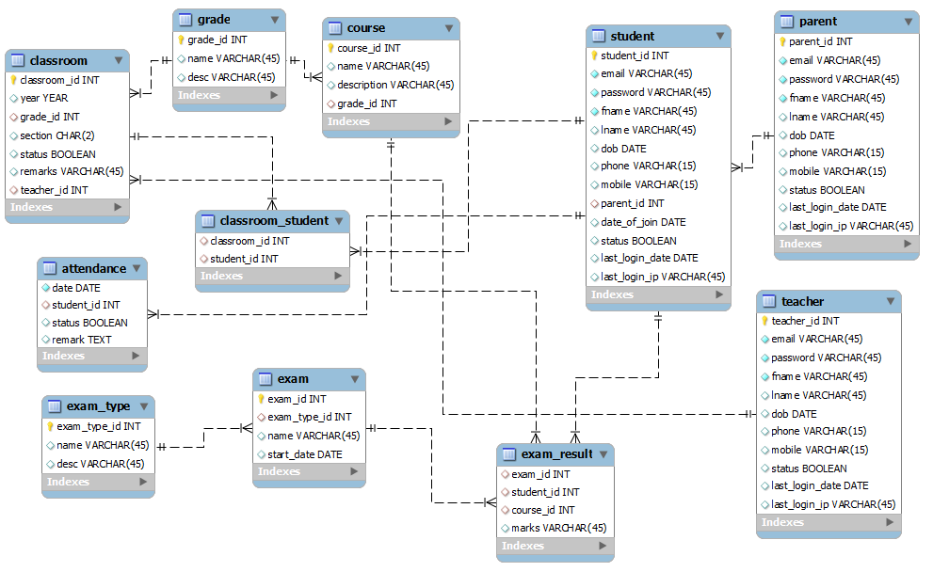
Database Management Systems
A database management system (DBMS) may be used to store data associated with a web page
  Microsoft Access
    Small database, suitable for only a very minimal audience with limited needs
  Microsoft SQL Server
    Provides scalable DB functions on Windows hosts
  Oracle
    Enterprise grade database software
    Licensing costs and considerations
  MySQL, MariaDB, etc.
    Free and Open Source multi-platform database software
  SQL
    Structured Query Language – Used to communicate with the database
    Pronounced “Sea-Quill”
Notes:
Database redundancy
Single Instance/failover

Slide 60

User Administration
Possible to have large number of users
Productivity
System Access
Consistency
Group Administration
Password Complexity Requirements
  Minimum and maximum length
  Letters, numbers, and symbols
  Change frequency, reuse policy

Slide 61
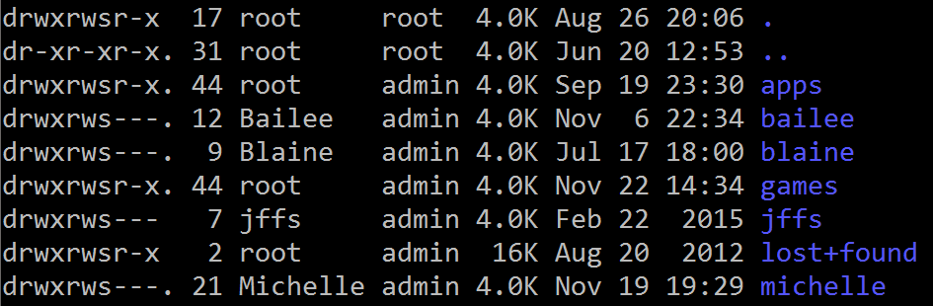
Access Control
Give users just enough access
Organize users in to groups
Access provided to groups
Permissions and privileges
  Sudo or administrative privileges
  User/group/world permissions
  Read, write, and execute access

Slide 62

Linux
Free and Open Source Software (FOSS)
  Free as in speech, not as in beer
  Source code readily available for anyone to view or modify
  Absolves programmers from liability
GNU Public License
  Dictates licensing behavior
  Software is free, may be modified and resold provided full source code
  and changes are released as open source
Kernel Differences
  Distribution vendors take a base kernel, add customized patching, perform additional QA
Upstream and Downstream
  Software project maintainers release tools and programs (upstream)
  Distribution vendors put software and tools together into a package (downstream)

Slide 63
Linux
Standards
  File Hierarchy Standard (FHS)
  Linux Standard Base (LSB)
Single, Multiple, Network User
  Windows originally a “one computer, one desk, one user” operating system
  Linux originally developed with networking and multiple users in mind
Registry and text files
  Windows uses a registry – a large database of configuration values
  Linux uses text files – small scattered configurations
Authentication
  Local and network

Slide 64
Virtual Machines
IP Address: 147.64.243.1## (01-25)
Hostname: ecsc325-1##.cs.edinboro.edu (01-25)
Alias: 1##.megastuff.biz (01-25)
  Also 1##.ultrastuff.net!
Assignment 1 due next week!
VM’s in week 3-4?!

Slide 65

Linux Commands
nslookup
dig
route

Slide 66

Key Terms and Items
Syllabus & Class Info
Servers
Server considerations
Server types
Server hardware types
Server environment
Virtual machines
Hot & Cold aisles
Server administrators
The Internet
World Wide Web
TCP/IP
Data
IPv4/IPv6 Addresses
Network layers
TCP & UDP
Hubs, Switches, Routers
Firewalls
ISP Tiering & Peering
Storage & RAID
Application protocols
DNS
Operating Systems
Users and Groups

Slide 67

For Next Week
Life is like riding a bicycle. In order to maintain balance, you must keep moving.
Textbook:
  Introduction
  Chapter 1: Technical Summary of Linux Distributions
Assignment 1
  Due January 22nd, 2025
Next week topics
  Types of servers, server components, storage, NICs
  Disaster planning, redundancy, HA, backups

