Slide 1
ECSC 325.200 Web Server Administration
Spring 2025 – Week 13-1 – April 8th, 2025
Security and Authentication
Prof. Jason Patalon

Slide 2

Objectives
Core System Services
Hashes
Rainbow Tables
Salt
Types of Attacks
Filters and Firewalls
IPTables Examples
Proxy Servers
Intrusion Detection
Hypertext Transfer Protocol Secure (HTTPS)
Example configurations
Secure Socket Layer (SSL)
MFA
SE Linux
Privileged Programs
Security

Slide 3

Weekly Info
“Money can buy you a fine dog, but only love can make him wag his tail.”
– Kinky Friedman
Attendance
Assignment 12 due this week!
NIC, VIP, VLANs, Disk, PV/VG/LV, NFS mount & export
Final Exam – Tuesday April 29th, 2025
5:00PM to 7:00PM
Good of the class

Slide 4

Recap and Review
The next few weeks…
Security and authentication, cloud
Final Exam!
Corrections, updates, etc.
Questions from previous classes?
Assignment 12 due April 9th, 2025
Assignment 13 due April 16th, 2025
Assignment 14 due April 23rd, 2025
Final Exam – Tuesday April 29th, 2025
5:00PM to 7:00PM

Slide 5

Remaining Class Schedule*
Week 13 – April 8/10, 2025
HTTPS/SSL
Authentication
Security
Work time
Week 14 – April 15/17, 2025
Firewalls
Monitoring
Security
Lab Time
Performance Tuning
* Exact topics/dates may change
Week 15 – April 22/24, 2025
Cloud
Automation
The Future
Additional Topics
Final Review
Work Time
Week 16 – Final Exam
300 Points
Tuesday April 29th, 2025
5:00PM – 7:00PM

Slide 6
Semester Grades Review
Grades are assessed according to the following breakdown:
Description Percentage Total Points Graded points Remaining Points
Midterm Exam 21.42% 300 300 0
Final Exam 21.42% 300 0 300
Attendance 23-28 6.00% 84 66 18
Assignments 12-14 51.14% 716 476 240
Total 100.0% 1400 842 558
Assignment 14 – 150 Points, more detail & input expected!
Final – 300 Points – Hands on configuration portion (40 points), mostly 2nd half content
Not including today’s attendance points
Bonus assignment AWS – 50 points

Slide 7

Assignment 11 Review
<Directory "/usr/share/awstats/wwwroot">
Options None
AllowOverride None
<IfModule mod_authz_core.c>
# Apache 2.4
Require all granted
</IfModule>
<IfModule !mod_authz_core.c>
# Apache 2.2
Order allow,deny
Allow from any
</IfModule>
</Directory>
Install and configure AWStats to monitor Apache
Week 11
Install AWStats
dnf -y install awstats
Edit AWStats Apache config file, allow any IP to connect
File: /etc/httpd/conf.d/awstats.conf
Change Require local to Require all granted
Change the Allow from lines to say Allow from any
Restart Apache
systemctl restart httpd.service
Visit and refresh your webpages a few times
##.megastuff.biz
1##.megastuff.biz
31##.megastuff.biz
etc…

Slide 8
Assignment 11 Review
Install and configure AWStats to monitor your Apache services
Week 11
Configure automatic statistic updates - Create a new crontab entry for root user:
*/5 * * * * /usr/share/awstats/wwwroot/cgi-bin/awstats.pl -config=localhost.localdomain -update
This runs the command every 5 minutes as the root user to update our log statistics
Update statistics manually the first time by running the following command:
/usr/share/awstats/wwwroot/cgi-bin/awstats.pl -config=localhost.localdomain -update
Refresh earlier stats webpage after updating statistics!
http://ecsc325-1##.cs.edinboro.edu/awstats/awstats.pl?config=localhost.localdomain

Slide 9

Firewall Configurations
FirewallD
Front-end controller for iptables, used to implement persistent network traffic rules
Command line and graphical interfaces available
Rules can be added/removed/modified without interfering with current network traffic
firewall-cmd command used to modify firewall rules
firewall-cmd --get-default-zone
What zone is currently being used by default
Different zones can be applied to different interfaces
firewall-cmd --get-active-zones
What zones are currently active on what interfaces
firewall-cmd --zone=public --list-all
What rules are currently configured in the firewall

Slide 10
Firewall Configurations
FirewallD
Front-end controller for iptables, used to implement persistent network traffic rules
Command line and graphical interfaces available
firewall-cmd command used to modify firewall rules
firewall-cmd --zone=public --add-service=http
Allow http traffic to the runtime configuration
firewall-cmd --zone=public --add-service=http --permanent
Allow http traffic to the permanent configuration
firewall-cmd --zone=public --add-port=8080/tcp
firewall-cmd --zone=public --add-port=8080/tcp --permanent
Allow traffic to TCP port 8080 from any host, runtime and permanent configs
Rich Rules can be created for more advanced traffic control
firewall-cmd --zone=public --add-rich-rule 'rule family="ipv4" source address="192.168.0.0/24" port port=12345 protocol=udp accept' --permanent
The above command is all one line…

Slide 11
Firewall Configurations
We did this in week 12!
FirewallD Configuration
Start firewalld service and enable on boot
systemctl start firewalld
systemctl enable firewalld
Check our default and active zones and list all rules in our active zone
firewall-cmd --get-default-zone
firewall-cmd --get-active-zones
firewall-cmd --zone=public --list-all
Add the http and https services to our firewall to allow traffic
If we try to connect to our websites right now, all web traffic should be blocked!
firewall-cmd --zone=public --add-service=http
firewall-cmd --zone=public --add-service=http --permanent
firewall-cmd --zone=public --add-service=https
firewall-cmd --zone=public --add-service=https --permanent

Slide 12
Firewall Configurations
We did this in week 12!
FirewallD Configuration
Add SSH if necessary
firewall-cmd --zone=public --add-service=ssh
firewall-cmd --zone=public --add-service=ssh --permanent
Should already be enabled
Add a custom rule, allowing TCP traffic on port 55555 from CS subnet
firewall-cmd --zone=public --add-rich-rule 'rule family="ipv4" source address="147.64.242.0/23" port port=55555 protocol=tcp accept'
firewall-cmd --zone=public --add-rich-rule 'rule family="ipv4" source address="147.64.242.0/23" port port=55555 protocol=tcp accept' --permanent
There are two commands listed above (each command is on two lines)
We could also replace accept with reject, to explicitly reject the traffic!
Add another rule, using this easier syntax, allowing all sources.
firewall-cmd --zone=public --add-port=43234/udp
firewall-cmd --zone=public --add-port=43234/udp --permanent

Slide 13
Firewall Configurations
We did this in week 12!
FirewallD Configuration
Explicitly REJECT the following traffic
Perhaps we want to intentionally reject something (speed up timeouts maybe?)
firewall-cmd --zone=public --add-rich-rule 'rule family="ipv4" source address="147.64.242.0/23" port port=32123 protocol=tcp reject'
Change our default response to DROP!
By default, our firewall will respond with a “Blocked” response. We want it to just completely ignore it instead!
firewall-cmd --zone=public --set-target=DROP --permanent
Reload our firewall to apply any unapplied configurations, and list what is enabled in our public zone:
firewall-cmd --reload
firewall-cmd --zone=public --list-all
Check out what is happening in all of the zones
firewall-cmd --list-all-zones

Slide 14
Firewall Configurations
FirewallD Configuration
Configure NFS server to allow NFS connections! (For professors server!)
firewall-cmd --permanent --add-service=nfs
firewall-cmd --permanent --add-service=mountd
firewall-cmd --permanent --add-service=rpc-bind
firewall-cmd --reload
Check out what is happening
firewall-cmd --list-all
RPC Bind
The rpcbind utility maps RPC services to the ports on which they listen. RPC processes notify rpcbind when they start, registering the ports they are listening on and the RPC program numbers they expect to serve. The client system then contacts rpcbind on the server with a particular RPC program number. The rpcbind service redirects the client to the proper port number so it can communicate with the requested service.
The rpcbind service uses TCP wrappers for access control, and access control rules for rpcbind affect all RPC-based services.

Slide 15
Nmap – The Network Mapper
Features
Scan IP address ranges
Scan and ID port ranges
Perform OS fingerprinting
Scriptable interactions with target (NSE)
Organization Unique Identifier Information (OUI)
Use Cases
Network auditing
Inventory mapping
Network response analysis
Identifying and abusing exploits
Connection and communication testing

Slide 16
Nmap – The Network Mapper
Install Nmap
dnf install nmap -y
Do some sample scans
nmap 147.64.32.6
Perform a basic scan on commonly used ports
nmap -sn 147.64.242.100
Perform a ping scan (no port scan) – used to identify if a host responds
Can be customized to use traceroute or Nmap Scripting Engine (NSE)
nmap -p 1-1024 147.64.242.101
Scan TCP ports 1-1024
nmap -O 147.64.32.242
Perform OS fingerprinting; try to determine the guest OS!
Capital oh!
man nmap !

Slide 17
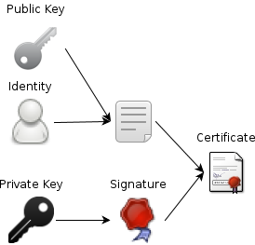
Securing Network Services
Encrypt transmitted data
SSH, SCP, SFTP
HTTPS/SSL
Encrypted WiFi
Establish trusted authorities
Certificate Authorities (CA) verify certificate holders
Create methods of establishing secure connections
Public Key Cryptography
Diffie-Hellman Key Exchange
https://www.youtube.com/watch?v=YEBfamv-_do
8 minutes 37 seconds

Slide 18
Certificate Authority
A Certificate Authority (CA) issues digital certificates
SSL Certificates for use on our websites
Devices (browsers) come with a list of trusted third-party CA’s
Because they are more trustworthy than me…
CA’s certify the ownership of the certificate
CA’s validate the legitimacy of the person or organization
CA’s can also revoke a certificate, if it has been compromised
When we create our own certificates, they are self-signed.
Our browser doesn’t automatically accept it, but we can manually override
We could potentially create our own CA, add it to the trusted list of our servers/clients, and issue our own trusted certificates, to encrypt network traffic

Slide 19

Secure Sockets Layer (SSL)
Digital certificate’s issued by a Certificate Authority (CA)
Identifies an organization
CA most often a third party (e-commerce)
Public Key Infrastructure (PKI)
Defines the system of certificates and authorities
Public key cryptography depends on two keys
Public key
Shared with everyone
Used to encrypt data to sent to a server
Client encrypts session key (clients private key) with message
Private key – kept by owner of the public key
needed to decrypt the data

Slide 20
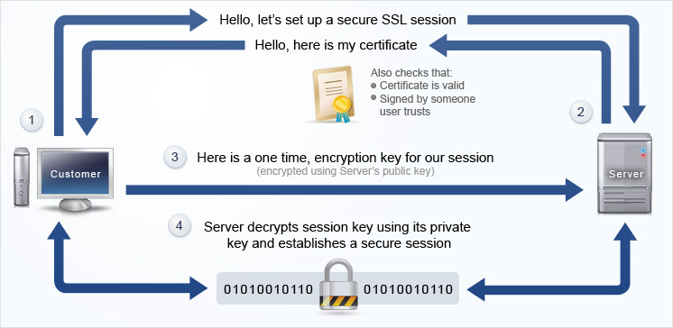
Establish HTTPS Session – Session Key

Slide 21
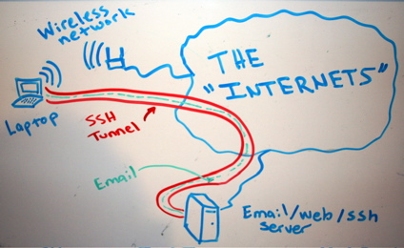
SSH Tunnels
SSH Tunnels are secure and encrypted between endpoints!
Unencrypted (or encrypted) traffic can be routed through encrypted SSH connection
Local Port Forwarding
Good for specific services (RDP, POP3, etc)
SOCKS (Dynamic) Proxy
Good for web traffic
Reverse SSH Tunnel
Initiate connection from inside secure location
Provide access otherwise not possible

Slide 22

System Security – Best Practices
Only give users the necessary account privileges
Performing routine tasks as a root/admin user can create vulnerabilities!
Only install necessary software for server operation on servers
Most servers don’t need Adobe Flash or spreadsheet software
Review all services running on a server
Disable unnecessary services
Secure any necessary services
Disable open email forwarding or DNS resolution
Enforce auditing where appropriate
Keep logs of user actions and connections
Make use of remote logging facilities

Slide 23
System Security – Best Practices
Regularly audit running services and file permissions
Perform vulnerability or penetration testing on your own systems
Find any issues before attackers can
Disable insecure services
Replace with more secure software
May be hard in large organizations with legacy systems
Use secure/encrypted version of services
HTTP → HTTPS
Telnet → SSH
FTP → SCP
Force secure POP3/IMAP type services

Slide 24
System Security – Best Practices
System Configuration
Limit disk space one user or application can use
Impose storage quotas, separate disk partitions
Limit CPU/RAM resources one user or application can use
Limit data that a user or application can access
Disable unnecessary features
Enforce user and group security
Disable world/anonymous/everybody access
Only where appropriate!
Many built-in functions may rely on such access!
Secure web directories
Web folders should only be readable by web services
Potentially only allow users from specific IP address, or deny specific IP addresses
Implement username/password login where appropriate

Slide 25

One-Way Hash
A One-Way Hash is a function that takes a variable length input string, and returns a fixed length output string
Two input strings should not be able to produce the same output hash
Process should be difficult to reverse
A minor change in input should create significant change in output
Sometimes called message digest or fingerprint
Examples:
MD4 & MD5 (Message Digest)
128-bit hash values
SHA (Secure Hash Algorithm)
160-bit hash values; generally accepted algorithm
SHA256/512
256/512-bit hash values

Slide 26
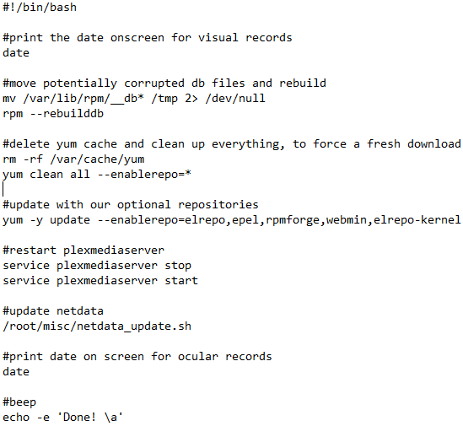
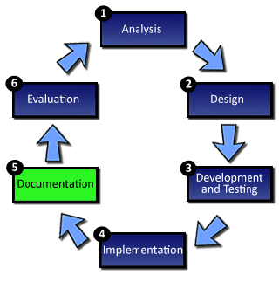
Documentation
Make things easily repeatable
Use commands and comments to make an actual script!
Test things
Automate testing?!
Example →

Slide 27

System Life Cycle
A method of breaking down the development of a new system into a logical set of stages, each of which are involved with specific tasks.
The SLC consists of the following stages:
Definition
Investigation and analysis
Design
Implementation
Testing
Installation
Documentation
Evaluation
Maintenance
Notes:
http://www.teach-ict.com/as_as_computing/ocr/H047/F451/312/slc_cycle/miniweb/index.htm

Slide 28
Web Server Security - SSL
Install Apache SSL module
dnf -y install mod_ssl
Create self-signed certificates and keys
cd /etc/pki/tls/private
openssl req -newkey rsa:2048 -nodes -keyout server.key -x509 -days 365 -out server.crt
Country Name (2 letter code) [XX]:US
State or Province Name (full name) []:Pennsylvania
Locality Name (eg, city) [Default City]:Edinboro
Organization Name (eg, company) [Default Company Ltd]:EUP
Organizational Unit Name (eg, section) []:ECSC325
Common Name (eg, your name or your server's hostname) []: ecsc325-1##.cs.edinboro.edu
Email Address []:jpatalon@pennwest.edu
Assignment 13?
Enter your email address, not mine!

Slide 29
Web Server Security - SSL
2048 bit RSA key pair created
Expires in 365 days
Items are encrypted with one key and decrypted with the other
Asymmetric crypto
Different keys to encrypt and decrypt
Move certificate file to proper location with secure permissions
Change permissions
chown root:root server.*
chmod 600 server.key
chmod 644 server.crt
Move certificate to certs folder
mv server.crt ../certs/
/etc/pki/tls/certs/server.crt should have cert
/etc/pki/tls/private/server.key should have key

Slide 30
Web Server Security - SSL
Use SSL certificates with Apache Web Server
Create SSL Virtual Host
cd /etc/httpd/conf.d/
cp phpMyAdmin.conf phpMyAdminSSL.conf
Edit SSL Virtual Host phpMyAdminSSL.conf
Change <VirtualHost *:80> to <VirtualHost *:443>
Add the following after ServerName/ServerAlias lines
SSLEngine on
SSLCertificateFile /etc/pki/tls/certs/server.crt
SSLCertificateKeyFile /etc/pki/tls/private/server.key
Restart Apache!
systemctl restart httpd.service
Go to secure phpmyadmin page! Accept the self-signed cert and continue!
https://ecsc325-1##.cs.edinboro.edu/phpmyadmin
https://147.64.243.1##/phpmyadmin
The certificate is not trusted because it is self-signed… That’s OK!

Slide 31
Web Server Security - SSL
Force SSL certificates with SquirrelMail
Edit file /etc/httpd/conf.d/squirrelmail.conf
Un-comment 3 Rewrite Rules
RewriteEngine on
RewriteCond %{HTTPS} !=on
RewriteRule (.*) https://%{HTTP_HOST}%{REQUEST_URI}
Restart Apache!
systemctl restart httpd.service
Go to insecure SquirrelMail page, should be redirected to secure!
http://ecsc325-1##.cs.edinboro.edu/webmail
http://147.64.243.1##/webmail
You will have to manually accept the self-signed certificate.

Slide 32
Web Server Security - SSL
Force SSL certificates with Roundcube
Edit file /etc/httpd/conf.d/roundcube.conf
Add 3 Rewrite Rules inside the <VirtualHost *:80> configuration
RewriteEngine on
RewriteCond %{HTTPS} !=on
RewriteRule (.*) https://%{HTTP_HOST}%{REQUEST_URI}
Add an SSL configuration VirtualHost block for Roundcube!
<VirtualHost *:443>
ServerName roundcube.10.megastuff.biz
DocumentRoot "/var/www/roundcube"
SSLEngine on
SSLCertificateFile /etc/pki/tls/certs/server.crt
SSLCertificateKeyFile /etc/pki/tls/private/server.key
</VirtualHost>
Restart Apache!
systemctl restart httpd.service
Go to insecure Roundcube page, should be redirected to secure!
http://roundcube.##.megastuff.biz
You will have to manually accept the self-signed certificate.

Slide 33
Web Server Security - SSL
Create secure private web site
Create private directory
cd /var/www/html
mkdir /var/www/html/private
Create .htaccess file to secure directory
Edit file /var/www/html/private/.htaccess
AuthUserFile /var/www/html/private/.htpasswd
AuthName "Please Log In"
AuthType Basic
Require valid-user
Secure private directory
chown -R apache:apache /var/www/html/private
chmod -R u+rwX,g+rX,g-w,o-rwx /var/www/html/private

Slide 34
Web Server Security - SSL
Edit Apache security – Create a secure directory configuration file
Force SSL and force authentication!
Create file /etc/httpd/conf.d/secure.conf
<Directory "/var/www/html/private">
RewriteEngine on
RewriteCond %{HTTPS} !=on
RewriteRule ^/?(.*) https://%{SERVER_NAME}/$1 [R,L]
AuthType Basic
AuthName "Authentication Required"
AuthUserFile "/var/www/html/private/.htpasswd"
Require valid-user
AllowOverride AuthConfig
Options MultiViews Indexes SymLinksIfOwnerMatch IncludesNoExec
Order allow,deny
Allow from all
</Directory>

Slide 35
Web Server Security - SSL
Apache Directive | Description
AuthName | Specifies descriptive text for user authentication that appears on the user’s browser when the request is made to log on. Example: AuthName Internal Product Information
AuthType | Specifies the authentication type, use Basic. Example: AuthType Basic
AuthUserFile | Specifies the complete path to the user authentication file (.htpasswd) Example: AuthUserFile /var/www/users
AuthGroupFile | Specifies the complete path to the text file that associates users with groups.
require | Defines which users in the user authentication file are allowed access to the directory. Examples: require user Jason bob require group developers administrators require valid-user

Slide 36
Web Server Security - SSL
Create secure private web site
htpasswd -c /var/www/html/private/.htpasswd USERNAME
Enter password when requested for user USERNAME specified above
Creates encrypted/hashed user:password combination in file /var/www/html/private/.htpasswd
Let’s secure the permissions on the .htpasswd
chown root:apache /var/www/html/private/.htpasswd
chmod 640 /var/www/html/private/.htpasswd
Edit file /etc/httpd/conf.d/phpMyAdmin.conf
Add the following on a new line directly after <VirtualHost *:80>:
Redirect permanent /private https://ecsc325-1##.cs.edinboro.edu/private
Restart Apache!
systemctl restart httpd.service

Slide 37
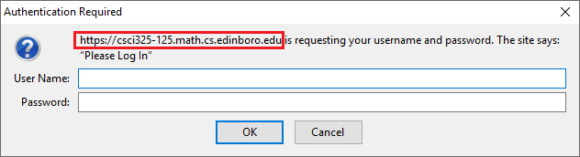
Web Server Security - SSL
Create secret webpage
echo This webpage is a secret! > /var/www/html/private/index.html
chown apache:apache /var/www/html/private/index.html
chmod 640 /var/www/html/private/index.html
Check Website
http://ecsc325-1##.cs.edinboro.edu/private/
Should redirect to https, note below!
Should prompt you for login, similar to below!

Slide 38
Web Server Security - Permissions
Check what user and group apache runs as
grep ^User /etc/httpd/conf/httpd.conf
grep ^Group /etc/httpd/conf/httpd.conf
By default, both are apache
Check permissions on web files
[root@ecsc325-125 ~]# ls -lah /var/www/
total 12K
drwxr-xr-x. 6 root root 57 Mar 19 13:01 .
drwxr-xr-x. 22 root root 4.0K Apr 10 10:29 ..
drwxr-xr-x. 2 root root 6 Nov 19 16:43 cgi-bin
drwxr-xr-x. 3 root root 75 Apr 10 19:31 html
drwxr-xr-x. 6 root root 4.0K Mar 7 11:19 web
drwxrwxr-x. 5 root apache 4.0K Mar 20 17:23 wordpress

Slide 39
Web Server Security - Permissions
Secure html directory
Open your PHP Info website
http://ecsc325-1##.cs.edinboro.edu
Change html directory permissions
chmod -R g+rX,o-rwx /var/www/html
Refresh webpage, access should be denied…
Test welcome page might be shown, since actual page cannot be accessed! (if the test welcome page is still enabled)
Comment out everything in the test welcome page configuration and restart apache to apply config change:
sed -i 's/^/#/' /etc/httpd/conf.d/welcome.conf
systemctl restart httpd.service
Refresh again, should get Forbidden error (if you didn’t before)!
Log files will show an error accessing files!!! Log files are in /var/log/httpd
Grant apache group access to files – recursively change ownership/permissions
chgrp -R apache /var/www/html
Refresh webpage one more time!

Slide 40
Web Server Security - Permissions
Check permissions on web files now…
[root@ecsc325-125 ~]# ls -lah /var/www/
total 12K
drwxr-xr-x. 6 root root 57 Mar 19 13:01 .
drwxr-xr-x. 22 root root 4.0K Apr 10 10:29 ..
drwxr-xr-x. 2 root root 6 Nov 19 16:43 110
drwxr-xr-x. 2 root root 6 Nov 19 16:43 3110
drwxr-xr-x. 2 root root 6 Nov 19 16:43 3110p81
drwxr-xr-x. 2 root root 6 Nov 19 16:43 cgi-bin
drwxr-x---. 3 root apache 75 Apr 10 19:31 html
lrwxrwxrwx. 1 root root 22 Feb 27 16:20 roundcube -> ./roundcubemail-1.3.8/
drwxr-x---. 12 root apache 4.0K Feb 27 16:25 roundcubemail-1.3.8
drwxr-xr-x. 6 root root 4.0K Mar 7 11:19 web
drwxrwxr-x. 5 root apache 4.0K Mar 20 17:23 wordpress

Slide 41
Web Server Security - Directory
Limit allowed sources
Open your Ultra Modern Template website in web browser
http://1##.ultrastuff.net
Add directory stanza inside virtual host stanza in file /etc/httpd/conf.d/web.conf
Restart apache to apply configuration change!
systemctl restart httpd.service
Refresh webpage, should be forbidden!
<VirtualHost *:80>
DocumentRoot "/var/www/web"
# Note server name below is 3 digits
ServerName 1##.megastuff.biz
<Directory /var/www/web>
Order Deny,Allow
Deny from all
</Directory>
</VirtualHost>

Slide 42
Web Server Security - Directory
Limit allowed sources
Modify that directory stanza inside virtual machine stanza in file /etc/httpd/conf.d/web.conf
Restart apache to apply configuration change!
systemctl restart httpd.service
Refresh webpage, should be allowed now!
<VirtualHost *:80>
DocumentRoot "/var/www/web"
# Note server name below is 2 digits
ServerName ##.megastuff.biz
<Directory /var/www/web>
Order Deny,Allow
Deny from all
Allow from localhost 147.64.0.0/16 10.0.0.0/8 192.168.0.0/16 172.16.0.0/12
</Directory>
</VirtualHost>

Slide 43

Assignment 13
Apache SSL, cert, key creation
phpMyAdmin SSL enforcement
Roundcube SSL enforcement
Private directory creation
SSL Enforcement, secure user/password login, secure directory structure
Limited HTTP access
Authorized hosts
Firewall Enabled
Assignment
https://jpatalon.cs.edinboro.edu/ecsc325/Assignment%2013.pdf
Check script
https://jpatalon.cs.edinboro.edu/ecsc325/classfiles/assignment13check.sh
Documentation!

Slide 44

For Next Class
“If you will spend an extra hour each day of study in your chosen field, you will be a national expert in that field in five years or less.” – Earl Nightingale
Textbook:
Chapter 14: Local Security
Next week topics
Security & Authentication Part 2
Continuing work with VM’s
Assignment 12 due April 9th, 2025
Assignment 13 due April 16th, 2025
Assignment 14 due April 23rd, 2025
Final Exam – Tuesday April 29th, 2025
5:00PM to 7:00PM
Just because all tests say OK, doesn’t mean everything is working properly!
Sometimes my check scripts have errors…
I can’t write check scripts for every possibility…

Slide 45
ECSC 325.200 Web Server Administration
Spring 2025 – Week 13-2 – April 10th, 2025
Security and Authentication
Prof. Jason Patalon

Slide 46
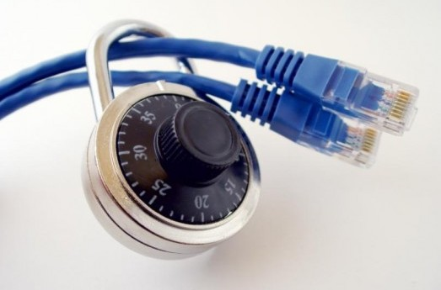
Secure Copy
Rsync – Remote Synchronize
Used to keep files in in sync between hosts
Can use SSH for encrypted communications
Some systems use SSH as default for rsync, some don’t
Force ssh with –e “ssh”
Supports multiple options
-a : Archive mode – Copy recursively, preserve links/permissions/ownership/timestamps
-v : Verbose – Show what files are being copied and where
-z : Compression – Compress data being transferred
-h : Human-readable – Display numbers in human-readable format
Ex:
rsync –avzh /data/Blockland/ 10.11.186.146:/opt/Blockland/

Slide 47
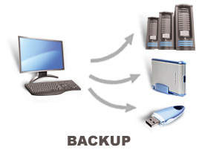
Backups
The process of copying and archiving data so it can be used to restore data in the event of a data loss.
Backups should be kept in a geographically different location from primary data storage.
Testing that your backups work is critical!
Backups can use any type of media.
Writable discs (CD/DVD) generally have a shorter lifespan
Magnetic tapes have a longer life but are restricted by serial access
Multiple backups for redundancy!
Backups can be of an entire system, or only specific data.
We used rsync and mysqldump to backup our data!

Slide 48
Backups
Full Backups
Takes a complete backup of all data at a given point
System images may be useful for backup, can be more difficult to restore from
Incremental
Only makes backups of items that changed since last incremental backup
Full system restore requires restoring a full backup, followed by each incremental
Synthetic full backups can be created through software
Weekly full, daily incrementals
Differential
Only makes backups of items that have changed since last full backup
Restore requires a full and most recent differential backup
Weekly full, daily differentials
Most common type of backups

Slide 49

Core System Services - SysVinit
inittab: Set system run level – How does the system boot
Runlevel 1: Single user mode – great for troubleshooting
Runlevel 3: Multi-user mode – Standard operation, console boots to command line
Typical Server Runlevel Setting
Runlevel 5: Multi-user GUI mode – Same as runlevel 3, server console boots to GUI
GUI uses more resources, typically we don’t want the GUI running!
Services typically boot in a serial fashion!
Server attempts to start a service, waits for confirmation or failure, before moving to next service
Different services can be configured to boot at different runlevels
Individual scripts used to start each service
Inittab and sysVinit are considered obsolete!
Have been replaced with systemd!

Slide 50
Core System Services - SystemD
Systemd – Suite of software that provides system and service management
Runlevels replaced with targets
Runlevel 1 - rescue.target
Runlevel 3 - multi-user.target
Runlevel 5 – graphical.target
Custom, poweroff, and reboot targets also available
Services can be started in parallel
Services dependencies can be created
Services can be started if all required dependent services are started
System can start faster, parallelize
Can also control additional units
Socket units – local and network connections
Device units – devices on a system
Mount units – file system mounts
Timer units – can be used for triggering activation of other units
Snapshot units – used to save the state of a set of units
Standard configuration file type – less complicated than individual scripts

Slide 51
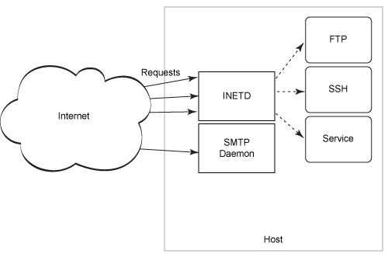
Core System Services - xinetd
inet and xinetd are a suite of packages that provide services to other services
xinetd is the modern replacement of legacy package inetd
Function as “super-server” to other network related services
If a service is not used frequently, and a separate service is not warranted, xinetd may instead run and call the additional systems when needed
Low-volume services are best used through xinetd, high-volume services run better with dedicated processes.
Typical xinetd services include tftp, chargen, echo, or time

Slide 52
Core System Services – Logging & Cron
Rsyslog service – Provides a standardized way to perform logging
Can specify what priority of logs are written where
Emergency messages may be logged to the console screen!
Can classify log messages as different types (facility)
Messages may come from mail subsystem, or authentication subsystem, etc.
Logging details specified within rsyslog configuration files
Templates available for custom log creation
Cron – Schedule a program to run at a specific time
Cron service runs, reading cron configuration files, running commands at the appropriate times
Commands can be set to run on a schedule, or only run once
Crontab files edited with the crontab -e command
Uses vi editor by default!
Change default editor with the following command: export env EDITOR=nano

Slide 53
Netfilter Firewall
The Linux Netfilter Firewall operates multiple tables and chains
Each table uses a different combination of chains
Packets coming in first hit the prerouting chain, which is within NAT and Mangle tables.
This is where Destination NAT would be implemented
Packets may be forwarded according to rules in the forward chain, if forwarding is enabled
Similar to routing, when a server is forwarding packets between networks
Packets are further inspected in the input chain, if destined for the server
The input chain specifies what packets are allowed in to the server
The output chain is invoked, when packets are sent from applications running on the host itself
Outbound SSH connections could be blocked from the output chain
Many more options available
Connection tracking for established or related traffic (FTP or IRC)
Quality of Service packet manipulation for traffic shaping

Slide 54
Firewalld
Firewalld is a dynamic firewall manager, managing netfilter rules
Firewalld is configured with the firewall-cmd command
Add or remove rules, list services, configure zones
Firewalld uses different zones, to specify trust levels for certain connections
Local connections may be trusted more than internet connections
Home, work, public, etc. types of networks

Slide 55
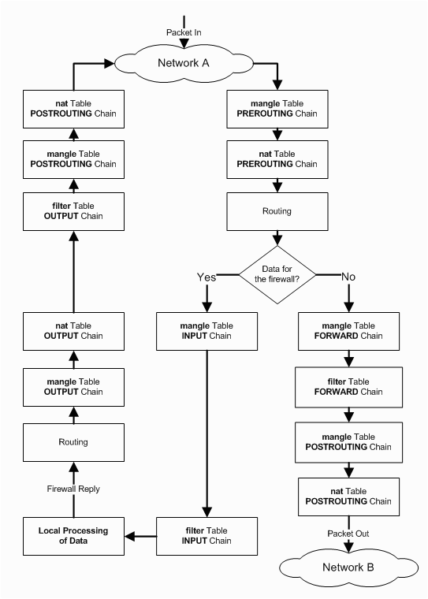
IPTables Flowchart
Traffic flow through the Linux firewall

Slide 56

Stuxnet
High-level overview of the Stuxnet virus
https://www.ted.com/talks/ralph_langner_cracking_stuxnet_a_21st_century_cyberweapon
10 minutes 40 seconds runtime
We already talked about a similar video?!
When first discovered in 2010, the Stuxnet computer worm posed a baffling puzzle. Beyond its sophistication loomed a more troubling mystery: its purpose. Ralph Langner and team helped crack the code that revealed this digital warhead's final target. In a fascinating look inside cyber-forensics, he explains how — and makes a bold (and, it turns out, correct) guess at its shocking origins.
Anonymous American officials speaking to The Washington Post claimed the worm was developed during the Bush administration to sabotage Iran's nuclear program with what would seem like a long series of unfortunate accidents.
Nation-state warfare?!

Slide 57
Multi Factor Authentication (MFA)
Presenting multiple pieces of information to confirm who you are
Something only you know (password or pin)
Something only you have (your card or your phone/token)
Something only you are (biometrics)
Somewhere you have to be (location)
A subset is known as Two Factor Authentication (2FA)
Only 2 of the three items are needed
Can prevent exposed password attacks
Can’t protect against some attacks, can create a false sense of security (skimming, MITM, phishing)
Considerations of systems
Cost, complexity, overhead/maintenance

Slide 58
One-Way Hash
A One-Way Hash is a function that takes a variable length input string, and returns a fixed length output string
Two input strings should not be able to produce the same output hash
Process should be difficult to reverse
A minor change in input should create significant change in output
Sometimes called message digest or fingerprint
Examples:
MD4 & MD5 (Message Digest)
128-bit hash values
SHA (Secure Hash Algorithm)
160-bit hash values; generally accepted algorithm
SHA256/512
256/512-bit hash values

Slide 59
One-Way Hash
Sha 1
echo Jason | sha1sum
fd63cd05af60b1cc6335c58edf763b3dda6ac9da -
Sha 256
echo Jason | sha256sum
3c8315b413f539959cbccb7572a9ed403a29e71175dc3e29c59fbaf2b6c1c9b0 -
Sha 512
echo Jason | sha512sum
41edac92c7ef6d8d1c63c1e550bf09ecfb1577a26ecc4bfbe8cb1293650ec556f5f10d978c99a954b141044c4ffe5871b0bffaeffc5b4e12c91c79392425b6f7 -
echo jason | sha512sum
79ca5c1bd9b053f3712cde8c1001de2dadd18500cf8161da5099c5351380332f8ec43916bf529251b26e17492871dc32d8e35e49b5bbf715d22a3ff579fbff65 -
Notes:
Notice that the change in one character makes the string drastically different

Slide 60

Rainbow Tables
A precomputed table for reversing cryptographic hash functions, usually for cracking password hashes.
Simple rainbow table may be called a lookup table
Large amount of space may be necessary
Effective use of a password salt can make this method impractical
a | 87428fc522803d31065e7bce3cf03fe475096631e5e07bbd7a0fde60c4cf25c7
rainbow | b0578f4319d0d3b8e6dab5b958c43e321680771caf9cf29e5e5755fe442327f0
table | 7ed9ac3831f7d8525696b390cde2ece4c1df132a433268072a47b4d42a6e8931
is | 55165eeb5ff20b59c77fbc5b28095f2ac50ed622326dba9f2e8ca2b7e355b026
a | 87428fc522803d31065e7bce3cf03fe475096631e5e07bbd7a0fde60c4cf25c7
precomputed | 5830e8d919056cff3260a1b29466fd28d867f0055d31a1cc6c59cdadcdb6cb16
table | 7ed9ac3831f7d8525696b390cde2ece4c1df132a433268072a47b4d42a6e8931
for | fb599077f68975786911064cdb9179bf4a51cb9df4f852b7181763835b1306f3
reversing | e079fe4734eee81c7ff2e7b42df50a50addd10b27daa99c6c1ebcd4ee58b75f9
cryptographic | 3c6e8d0d4d353f545e47457c0f5efed3d80aa80f977af4bf899ecf77e9bc30d3
hash | 4e5e494fa316ffc82b8252b23524f1433639858267d641c1217059dc4403e045
functions | aa7b7f1d11b545fbbab39bcc6b089769703a649b27a72a038c8fceaf3d98347a
usually | 6a7bfef230b7e43f469c3eeb77c78828e22350d5cdbd5c866dc3f85406a80eeb
for | fb599077f68975786911064cdb9179bf4a51cb9df4f852b7181763835b1306f3
cracking | b565cf1343768ab362958b3115cfe305a4bb891df8c879c60611e13313edd801
password | 6b3a55e0261b0304143f805a24924d0c1c44524821305f31d9277843b8a10f4e
hashes | 2606bc2e70a5398d273d5726950202a0df629d1badd659945f20eff1c820bf5c

Slide 61

Password Salt
Random data used as an additional input to a password hashing function
Salts are typically kept in separate locations/databases than hashed password values
Provides additional security
sha256sum(password) = 6b3a55e0261b0304143f805a24924d0c1c44524821305f31d9277843b8a10f4e
sha256sum(password+salt) = c9a9e4fe603b1eca1653272eb95d7ddc1d2f29f720b59980b85695fe2c1d46c9

Slide 62

Dictionary Attack
Attackers try all the strings in a predefined list, such as a dictionary.
Pre-computed hash tables are called rainbow tables!
These precomputed tables can be mitigated against by using password salts.
People have a tendency to choose short passwords, ordinary words, or common passwords
This is what allows dictionary attacks to work
Dictionary attacks can be defeated by choosing a password that is not a simple dictionary word
A simple variant of a dictionary word should not be used either!

Slide 63

Brute Force Attack
Also called exhaustive key search
Brute force attacks systematically check all possible password combinations
Shorter passwords take less time, longer passwords take more time
Larger possibility of characters increases time necessary to brute force a password
Uppercase/lowercase letters
Numbers
Symbols
Salting passwords makes brute force more difficult
Given enough time a brute force attempt will always succeed
One of the simplest types of password attacks

Slide 64
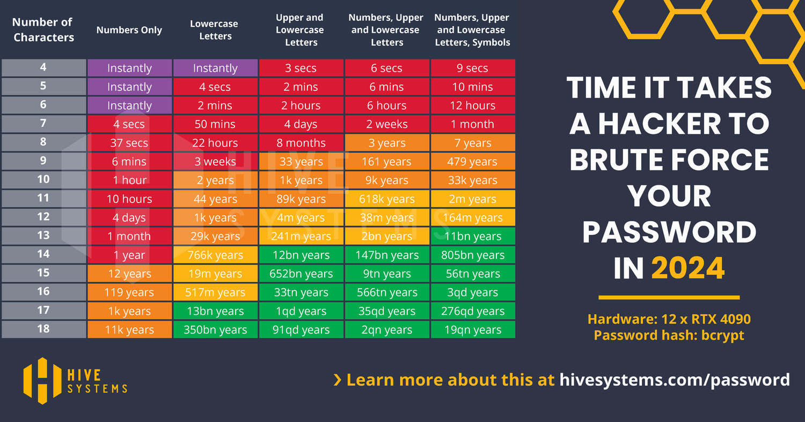
Brute Force Attack

Slide 65
Assignment 14 Info
a14.##.conf
<VirtualHost *:80>
ServerName a14.##.megastuff.biz
DocumentRoot "/var/www/a14"
RewriteEngine on
RewriteCond %{HTTPS} !=on
RewriteRule ^/?(.*) https://%{SERVER_NAME}/$1 [R,L]
</VirtualHost>
<VirtualHost *:443>
ServerName a14.##.megastuff.biz
DocumentRoot "/var/www/a14"
SSLEngine on
SSLCertificateFile /etc/pki/tls/certs/a14.##.megastuff.biz.crt
SSLCertificateKeyFile /etc/pki/tls/private/a14.##.megastuff.biz.key
</VirtualHost>

Slide 66
Assignment 14 Info
Create new SSL Cert
cd /etc/pki/tls/private/
openssl req -newkey rsa:2048 -nodes -keyout a14.##.megastuff.biz.key -x509 -days 365 -out a14.##.megastuff.biz.crt
chmod 600 a14.*.megastuff.biz.key
mv a14.*.megastuff.biz.crt ../certs
Country Name (2 letter code) [XX]:US State or Province Name (full name) []:Pennsylvania Locality Name (eg, city) [Default City]:Edinboro Organization Name (eg, company) [Default Company Ltd]:EUP Organizational Unit Name (eg, section) []:ECSC325 Common Name (eg, your name or your server's hostname) []: a14.##.megastuff.biz Email Address []:YOUR_ACCOUNT@##.megastuff.biz

Slide 67
Assignment 14 Info
Crontab
# ┌───────────── minute (0 - 59)
# │ ┌───────────── hour (0 - 23)
# │ │ ┌───────────── day of the month (1 - 31)
# │ │ │ ┌───────────── month (1 - 12)
# │ │ │ │ ┌───────────── day of the week (0 - 6) (Sunday to Saturday;
# │ │ │ │ │ 7 is also Sunday on some systems)
# * * * * * <command to execute>
0 2 * * * rsync -avz --delete /var/log /backups/var/ # Executes at 2:00AM
30 1 * * * /root/backups.sh # Executes at 1:30AM
Backups.sh
#!/bin/bash
# Sync /var/log directory to /backups/var/log
rsync -avh --delete /var/log /backups/var/
One or the other…

Slide 68
Assignment 14 Info
Firewall Config
firewall-cmd --zone=public --add-service=ftp --permanent
firewall-cmd --zone=public --add-service=ssh --permanent
firewall-cmd --zone=public --add-service=imap --permanent
firewall-cmd --zone=public --add-service=pop3 --permanent
firewall-cmd --zone=public --add-service=smtp --permanent
firewall-cmd --zone=public --add-service=http --permanent
firewall-cmd --zone=public --add-service=https --permanent
firewall-cmd --reload
NMap
nmap -p 1-65535 147.64.243.110 #run a full scan on all ports
nmap 147.64.243.160 #run a default scan
nmap -O 147.64.243.160 #run an OS fingerprinting scan – capital O

Slide 69
Assignment 14 Info
enp10s0
nmcli con add type ethernet con-name enp10s0 ifname enp10s0 ip4 172.16.99.1##/23
nmcli con mod enp10s0 ipv4.method manual
nmcli con reload enp10s0
nmcli con down enp10s0
nmcli con up enp10s0
enp10s0.200 VLAN
nmcli con add type vlan con-name enp10s0.200 ifname enp10s0.200 dev enp10s0 id 200 ip4 172.20.200.1##/23
nmcli con reload enp10s0.200
nmcli con down enp10s0.200
nmcli con up enp10s0.200

Slide 70
Assignment 14 Info
Firewall Rich Rule Accept
firewall-cmd --zone=public --add-rich-rule 'rule family="ipv4" source address="172.20.0.0/16" port port=12345 protocol=udp accept'
firewall-cmd --zone=public --add-rich-rule 'rule family="ipv4" source address="172.20.0.0/16" port port=12345 protocol=udp accept' --permanent
Firewall default target
#firewall-cmd --zone=external --set-target=DROP
firewall-cmd --zone=external --set-target=DROP --permanent
firewall-cmd --reload
Firewall Rich Rule Reject
firewall-cmd --zone=public --add-rich-rule 'rule family="ipv4" source address="147.64.242.0/23" port port=32123 protocol=tcp reject'
firewall-cmd --zone=public --add-rich-rule 'rule family="ipv4" source address="147.64.242.0/23" port port=32123 protocol=tcp reject' --permanent

Slide 71
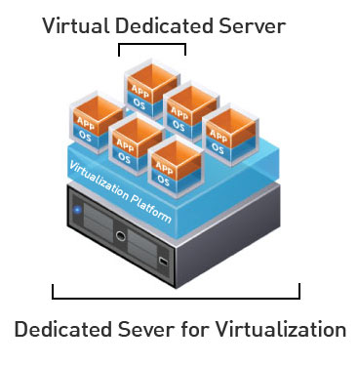
Virtual Machine Info
IP Address: 147.64.243.1##/23 (01-25)
Hostname: ecsc325-1##.cs.edinboro.edu (01-25)
Aliases:
31##.megastuff.biz, 1##.megastuff.biz, ##.megastuff.biz (01-25)
1##.ultrastuff.net, more?
Assignment 12 due April 9th
Check script and upload in D2L!
Assignment 13 due April 16th
Check script and upload in D2L!
Accessing VM’s from off campus requires a connection to the CS VPN first, before opening a connection to your machine!
CS firewall prevents direct connections from other networks to our VM’s!
Once VPN is active: ssh user@ecsc325-1##.cs.edinboro.edu

Slide 72
Virtual Hosts
http://ecsc325-1##.cs.edinboro.edu, http://147.64.243.1##
PHP Info
http://ecsc325-1##.cs.edinboro.edu/phpmyadmin, http://147.64.243.1##/phpmyadmin
phyMyAdmin Website
http://1##.megastuff.biz/temp/temp.php
Temperature Graph Website
http://31##.megastuff.biz
index.html: Hello Megastuff Website
http://##.megastuff.biz, http://1##.megastuff.biz
TBD: Testing 123…
http://ecsc325-1##.cs.edinboro.edu/awstats/ awstats.pl?config=localhost.localdomain
AWStats
http://ecsc325-1##.cs.Edinboro.edu/squirrelmail
Squirrelmail website
http://roundcube.##.megastuff.biz
Roundcube webmail
http://1##.ultrastuff.net
Ultra Modern Template Website
http://31##.ultrastuff.net
WordPress Website
https://ecsc325-1##.cs.edinboro.edu/private
Private web site!
https://a14.##.megastuff.biz
Assignment 14 web site!
Replace the ## with your 2 digit number!!!

Slide 73

Linux Commands
yum
cd
vi
nano
make
systemctl
htpasswd
grep
rm
chmod
mount
umount
lsof
grep
fsck
xfs_repair
fdisk
pvcreate
vgcreate
lvcreate
iptables
firewall-cmd
sha1sum
sha256sum
sha512sum
echo
chown
mkfs

Slide 74

Key Terms and Items
inittab
runlevels & targets
cron
rsyslog
firewall
stuxnet
one-way hash
rainbow table
password
salt
dictionary attack
brute force attack
packet filtering
stateful packet inspection
FTP active/passive transfers
Intrustion detection software
SELinux
Proxy Server

Slide 75
Key Terms and Items
Hacker
Cracker
Attacker
Denial of Service (DoS)
Distributed DoS (DDoS)
TCP 3-way handshake
SYN flood
Reflection attacks
i-nodes
Blocks & Superblocks
File Systems
Partitions
Ping Flood
DNS Cache Poisoning
Input Sanitizing
Diffie-Hellman Key Exchange
SSL
HTTPS Session
System Life Cycle
One-Way Hash
Physical volumes
Volume Groups
Logical Volumes
/etc/fstab

Slide 76
For Next Week
They who can give up essential liberty to obtain a little temporary safety deserve neither liberty nor safety. -Benjamin Franklin
Textbook:
Chapter 14: Local Security
Chapter 15: Network Security
Next week topics
Monitoring & Performance Tuning
Backups
Work Time
Scripting?
Continuing work with VM’s
Assignment 12 due this week, assignment 13 due next week!
Just because all tests say OK, doesn’t mean everything is working properly!
Sometimes my check scripts have errors…
I can’t write check scripts for every possibility…

