Slide 1
ECSC 325.200
Web Server Administration
Spring 2025 – Week 2-1 – January 21st, 2025
Introduction and overview 2

Slide 2

Objectives
Attendance
Reviews
Servers
Server Specifications
Server Administrators
Internet and the World Wide Web
Database Management Systems
User Administration & Access Control
IP Addressing
Internet Protocol Suite
Networking
Data & Storage
Application Protocols
DNS Lookup
Operating Systems

Slide 3

Weekly Info
“He who conquers himself is the mightiest warrior” – Confucius
James Web Space Telescope recently discovered another exoplanet
  An Earth-sized rocky planet called LHS 475 b.
  Located just 41 light-years away
  The planet orbits very close to a small, dim star,
  It completes a full orbit in just two days.
Attendance
Good of the Class
Preferred method of communication is E-Mail.
Email is a best effort (typically daily)

Slide 4

Recap and Review
Review of topics from last class
Corrections, updates, etc.
Review of previous assignments
Questions from previous classes
Assignments 1 due tomorrow!
Stuff & Things
Etc…

Slide 5
Objectives
Types of servers
  File, Application, DB, Web, Virtual
Server Components
  CPU, RAM, ROM
Storage Types
  Devices, Types, Considerations
Network Interface Controllers
  Speeds and types, topology, CSMA/CD
Disaster Planning
  Fault tolerance, fault domains, single point of failures
System Redundancy
  Multiple devices, spare hardware, RAID
High Availability
  Fault Tolerance
Backups
  Types, considerations, restores
Linux Kernel
Virtual File Systems

Slide 6
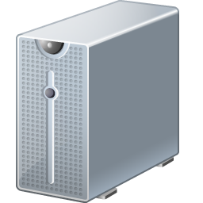
Types of Servers
File Server
  A computer attached to a network that has the primary purpose of providing a location for shared disk access, i.e. shared storage of computer files (such as documents, sound files, photographs, movies, images, databases, etc.) that can be accessed by the workstations that are attached to the same computer network.
  Shares files and folders, storage space to hold files and folders, over a network.
  Often replaced by a large standalone device (NAS).
  Storage size, storage speed, redundancy
  Fast storage subsystem is more important than RAM or CPU speed
  Useful in web environments with a large number of static web pages
  May also appropriate for FTP servers
Notes:
https://en.wikipedia.org/wiki/File_server
RAID Arrays

Slide 7
Types of Servers
Application Server
  A component-based product that resides in the middle-tier of a server centric architecture. It provides middleware services for security and state maintenance, along with data access and persistence.
  Hosts applications which allows users in the network to run and use them, without having to install a copy on their own machines.
  Many run Java applications on the Java 2 Enterprise Edition (J2EE) platform
  Provide containers for components along with application program interfaces (APIs) to support the components.
  Main server resources include processing power and memory.
Notes:
http://www.service-architecture.com/articles/application-servers/application_server_definition.html

Slide 8
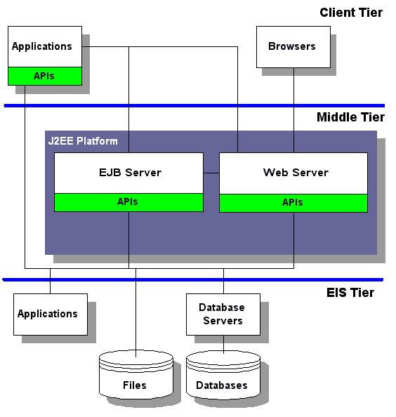
Types of Servers
Application Server
Notes:
http://www.service-architecture.com/articles/application-servers/application_server_definition.html
EIS: Enterprise Information System

Slide 9
Types of Servers
Database Server
  Provides database services to other computer programs or computers, as defined by the client–server model. The term may also refer to a computer dedicated to running such a program.
    Database – An organized collection of data; a set of related data and the way it is organized.
  Data typically organized to model aspects of reality in a way that supports processes requiring information
  Maintains and shares any form of database, often over a network.
  Processing power, memory, storage size, storage speed
  May be considered an application server
  MySQL, Microsoft SQL Server, Oracle, Sybase, IBM DB2
    MariaDB!
  SQL pronounced “sea-quill”

Slide 10
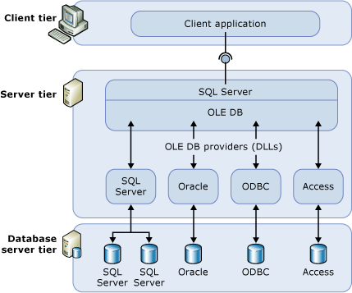
Types of Servers
Database Server

Slide 11
Types of Servers
Web Server
  Hosts web pages and serves web pages to clients.
  Provides server-side processing platform.
  Processing power, memory, network bandwidth
Game Server
  Hosts application resources necessary for multiplayer gaming.
  Processing power, memory, network bandwidth
Mail Server
  Provides various mail functions (sending, receiving, managing)
  Large installations may have multiple mail servers and types.
  Processing power, memory, network bandwidth, storage
  Typically highly visible and very important

Slide 12
Types of Servers
Fax Server
  Provide fax services to network clients
  Connection to fax devices
Proxy Server
  Network forwarding and control
  Network bandwidth
Mixed
  Combination of server functions
Virtual
  Runs within specialized software layer
Physical
  Actual physical hardware server

Slide 13
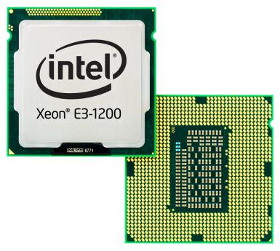
Server Components
Central Processing Unit
  “Brains” of the computer where most calculations take place.
  Usually the main focus of server construction
  Speed – Upwards of 4 GHz (4 billion cycles per second)
    CPU cycle: A single clock tick on the CPU, essentially the smallest unit of time the processor can measure
    Instruction cycle: The whole process of fetching, decoding, and executing a single instruction, which can take multiple CPU cycles to complete
  Cores – 12 or more, Hyper Threading
  Cache – Memory directly on board the CPU unit
    L1 Cache – Primary cache, extremely fast, small, embedded directly within CPU core
      L1i (instruction) and L1d (data) caches
    L2 Cache – Larger and slower than L1 cache, may be shared among cores
    L3 Cache – Largest and slower than L2 cache, usually shared among all cores
Notes:
Hertz: Cycles per second
Hertz: Rental car company
Intel 4004: The first microprocessor

Slide 14
Server Components
Central Processing Unit
  Arithmetic Logic Unit (ALU) – Performs arithmetic and logical operations
  Control Unit (CU) – Extracts instructions from memory, decodes and
  executes them, calling the ALU when necessary.
  Math Coprocessor
  Intel, AMD main CPU producers
  x86, ARM, SPARC main architecture types
    Fetch, decode, execute, memory access and write
  Everyone makes their own CPU’s these days
    Apple, Tesla, Intel, Qualcomm, ARM, TI, Nvidia, Samsung, IBM…
Notes:
Hertz: Cycles per second
Hertz: Rental car company
Intel 4004: The first microprocessor

Slide 15
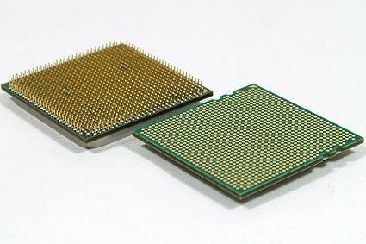
Server Components
Central Processing Unit
  Hyper Threading
    Makes one physical CPU appear as two logical CPUs. It uses additional registers to overlap two instruction streams in order to achieve an approximate 30% gain in performance. Multithreaded applications take advantage of the Hyper-Threaded hardware as they would on any dual-processor system; however, the performance gain cannot equal that of true dual-processor CPUs or a CPU with multiple cores.
  Various different socket sizes.
    Socket 7, Slot 1, LGA 1366, etc
    Pin Grid Array – Pins arranged in an array on the underside of the CPU package
    Land Grid Array – Pins located on socket instead of CPU
    Ball Grid Array – Uses a grid of solder balls instead of pins
Notes:
Physical cores and hyper-thread cores are not equal!
http://www.pcmag.com/encyclopedia/term/44567/hyperthreading

Slide 16
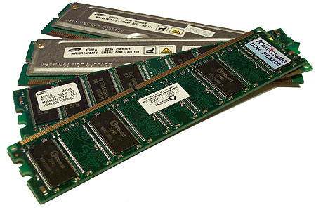
Server Components
Random Access Memory (RAM)
  Computer memory that can be accessed randomly.
    Any byte of memory can be accessed without touching the preceding bytes.
  The most common type of memory found in computers and other devices.
  Most commonly packaged in a dual in-line memory module (DIMM)
  Types
    Dynamic Random Access Memory (DRAM)
      Must be constantly reenergized or it will lose its contents
    Static Random Access Memory (SRAM)
      Doesn’t need refreshed; faster, more expensive
    Synchronous DRAM (SDRAM)
      Faster than DRAM; synchronized with CPU bus

Slide 17
Server Components
Random Access Memory (RAM)
  Volatile – Requires power to maintain the stored information; loses data when power is removed
    RAM, DRAM, SDRAM, SRAM
  Non-Volatile – Retains information even after power is lost
    NVRAM, ROM, EPROM, EEPROM
    Flash Memory, Solid State Storage

Slide 18
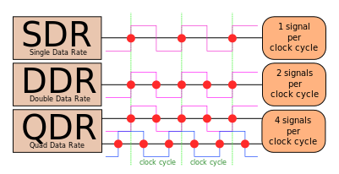
Server Components
Synchronous Dynamic Random Access Memory (SDRAM)
  Most common type of PC/Server RAM
  Eliminated wait states by dividing chip into two blocks and interleaving data between blocks
    Data in one block is accessed while other block is prepared for access
  Double Data Rate (DDR) doubled transfer rate by using both the rising and falling edges of the clock cycle
    DDR2, DDR3, DDR4 further increased transfer speed,
    operational frequencies, and reduced power usage
  Quad Data Rate (QDR) uses a second clock that
  is 90° out of phase
  Multiple memory channels may be supported
    Dual channel benefits from pairs of DIMM
Notes:
By Anderson Batista Evangelista Lima - Own work, CC BY-SA 3.0

Slide 19
Server Components
Synchronous Dynamic Random Access Memory (SDRAM)
  Speeds
Names | Memory Clock | I/O Bus Clock | Transfer Rate | Theoretical Bandwidth
DDR-200, PC-1600 | 100 MHz | 100 MHz | 0.2 GT/s | 1.6 GB/s
DDR2-800, PC2-6400 | 200 MHz | 400 MHz | 0.8 GT/s | 6.4 GB/s
DDR3-1600, PC3-12800 | 200 MHz | 800 MHz | 1.6 GT/s | 12.8 GB/s
DDR4-3200, PC4-25600 | 400 MHz | 1600 MHz | 3.2 GT/s | 25.6 GB/s

Slide 20
Server Components
Synchronous Dynamic Random Access Memory (SDRAM)
  DDR4 Timings
Standard name | I/O bus clock (MHz) | Data rate (MT/s) | Module name | Peak transfer rate (MB/s) | Timings (CL-tRCD-tRP) | CAS latency (ns)
DDR4-1600J* DDR4-1600K DDR4-1600L | 800 | 1600 | PC4-1600 | 12800 | 10-10-10 11-11-11 12-12-12 | 12 ¹⁄₂ 13 ³⁄₄ 15
DDR4-1866L* DDR4-1866M DDR4-1866N | 933⅓ | 1866⅔ | PC4-1866 | 14933⅓ | 12-12-12 13-13-13 14-14-14 | 12 ⁶⁄₇ 13 ¹³⁄₁₄ 15
DDR4-2133N* DDR4-2133P DDR4-2133R | 1066⅔ | 2133⅓ | PC4-2133 | 17066⅔ | 14-14-14 15-15-15 16-16-16 | 13 ¹⁄₈ 14 ¹⁄₁₆ 15
DDR4-2400P* DDR4-2400R DDR4-2400U | 1200 | 2400 | PC4-2400 | 19200 | 15-15-15 16-16-16 18-18-18 | 12 ¹⁄₂ 13 ¹⁄₃ 15
Notes:
* optional

Slide 21
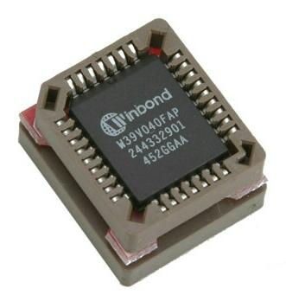
Server Components
Read Only Memory (ROM)
  A type of non-volatile memory used in computers and other electronic devices.
  Can usually only be modified slowly, with difficulty, or not at all
  Typically used to store firmware
    Firmware – Software closely tied to specific hardware
  Meant to store data which is critical for normal operation and should not be changed under normal circumstances
  Read only in normal operation, can be changed using special equipment
  Programmable ROM (PROM)
  Erasable Programmable ROM (EPROM)
  Electrically Erasable Programmable ROM (EEPROM)

Slide 22
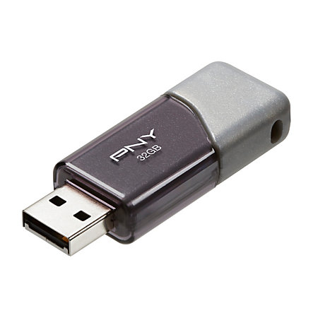
Storage Types
Devices
  Hard Disk Drives – Typically the largest storage devices in a computer.
    Spindle based – Traditional hard disk using spinning magnetic platters
    Solid state – NAND-based non-volatile flash memory, no spinning parts
  Flash Drives – Portable, small, nonvolatile storages, such as thumb drives and Secure Digital (SD) cards.
    SATA DOM – Flash memory inserted directly into SATA port
  Optical Discs – CDs, DVDs, and Blu-Ray use lasers to read and write information. Fairly inexpensive and widely portable.
    Progressively smaller lasers
  Tape Drives – Drives that record data on magnetic tape, usually used to archive system data (backups).
    Sequential access
  Floppy Drives
    Legacy disk drives offering low storage space and portability
Notes:
SATA DOM: Serial Advanced Technology Attachment Disk On Module

Slide 23
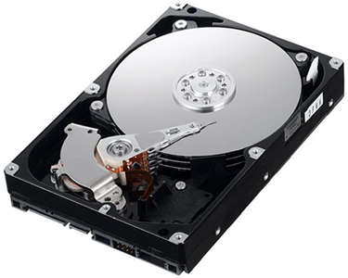
Storage Types
Block Storage Devices
  Data stored in blocks; block size set per disk
    Typical block sizes 512B, 4KB, 8KB, can be others.
    A block can only contain data for one file!
Hard Disk Drives (HDD)
  Parallel ATA Interface (PATA)
    Data sent across wires in parallel (simultaneous)
    IDE/EIDE – (Enhanced) Integrated Drive Electronics
    40 conductor ribbon cable (80 conductor in later modes)
    Master/Slave configuration, cable select
    Transfer rates upwards of 167MBps (1.3 Gbps)
    Powered by 4-pin MOLEX connectors
      AMP MATE-N-LOK 1-480424-0 Power Connector
    Replaced by Serial ATA

Slide 24
Storage Types
Hard Disk Drives (HDD)
  Serial ATA Interface (SATA)
    Data sent across wires in serial manner (one operation at a time)
    Multiple revisions, increasing speed and functionality
    Hot-pluggable, provided devices meet necessary specifications
    7 conductor cable (3 grounds and two pars of active data lines)
    Updated 15 pin power connection
      Additional voltage supplies (3.3, 5, 12v)
      Reduced impedance and increased current capability
      Hot-swappable
    Speeds of up to 1969MBps (16Gbps)

Slide 25
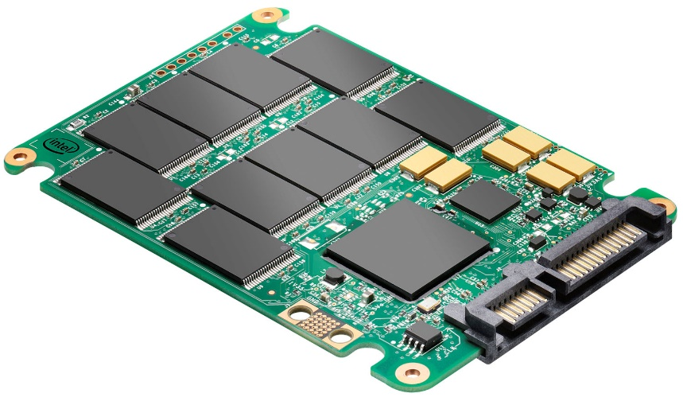
Storage Types
Hard Disk Drives (HDD)
  Solid State Drives (SSD)
    No moving parts to fail mechanically
    Uses integrated circuit (IC) assemblies as memory to store data persistently.
    Most use NAND-based flash memory, a type of non-volatile memory.
    More resistant to physical shock, silent operation
    Lower access times, less latency, faster data transfer rates
    Limited number of erases per block!
      6 year average mean-time between/before failure (MTBF) (2007)
    Increased price
  Hybrid Drives
    Combine storage capacity of traditional spindle-based disks, while also providing flash storage for caching to improve performance
Notes:
A study performed by Carnegie Mellon University on manufacturers' published MTBF: http://www.dailytech.com/Study+Hard+Drive+MTBF+Ratings+Highly+Exaggerated/article6404.htm

Slide 26
Storage Types
Hard Disk Drives (HDD)
  Small computer systems interface (SCSI)
    Defines standards for physically connecting and transferring data
    Faster and more robust when compared to PATA
    Sometimes referred to as Parallel SCSI
  Serial Attached SCSI (SAS)
    Uses standard SCSI command set
    SCSI disks connected using serial interface
    Point-to-point operation
    Dual ports, allowing for redundancy or multipathing
    12 - 22.5 Gbps (1.5 - 2.8 GBps)

Slide 27
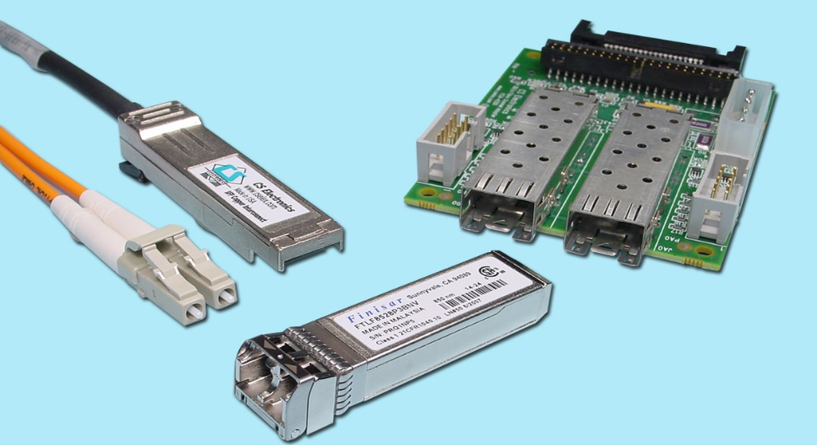
Storage Types
Fibre Channel
  High speed network technology primarily used to connect data storage
  Common in storage area networks (SANs)
  Uses Fiber Channel Protocol (FCP – similar to TCP in IP networks)
  Fibre Channel signaling can run on an electrical (copper Ethernet) interface in addition to fiber-optic cables
    Fiber Channel over Ethernet (FCoE)
  Often uses Small Form-Factor Pluggable (SFP) transceivers
    Connects devices to cabling
    Works with SONET, gigabit Ethernet, Fibre Channel, and others
  1, 2, 4, 8, 16, 32, 128Gbps Typical Speeds
  Block Storage Devices
    Data is written, read, and transferred in blocks
    Block sizes can vary, typically 512B-8KB (4KB most common)
Notes:
Files are stored on disk in blocks
One or more blocks are used to store files
Only one file can occupy a block

Slide 28
Storage Types
Fibre Channel
  Supports various topologies
    Point to point – Direct connection between storage and device – DASD (Direct Attached Storage Device)
    Arbitrated loop – All devices connected in a loop, similar to token ring networking
    Switched fabric – Fibre channel switches between storage and devices, similar to modern Ethernet networking implementations
Notes:
Don’t look at the end of a lit fiber cable!

Slide 29
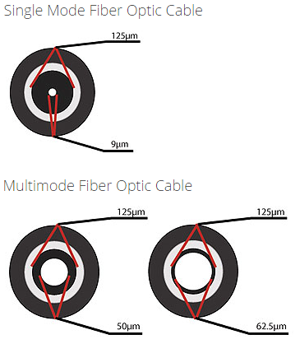
Storage Types
Fibre Channel
  Single-mode fiber
    Small core, supports only one mode of light at a time
    Fewer reflections within cable, lowering attenuation and allowing for longer distances at higher speeds
    Upwards of 40-100+ kilometer distance range
      Different speeds and max distances depending on specs!
  Multi-mode fiber
    Large core, allows multiple modes of light to propagate
    Increased number of reflections allowing more data to be transmitted at shorter distances
    Typically less than 2 kilometer range
      Different speeds and max distances depending on specs!
Notes:
Don’t look at the end of a lit fiber cable!

Slide 30
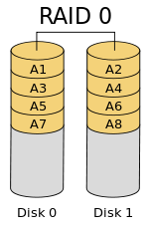
Storage Types
Redundant Array of Independent Disks (RAID) – Standard Levels
  Raid 0 – Stripe Set
    Splits (stripes) data evenly across two or more disks
    No parity information, redundancy or fault tolerance
    Failure of any single drive in the array results in total data loss
    Minimum 2 disk requirement
    Read performance: NX
    Write performance: NX
    Space efficiency: 1
RAID 0 provides zero redundancy!

Slide 31
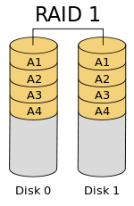
Storage Types
Redundant Array of Independent Disks (RAID) – Standard Levels
  Raid 1 – Mirror Set
    Mirrors data across two or more disks
    No striping, parity information, or disk spanning
    Array can only be as large as smallest disk
    Failure of any single drive in the array results in degraded array
      Array still operational, no data loss
    Minimum 2 disk requirement
    Read performance: NX
    Write performance: X
    Space efficiency: 1/N
    Low failure rate
N is the number of disks in the array!

Slide 32
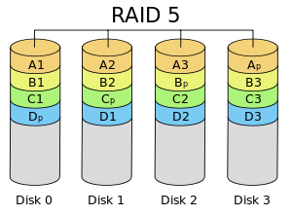
Storage Types
Redundant Array of Independent Disks (RAID) – Standard Levels
  Raid 5 – Block stripe with distributed parity
    Stripes data across three or more disks
    Parity information distributed across disks
    Possibility for disk spanning
    Array can only be as large as smallest disk
    Failure of any single drive in the array results in degraded array
      Array still operational, no data loss
    Failure of two disks results in data loss
    Minimum 3 disk requirement
    Read performance: NX
    Write performance: X(N-1)
    Space efficiency: 1-(1/N)
    Lower failure rate

Slide 33
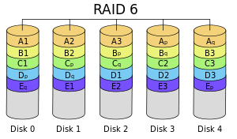
Storage Types
Redundant Array of Independent Disks (RAID) – Standard Levels
  Raid 6 – Block stripe with dual distributed parity
    Stripes data across four or more disks
    Failure of any two drives in the array results in degraded array
      Array still operational, no data loss
    Failure of three disks results in data loss
    Dual parity information distributed across disks
    Possibility for disk spanning
    Array can only be as large as smallest disk
    Minimum 4 disk requirement
    Read performance: NX
    Write performance: X(N-2)
    Space efficiency: 1-(2/N)
    Lowest failure rate

Slide 34
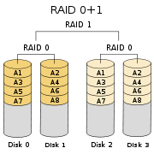
Storage Types
Redundant Array of Independent Disks (RAID) – Nested Levels
  Raid 01 – A Mirror of Stripes
    Mirrors data across multiple striped sets
    No parity information
    Array can only be as large as smallest disk
    Failure of any 1-2 drives in the array results in degraded array
      Array still operational, no data loss
    Minimum 4 disk requirement
    Lower failure rate

Slide 35
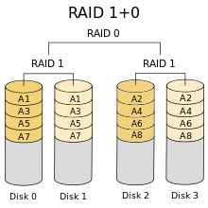
Storage Types
Redundant Array of Independent Disks (RAID) – Nested Levels
  Raid 10 – A Stripe of Mirrors
    Stripes data across multiple mirrored sets
    No parity information
    Array can only be as large as smallest disk
    Failure of any 1-2 drives in the array results in degraded array
      Array still operational, no data loss
    Minimum 4 disk requirement
    Lower failure rate

Slide 36
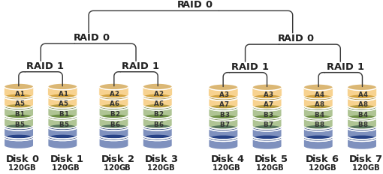
Storage Types
Redundant Array of Independent Disks (RAID) – Nested Levels
  Raid 50/60 – A Stripe of Stripes
  Raid 100 – RAID striped two ways

Slide 37
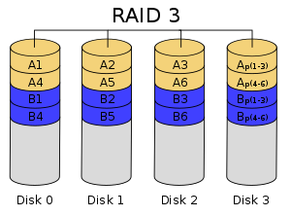
Storage Types
Redundant Array of Independent Disks (RAID) – Other Levels
  RAID 2 – Bit stripes with Hammering code for error correction
    Error correction is typically achieved today with internal disk functions
  RAID 3 – Byte stripes with dedicated parity disk
    Generally cannot service multiple requests simultaneously
    Benefits long sequential reads/rights
    Requires disks to spin together – painful
  RAID 4 – Block striping with dedicated parity disk
    Like RAID 5
    Must write all parity blocks to the same disk
  RAID 3 and RAID 4 replaced by RAID 5

Slide 38
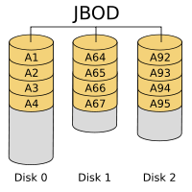
Storage Types
Just a Bunch Of Disks (JBOD) – Concatenation and Spanning
  Multiple hard drives presented as individual devices
  Drives then managed using OS software (LVM)
  Can be configured as individuals or groups
  Drives are concatenated together, just adding more space at the end
  Can use drives of various sizes and speeds
    Typically RAID requires identical disks
  No redundancy at all
Massive Array of Idle Drives (MAID)
  Hundreds to thousands of disks
  Write Once, Read Occasionally (WORO)
  Providing nearline storage - Long term storage with infrequent access
    Not online, but nearly online (ex: tape library, glacier array, jukebox)

Slide 39

Storage Types
Considerations
  Disk Capacity
    Size vs. speed tradeoff
  Data Transfer Rate
    Speed of data transfer
  Buffer Size
    Write acceleration, command queuing, cost
  Average seek times/access times
    Lag before data transfer can occur
  Rotational Speed
    RPM of Disk
      5,400; 7,200; 10,000; 15,000
  Interface
    Often dictates/dictated by other items
  IOPS
    Input/Output Operations Per Second
    Total IOPS
    Random Read, Random Write IOPS
    Sequential Read, Sequential Write IOPS

Slide 40
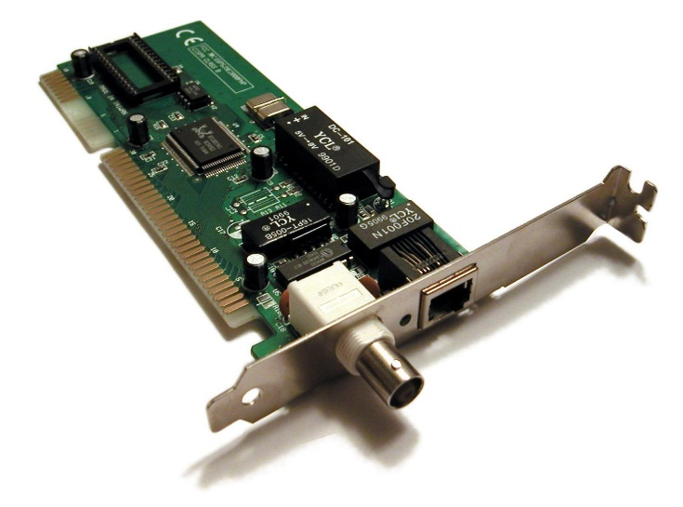
Network Interface Controllers (NIC)
Physical device which provides a connection between a device and a network
Multiple devices provide fault tolerance
Can connect to various computer buses
  ISA, PCI, PCIx, USB, etc.
Single device may support multiple connections!
Software capabilities can be part of a motherboard or
through a separate Ethernet chip
Typically 8-Pin 8-Conductor Registered Jack 45 socket
  8P8C RJ-45
Other connections include BNC and AUI
Notes:
BNC connects to a single copper coax cable
AUI is a 15-pin connection

Slide 41
Network Interface Controllers (NIC)
Ethernet
  A computer network architecture consisting of various specified local-area network protocols, devices, and connection methods
  Provides for collision detection with CSMA/CD
Wi-Fi
  A wireless local area network that uses radio waves to connect
  computers and other devices to a network
  Considered part of the Ethernet family of networking technologies
Fibre-Channel
  A high-speed transport technology used primarily to connect storage
  devices and build storage area networks (SANs).
  Can be used to carry ATM, IP, and other protocols (FCIP, etc)
  Uses the Gigabit Ethernet physical layer, can use copper media (FCoE)

Slide 42
Network Interface Controllers (NIC)
Asynchronous Transfer Mode (ATM)
  A telecommunications concept defined by ANSI and ITU (formerly CCITT) standards for carriage of a complete range of user traffic, including voice, data, and video signals.
  Operates at lowest 3 OSI Layers
Fiber Distributed Data Interface (FDDI)
  Originally used fiber to provide a standard for 100Mbps transmissions up to 200 km (120 mi)
  Adapted to use copper cables (CDDI)
Token Ring
  Uses a special 3 byte token frame, passed around the network,
  providing equal access for all devices and eliminating
  potential collisions
  Supports duplicate MAC addresses!

Slide 43
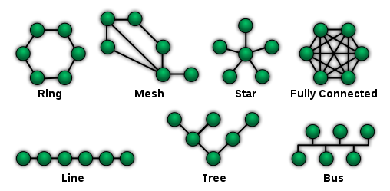
Network Topologies
Bus
  Nodes connected to common linear link
  Collision control
  Easy, lower cost
  Large fault domain, difficult to identify cable problems
Point-to-Point
  Direct link between two endpoints
  Switched topologies in telephony
  Easy, simple, minimal cost
Star
  Most common topology
  Central connection to each node
  Multiple fault domains
  More expensive to implement

Slide 44
Network Topologies
Ring
  Each computer connects to another, forming a closed loop
  Easier to identify and isolate faults
  One malfunctioning device can create problems
  Difficult to add or reconfigure nodes
Mesh
  Fully connected or partially connected
  Can use flooding or routing technique
  Usually most expensive

Slide 45
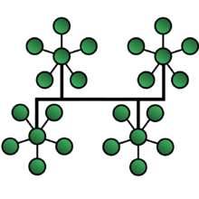
Network Topologies
Tree
  Combination of bus and star topology
  Scalable, multiple smaller fault domains
  Backbone failure essentially creates separate networks
Daisy Chain
  Each node connects in series to the next
  Liner or ring topology
Hybrid
  Uses any combination of two or more technologies

Slide 46
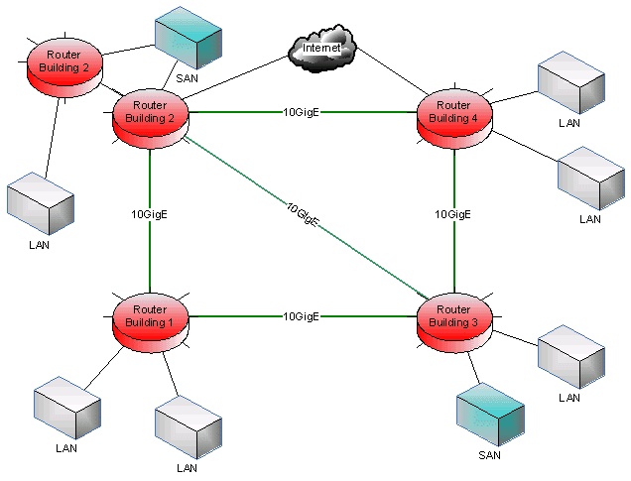
Network Topologies
LAN
  Local Area Network
  Connects devices within a limited area, such as a home or school
  Coax, twisted pair, fiber
  Switch Ethernet network is most common
MAN
  Municipal Area Network
  Computer network that is larger than a LAN, spanning multiple city blocks or an entire city
  ATM, FDDI

Slide 47
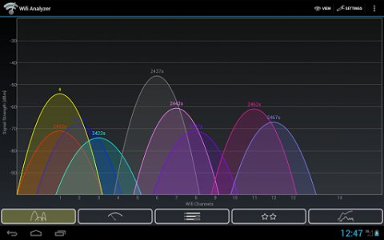
Network Topologies
WLAN
  Wireless LAN (Wi-Fi)
  Infrastructure, Ad-Hoc/Peer-to-Peer (P2P), bridge
  Clients connect to access points
  Roaming between access points
  Channels overlap
    1, 6, 11 don’t overlap

Slide 48
Network Topologies
WLAN
  Wireless LAN (Wi-Fi)
  Infrastructure, Ad-Hoc/Peer-to-Peer (P2P), bridge
  Clients connect to access points
  Roaming between access points
  Channels overlap
    1, 6, 11 don’t overlap
WLAN Standard | Frequency | Speed | Details
802.11b | 2.4 GHz | 11 Mbps | Initial Consumer Wi-Fi Offering
802.11g | 2.4 GHz | 54 Mbps | Mainstream Wi-Fi
802.11a | 5 GHz | 54 Mbps | Alternative frequency spectrum
802.11n (20 MHz channel, single antenna) | 2.4 or 5 GHz | 72Mbps | Support for both frequencies, up to 4 channels, and 20/40MHz channels
802.11n (40 MHz channel, single antenna) | 2.4 or 5 GHz | 150 Mbps | Support for both frequencies, up to 4 channels, and 20/40MHz channels
802.11n (40 MHz channel, multiple antennas) | 2.4 or 5 GHz | 600 Mbps | Support for both frequencies, up to 4 channels, and 20/40MHz channels
802.11ac | 5 GHz | 1-4Gbps | Support for both frequencies, up to 8 channels, and 160MHz channels

Slide 49
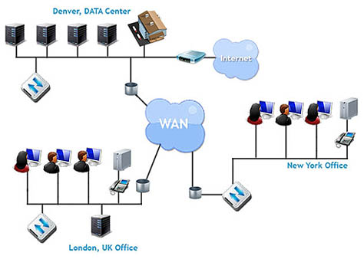
Network Topologies
WAN
  Wide Area Network
  Networking technologies used to transmit data over long distances, and between different LANs, MANs and other localized computer networking architectures.
  Internet can be considered a type of WAN
  Often used to connect multiple data centers
  Can provide for replication across long distances
  May be similar to a site-to-site VPN
Notes:
MAN: Metropolitan Area Network

Slide 50
Carrier Connection Types
Fractional T1 64 Kbit/s channels
  24 lines to split among voice/data
T1 1.544 Mbit/s (24 * 64k)
T3 44.736 Mbit/s
OC-1 51.84 Mbit/s
OC-24 1244.16 Mbit/s
OC-48 2488.32 Mbit/s
  Common carrier connection type used for many regional ISPs
OC-192 9953.28 Mbit/s
Dial-Up Modem 56Kbps
DSL 1-10Mbps
Satellite 1Mbps-15Mbps
Cable 5-50Mbps
Fiber to the Home 10-1000Mbps
Power-Line Internet 20-500Mbps
Wi-Fi 50Mbps-4Gbps
ATM and Frame Relay 10Mbps-10Gbps

Slide 51
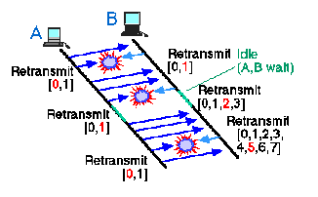
Collision Detection
Carrier sense multiple access with collision detection (CSMA/CD)
  Early Ethernet networking technology
  Necessary when using Ethernet hubs instead of switches
  Station checks for other devices transmitting data while transmitting itself
    Is my frame ready for transmission?
    Is the transmission medium idle?
    Start transmission
    If collision detected, go to collision detected procedure
      Continue transmission with a Jam signal, ensuring all stations detect collision
      Increment retransmission counter. If max, abort
      Calculate random wait time based on number of collisions
    Reset transmission counter and end frame transmission

Slide 52
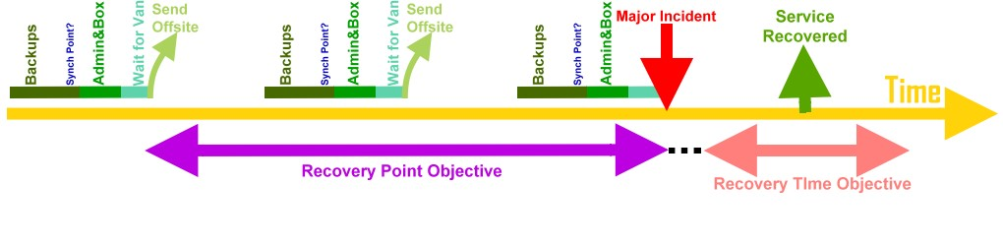
Disaster Planning and Recovery
A Disaster Recovery Plan is a documented process and/or set of procedures to recover and protect a business IT infrastructure in the event of a disaster.
Comprehensive statement of consistent actions to be taken before, during, and after a disaster.
  Unintentional: Meteorite, landslide, hurricane, weather, construction
  Infrastructure failure: Network or power provider unable to provide services
  Intentional: Terrorism, civil unrest
Notes:
RTO: Recovery Time Objective - The targeted duration of time and a service level within which a business process must be restored after a disaster (or disruption) in order to avoid unacceptable consequences associated with a break in business continuity.
RPO: Recovery Point Objective - The maximum targeted period in which data might be lost from an IT service due to a major incident.

Slide 53
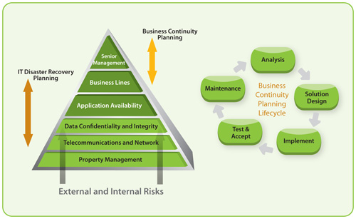
Disaster Planning and Recovery
An insurance plan for Business
  Sense of security
  Minimize risk
  Reduce delays
Tiering of applications
  Infrastructure Tier
  Business Critical Tier
  Lower Business Tiers
For example, of companies that had a major loss of business data, 43% never reopen and 29% close within two years.
Notes:
Business continuity statistics: where myth meets fact. Continuity Central. 24 April 2009. Retrieved 3 August 2012.
Infrastructure tier: Network services (DNS, DHCP, AD, NTP, etc.)
Business Critical Tier: Systems critical for business operation (database servers, file servers, email, critical business apps, etc.)
Lower Business Tiers: Not as critical systems (reporting services, payroll, internal intranet resources, etc)

Slide 54
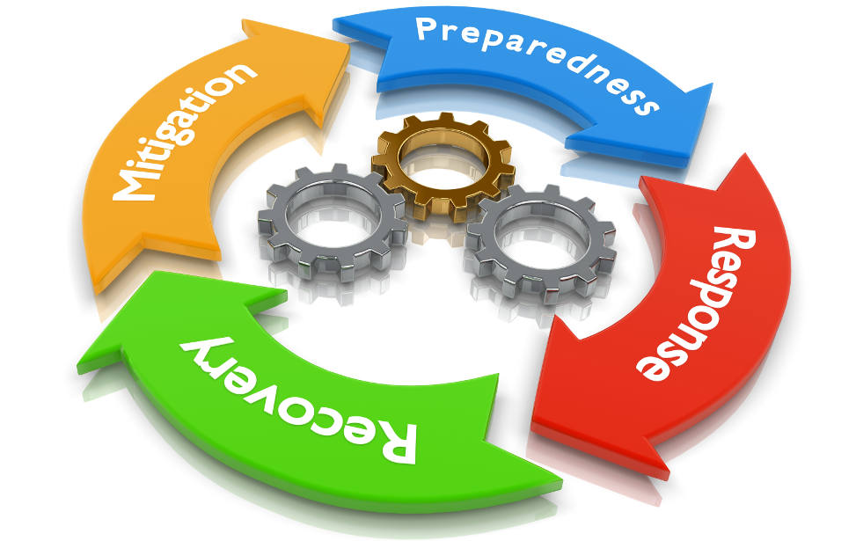
Disaster Planning and Recovery
Perform a risk assessment
  Determine potential consequence of various system disasters
Establish priorities
  Where to allocate resources first
Determine necessary strategies
  Facilities, hardware, software, communication links, data files, customer services
  Hot sites, warm sites, cold sites
Collect Data
  Gain input from multiple business areas
Document a written plan
Develop testing criteria and procedures
Test!

Slide 55
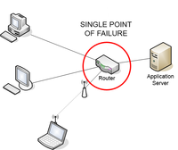
Disaster Planning and Recovery
Fault Tolerance
  The ability of a system to continue operating properly in the event of the failure of one (or more) of its components.
  A fault-tolerant design enables a system to continue its intended operation, possibly at a reduced level, rather than failing completely, when some part of the system fails.
Fault Domain
  A set of hardware components that share a single point of failure.
  Multiple servers connected to the same power feed or network hardware.
Single point of failure
  A part of a system that will stop the entire system from functioning
  upon failure
  Motherboard

Slide 56
ECSC 325.200
Web Server Administration
Spring 2025 – Week 2-2 – January 23rd, 2025
Introduction and overview 2 Continued

Slide 57
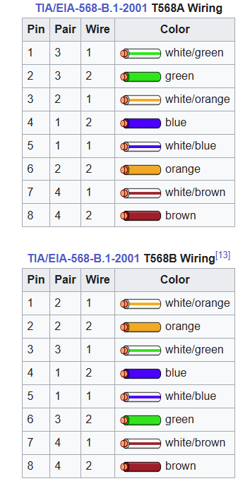
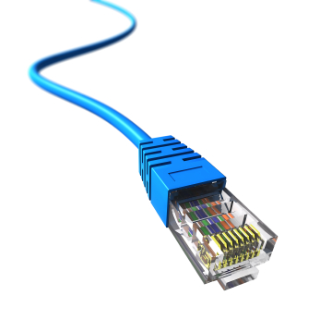
Ethernet Cables
Four twisted pairs of wires
Shielded or Unshielded
8 pin, 8 conductor connector (8P8C)
Category 5e:
  100MHz, 1 Gigabit up to 100 meters
Category 6:
  250MHz, 10 Gbit up to 55 meters
Category 6a:
  500MHz, 10 Gbit up to 100 meters
Category 7:
  600MHz, 10 Gbit up to 100 meters, shielded
Category 8:
  2GHz, 10 Gbit+, 30-36 meters, 8P8C, TERA, or GG45 connectors

Slide 58
System Redundancy
Redundancy is the duplication of critical components or functions of a system with the intention of increasing the reliability of the system
Maintain performance without human intervention
Examples:
  Multiple connections to the same network
  Multiple power feeds
  Multiple Disks (RAID)
  Duplicate copies of data
Advantages:
  Eliminate single points of failure
  Potentially provide extra capacity
  Distribution of load
  System reliability
Disadvantages:
  Increased cost
  Performance cost
  Maintenance cost
  Infrastructure overhead
N + 1 !

Slide 59
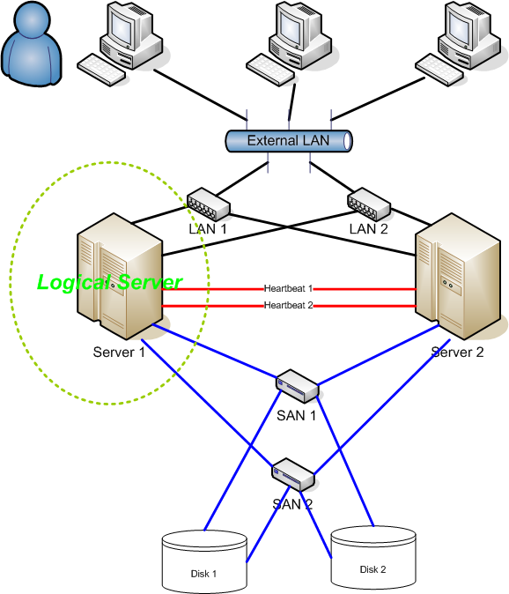
High Availability
High Availability (HA) refers to the availability of resources in a computer system, in the wake of component failures in the system.
HA is a characteristic of a system
HA Systems feature several key items:
  Elimination of single points of failure
  Reliable components
  Failure detection
HA is generally measured by unscheduled downtime
  Scheduled downtime would not be counted
Notes:
Heartbeat – Connection between two servers, so each knows the other is alive. Typically over LAN (not a separate network).

Slide 60
High Availability
HA is generally measured by downtime
  Scheduled downtime
    System patches or configuration changes requiring a reboot
    Logical, scheduled, approved events
  Unscheduled downtime
    Internal and external hardware or software failure
    Natural disaster, security breach
Availability is usually measured as a percentage
  Percentage of minutes per year a system is online
  99.999% - Five Nines – 5.26 minutes of downtime per year
May be measured and interpreted multiple ways

Slide 61
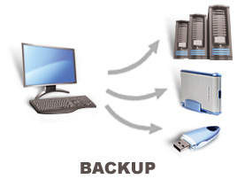
Backups
The process of copying and archiving data so it can be used to restore data in the event of a data loss.
Backups should be kept in a geographically different location from primary data storage.
Testing that your backups work is critical!
Backups can use any type of media.
  Writable discs (CD/DVD) generally have a short lifespan
  Magnetic tapes have a longer life but are restricted by serial access
Multiple backups for redundancy!
Backups can be of an entire system, or only specific data.

Slide 62
Backups
Full Backups
  Takes a complete backup of all data at a given point
  System images may be useful for backup, can be more difficult to restore from
Incremental
  Only makes backups of items that changed since last incremental backup
  Full system restore requires restoring a full backup, followed by each incremental
  Synthetic full backups can be created through software
  Weekly full, daily incrementals
Differential
  Only makes backups of items that have changed since last full backup
  Restore requires a full and most recent differential backup
  Weekly full, daily differentials
  Most common type of backups

Slide 63
Backups
Continuous Backups
  Changes on a primary system are immediately logged and propagated to backup system
  Typically works on byte/block level, instead of file level
Snapshot Backups
  Systems create a snapshot, which is presented as a copy of the original, which can then be backed up
  Services can be quiesced before snapshot, releasing any file locks
  Snapshots create a “crash-consistent” state
  Backups can then be taken of the snapshot
Hot and Cold backups
  Hot backups can make a backup while systems are online
  Cold backups require data files to be closed
  during backup to prevent change
    Quiesce a database to prevent changes during a backup

Slide 64
Backups
Compression
  Shrink the size of source data so more data can fit on destination device
  Typically will decrease overall backup speed
  Extra burden on compression hardware
Deduplication
  Reduce amount of data stored, by only storing a single copy and saving deduplication metadata
  Can be de-duped on source or target
  Can potentially increase speed
  Extra burden on deduplication hardware
Encryption
  Backup media is encrypted, minimizing risk if lost
  Typically decreases overall backup speed
  Additional burden on encryption hardware

Slide 65
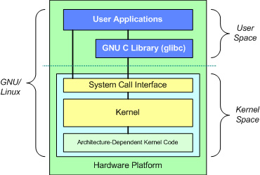
Linux Kernel
The Linux Kernel is the underlying hardware controlling interface
Provides a running environment for application
software through system calls
Handles network, disk, memory, and multitasking
Different Linux distributions take a base
kernel and modify it
You can freely download, inspect, build, and
run the standard Linux kernel
Multiple kernels can be installed at once
  Running kernel selected at boot time
Patch or upgrade your kernels as needed!

Slide 66
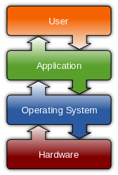
Virtual File Systems
A virtual file system is a representation of hardware within the file system
Virtual file systems are not backed by physical storage
  You can’t permanently save something to virtual storage
The /proc virtual file system allows configuration and management of
processes through virtual files
  You access, read, and write to it like a file, but it modifies running system behavior
  Make calls to the kernel space, request hardware info, etc.
  cat /proc/cpuinfo
SysFS (/sys) provides a view of the device tree as the kernel sees it
Temporary filesystems stored in virtual memory
  Faster, less disk I/O, less overhead
  Not-persistent on reboot
Notes:
Discuss cat command

Slide 67

SSH
SSH is a suite of network communication tools
  Based on open standards, guided by the Internet Engineering Task Force (IETF)
  100% Encrypted
  Remote connections
  File transfer
  Tunnels
  Uses Public Key Cryptography
    Senders private key, combined with destinations public key
    Destinations private key is used to decrypt
    Sufficiently large keys prevent reverse engineering
  Uses session keys
    Changed regularly
    Shared over secure communication session
    Extra shared key used to encrypt transmissions

Slide 68
SSH
SSH Keys
  A large number with special mathematical properties
  Key length is measured in bits
    128 bit key has 2^128 possibilities
  Larger key sizes create more possible permutations
  2048-bit or higher
  Higher encryption levels require more computation
  Various key types
    RSA, DSA, EDSA
Encryption Algorithms
  SSH can use many different encryption algorithms
  Both parties must agree!

Slide 69
SSH
Connecting with SSH
  We can use putty to connect from Windows
  We can use SSH from Mac or Linux
  From on campus, we can connect directly to our machines via SSH
    ssh username@ecsc325-1##.cs.Edinboro.edu
    ssh username@147.64.243.1##
  From off campus, you must connect through cslab100 or cslab101
    Firewall rules prevent direct connection from off campus to our VM’s
    SSH to cslab100/cslab101, then SSH to your VM
      This is an SSH Proxy!

Slide 70
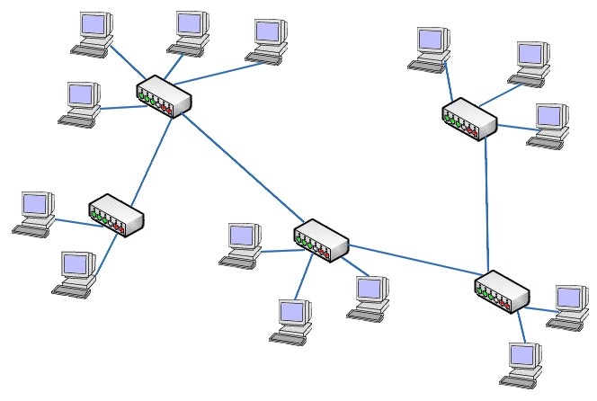
Network Connectivity
Routers – Forwards data packets between computer networks.
  Layer 3 device, operates using layer 3 information (IP address)
Switches – Connects networked devices using packet switching technology.
  Operate at layer 2, using hardware (MAC) addresses to direct packets
  Separate each single network connection segment
  Managed vs Unmanaged switch
Hubs – Connects networked devices in to a single network segment.
  Layer 1 device, essentially just forwarding all information
  One combined network connection segment for all devices
  Collision detection
  Repeater

Slide 71
Network Connectivity
Load Balancers
  A device that distributes network or application traffic across a number of servers. Load balancers are used to increase capacity and reliability of applications.
  Round Robin DNS
    Multiple IP addresses for a single hostname
  Separate users from host systems
  DDoS protection
  Bandwidth compression
  SSL/encryption offloading
  Caching
  Priority queuing
  Firewall

Slide 72
TCP/IP
OSI Model – 1988
  A conceptual model that standardizes the communication functions of a computing system
TCP/IP Model
  The computer networking model and protocols used on the Internet
OSI Model |  |  |  |  |  |  | TCP/IP Model
 | Layer | OSI Name |  | Example Protocols | Functions |  | TCP/IP Name | Layer
Host Layers | 7 | Application Layer |  | HTTP, FTP, DNS, SNMP, SSH | Network Process to Application |  | Application Layer | 4 | Host Layers
 | 6 | Presentation Layer |  | SSL, TLS | Data Representation and Encryption
 | 5 | Session Layer |  | NetBIOS, PPTP | Interhost Communication
 | 4 | Transport Layer |  | TCP, UDP | End to End Connections and Reliability |  | Transport Layer | 3
Media Layers | 3 | Network Layer |  | IP, ARP, ICMP, IPSec | Path and IP (Logical Addressing) |  | Internet Layer | 2 | Media Layers
 | 2 | Data Link Layer |  | PPP, ATM, Ethernet | MAC and LLC (Physical Addressing) |  | Network Interface Layer | 1
 | 1 | Physical Layer |  | Ethernet, USB, Bluetooth, 802.11 | Media, Signal, Binary Transmission

Slide 73
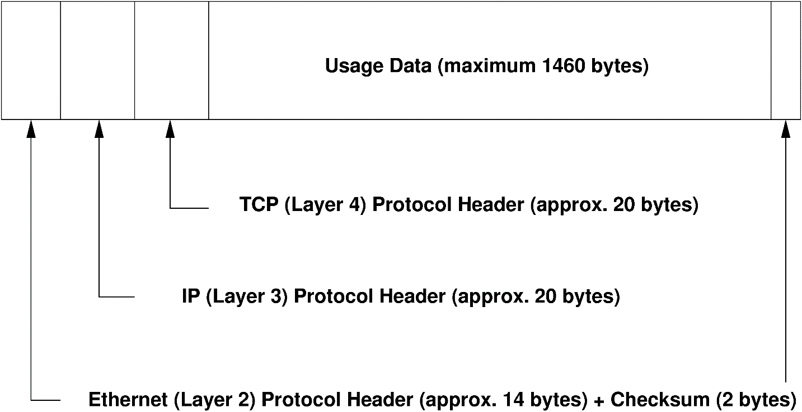
TCP/IP
The Transmission Control Protocol / Internet Protocol is built in layers:
  Packets contain all the information
  from the different layers
  Each protocol uses a header
  Headers are added or removed as
  the packet moves up or down
  the protocol stack
  Multiple headers
  Encapsulation
*OSI Layers in illustration above

Slide 74
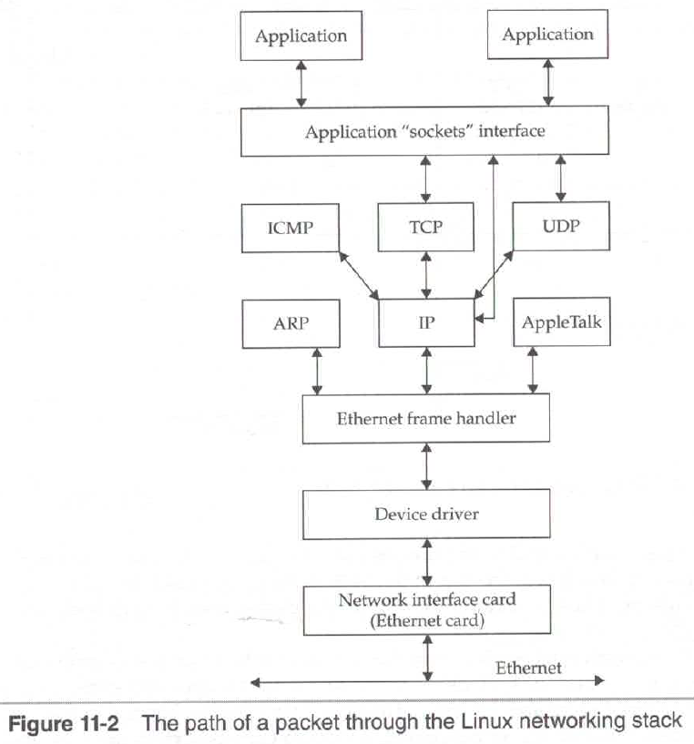
TCP/IP
The Transmission Control Protocol / Internet Protocol is built in layers:
  Packets are passed up the protocol stack,
  each layer using the different headers
    Network card accepts the packet
    Device interrupts the OS and the driver processes the packet
    Device driver transfers packet to appropriate protocol (ARP, IP, etc.)
    Remaining packet info passed up the stack to subsequent layer protocols
  Each layer strips off its info
    Ethernet layer removes Ethernet headers
    IP layer removes IP headers
    TCP removes TCP headers

Slide 75
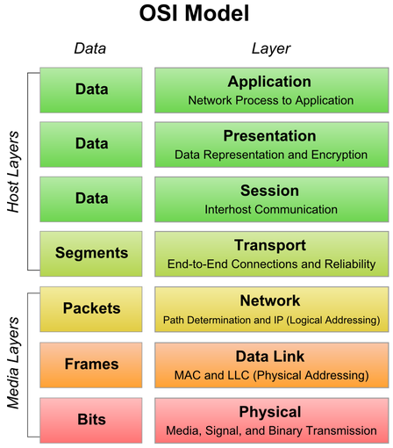
OSI Layers
Layer 1 – The Physical Layer (The Wire)
  This describes the actual physical items
    Cabling, interface connections, and electrical or optical signaling
Layer 2 – The Data Link Layer (Ethernet)
  Handles addressing and transport within a local area network
    Uses Media Access Control (MAC) address, unique to each Network Interface Card (NIC)
      48-bit, 6 hex groups, 01:23:45:67:89:AB
  Get packets from one side of the LAN to another
Layer 3 – The Network Layer (Internet)
  Contains the IP addressing information
    IPv4 or IPv6!
  Handles getting the packets between networks
  Globally addressable/routable functionality

Slide 76
OSI Layers
Layer 4 – Transport Layer (TCP/UDP)
  Transport Control Protocol (TCP) provides reliable transportation
    Error checking, packet sequencing, bidirectional communication
  User Datagram Protocol (UDP) provides no reliability
    Doesn’t detect lost, duplicate, or corrupted packets
    Preferred for short transmissions and real-time communications
      Single packets such as DNS, live audio or video, multiplayer gaming
Layers 5-7 – Application Layers (HTTP, SSH, SSL, XML)
  Layer 5 – Session Layer – Manages sessions between processes
  Layer 6 – Presentation Layer – Data representation and encryption
  Layer 7 – Application Layer – Where the applications communicate
  with the network
Layer 8 – The human layer
  It’s a layer 8 problem…

Slide 77
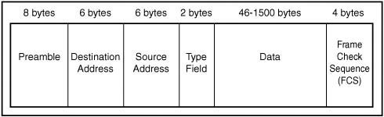
Headers
Ethernet
  Preamble – 64 bit (8 byte) – allows devices to synchronize
    7 sync + 1 start frame delimiter
  Destination address – 48 bit (8 byte) - MAC address of destination
  Source address – 48 bit (8 byte) - MAC address of source
  Type – Information about packet
    802.3: Indicates payload size below 1500
    Ethernet II: Type of encapsulated traffic above 1535
  Data – 46-1800 bytes – Encapsulated traffic
    IP or ICMP packets
    Headers of encapsulated packets
  Checksum
    Frame Check Sequence or CRC
  View Ethernet headers with the tcpdump command
1518 Byte Max!

Slide 78
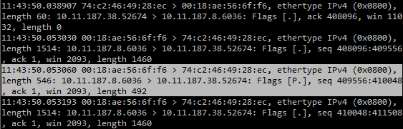
Headers
Ethernet (Network Interface Layer)
  tcpdump -e -nn
    Timestamp
    Source & destination MAC addresses!
    Source & destination IP addresses
    Source & destination ports
    Packet type
    Packet length
    Sequence
    Flags
    Options
An Ethernet packet is also called a frame

Slide 79
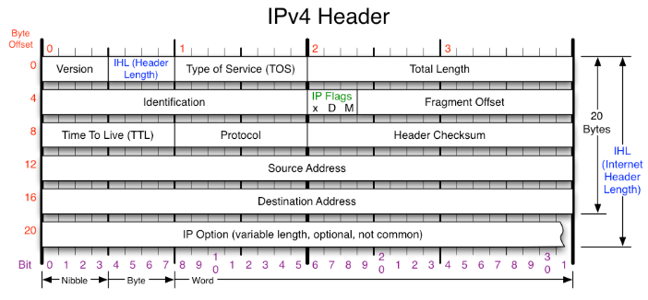
Headers
Internet Protocol version 4 (IPv4) (20 bytes, 160-bits)
  4-bit IP version number
  4-bit header length
    Various options may affect length
  8-bit Type of Service (ToS)
    Minimized delay, max throughput,
    max reliability, minimal cost
  16-bit Total packet length
  16-bit Identification
    Unique number used to ID a packet
    in a sequence
  3-bit Flags and Fragment Offset
    Indicate sequence and fragmentation info
    Packets are fragmented when the IP packet doesn’t
    fit in a single Ethernet packet MTU (Ex: 1500)
    4000 bytes split in to 1500, 1500, 1040
Notes:
ToS used for rate shaping, bandwidth prioritizing
4000 bytes split in to 1500, 1500, 1040 = 4000 (3080 data + 20 packet) data encapsulated in 3 20 bit packets
4000 (3080 data + 20 header) = 1500 (1480 data + 20 header) + 1500 (1480 data + 20 header) + 1040 (1020 data + 20 header)
Extra 40 bits is from 2 extra packets (20 bit header per packet)

Slide 80
Headers
Internet Protocol version 4 (IPv4) (20 bytes, 160-bits)
  8-bit Time To Live (TTL)
    Counter decrements with routing hops on the network (255 to 0)
    Prevents routing loops
  8-bit Protocol information
    TCP, UDP, ICMP
  16-bit Header checksum
    Sum of all byte values
  32-bit Source IPv4 address
  32-bit Destination IPv4 address
  Any IP options and finally the data
4-bits: Nibble
8-bits: Byte
32-bits: Word

Slide 81
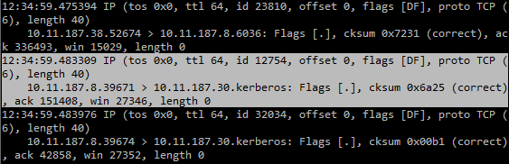
Headers
Internet Protocol version 4 (IPv4) (20 bytes, 160-bits) (Internet Layer)
  tcpdump -v -n
  Timestamp
  Options
  Source IP & Port
  Destination IP & Port
  Flags
  Checksum

Slide 82
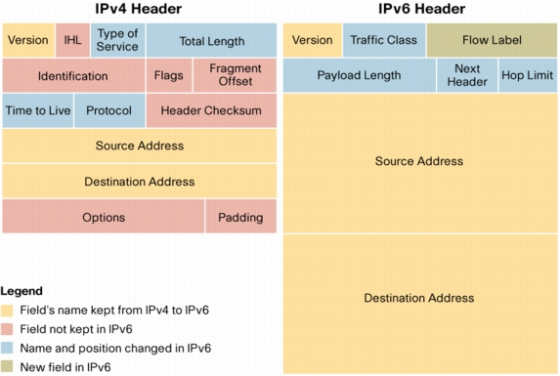
Headers
Internet Protocol version 6 (IPv6) (40 bytes, 320-bits) (Internet Layer)
  Less reserved information within the headers
    Items felt redundant or unnecessary were eliminated
  Longer source and destination addresses
    IPv6 addresses are 128 bits, IPv4 addresses are 32 bits
    This provides for many more unique addresses!
IPv6!

Slide 83
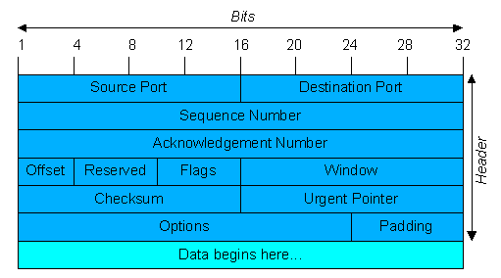
Headers
Transmission Control Protocol (TCP) (20 bytes, 160-bits) (Transport Layer)
  16-bit source port (0-65535)
  16-bit destination port (0-65535)
  32-bit sequence number
    Packet sequence within TCP stream
  32-bit acknowledgement
    Next expected packet, acknowledges receipt of
    all previous packets
  4-bit Offset indicates size of header
  3 Reserved and unused bits
  9-bit Control flags
    URG, ACK, PSH, RST, SYN, FIN, etc…
  16-bit Window size
    Size that can be received at once
Notes:
URD: Urgent
ACK: Acknowledgement
PSH: Push buffered data to application
RST: Reset the connection
SYN: Synchronize sequence numbers
FIN: Last package

Slide 84
Headers
Transmission Control Protocol (TCP) (20 bytes, 160-bits) (Transport Layer)
  16-bit Checksum
    Provides checksum against TCP data
  16-bit Urgent Pointer
    Indicates end of urgent data
  Options
    TCP Options
  Padding
    Consists of all zeroes
    Ensures header ends on 32-bit boundary

Slide 85
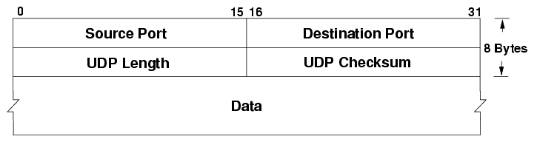
Headers
User Datagram Protocol (UDP) (8 bytes, 64-bits) (Transport Layer)
  16-bit source port (0-65535)
  16-bit destination port (0-65535)
  16-bit UDP Length
  16-bit UDP checksum
40% of TCP Header Size!

Slide 86


Headers
TCP & UDP (Transport Layer)
  TCP: tcpdump -v -nn -t
  UDP: tcpdump -v -nn udp port 53
Notes:
Example TCP and UDP headers

Slide 87

Headers
Packets
  Data is encapsulated
  Each layer adds or removes
  a header
  Headers inside of headers
  Layers of inception
Notes:
Example TCP and UDP headers

Slide 88

TCP Connection
TCP Three-Way Handshake
Typical network connection
  User sends SYN request to server, requesting a connection
  Server responds with SYN-ACK, acknowledging the connection request
  Client responds with ACK, acknowledging the request and establishing the connection
  Data can now be transferred
  TCP handles transmission of data
    Sequencing
    Error-checking
    Retransmitting
  Possibility for abuse?!
SYN flood?
Notes:
Syn flood

Slide 89

TCP Connection
TCP Three-Way Handshake
Typical network connection
  User sends SYN request to server, requesting a connection
  Server responds with SYN-ACK, acknowledging the connection request
  Client responds with ACK, acknowledging the request and establishing the connection
  Data can now be transferred
  TCP handles transmission of data
    Sequencing
    Error-checking
    Retransmitting
  Possibility for abuse?!
SYN flood!
Notes:
Syn flood

Slide 90

TCP Connection
TCP Connection Close
Typical network connection
  FIN signal is sent initiating end of transmission
  FIN and ACK signals are returned
  Final ACK is sent to acknowledge close of communication

Slide 91

Address Resolution Protocol (ARP)
ARP maps IP addresses to Ethernet MAC addresses
  LAN-Only traffic
    Non-routable
  Client optionally looks in local ARP cache
  If no cache hit is found, client sends a broadcast
    Broadcast to all clients on network
    What is the MAC address for IP 192.168.1.120?
  ARP reply is send pack to requestor only
    MAC address for IP 192.168.1.120 is 02-FE-05-A7-00-01
  28 bytes (224-bits)
ARP Spoofing?!

Slide 92

Address Resolution Protocol (ARP)
ARP maps IP addresses to Ethernet MAC addresses
  LAN-Only traffic
    Non-routable
  Client optionally looks in local ARP cache
  If no cache hit is found, client sends a broadcast
    Broadcast to all clients on network
    What is the MAC address for IP 192.168.1.120?
  ARP reply is send pack to requestor only
    MAC address for IP 192.168.1.120 is 02-FE-05-A7-00-01
  28 bytes (224-bits)

Slide 93

Address Resolution Protocol (ARP)
ARP maps IP addresses to Ethernet MAC addresses
  tcpdump -e -t -nn arp
  The ff:ff:ff:ff:ff:ff represents the MAC broadcast address
    This gets broadcast to all hosts on a subnet
    Non-routable
  Potential for abuse
    ARP Poisoning?!
    MITM Attack
Man in the Middle?!
Notes:
Example ARP packets

Slide 94

IP Addresses
IPv4 – Dotted decimal notation
  192.168.0.1/24
  2^32 addresses (4,294,967,296)
  Four 8-bit integers
  Private ranges
    10.0.0.0/8
      10.0.0.0-10.255.255.255
    172.16.0.0/12
      172.16.0.0-172.31.255.255
    192.168.0.0/16
      192.168.0.0-192.168.255.255

Slide 95
IP Addresses
IPv4 – Dotted decimal notation
  Uses “A” DNS records
  127.0.0.1 – Localhost
  Multicast Address Range
    224.0.0.0 – 239.255.255.255
  Reserved Range
    240.0.0.0 – 255.255.255.255
  Broadcast IP
    Sends to all hosts within the subnet
  Default Route
    Next destination for traffic not part of subnet

Slide 96

IP Addresses
IPv4 – Dotted decimal notation
Notes:
Google CIDR Calculator
CIDR: 227.82.157.177/20
Netmask: 255.255.240.0
Range: 227.82.144.0 - 227.82.159.255

Slide 97

IP Addresses
IPv6 – Hexadecimal notation
  2001:0000:0000:0000:0000:7a11:a1e:cafe/32 (2001::7a11:a1e:cafe/32)
  2^128 addresses (340,282,366,920,938,463,463,374,607,431,768,211,456)
  Eight groups of four hexadecimal digits
  Values between 0-F
    BEEF
    CAFÉ
    C0DE
    F00D
Notes:
IPv6 CIDR: 2001::7a11:a1e:cafe/32
Range: 2001:0:0:0:0:0:0:0 - 2001:0:ffff:ffff:ffff:ffff:ffff:ffff

Slide 98
IP Addresses
IPv6 – Hexadecimal notation
  More available IPv6 addresses than grains of sand on Earth.
  45984103637964657224780352355 per person
  Stateless address autoconfiguration (SLAAC)
    Client creates address based on designated prefix
  Special prefixes for tunnels, IPv4 mapped addresses
  Uses “AAAA” (quad-A) DNS records

Slide 99

IP Addresses
IPv6 – Hexadecimal notation

Slide 100

Classful/Classless Addressing
Classful IP Addressing
  IP address ranges divided among 5 classes
    Class A: First octet 1-127
      First octet represents network
    Class B: First octet 128-191
      First and second octet represent network
    Class C: First octet 192-223
      First, second, and third octet represent network
    Class D: First octet 224-239
      Multicast
    Class E: First octet 240-255
      Reserved

Slide 101
Classful/Classless Addressing
Classful IP Addressing
  Set up for organizations of different sizes
  Replaced with Classless Inter-Domain Routing in 1993 (CIDR)
  Limited number of separate networks (~2,100,000)
  Networks that needed an address space
  larger than a class C would be designated
  a class B address, leading to unused addresses
  CIDR specified in RFC’s 1518 and 1519

Slide 102
IP Address Classes
Classful IP Addressing
 | Leading bits | Network ID Bits | Host ID Bits | Number of networks | Number of hosts per network | Intended Use
A | 0 | 8 | 24 | 126 | 16,777,214 | very large organizations
B | 10 | 16 | 16 | 16,384 | 65,534 | medium-to-large organizations
C | 110 | 24 | 8 | 2,097,152 | 254 | smaller organizations
D | 1110 | n/a | n/a | N/A | N/A | IP multicasting
E | 1111 | n/a | n/a | N/A | N/A | Reserved for “experimental use”

Slide 103

IP Address Classes
IPv4 – Dotted decimal notation
Notes:
A: 0.0.0.0-127.255.255.255
B: 128.0.0.0-191.255.255.255
C: 192.0.0.0-223.255.255.255
D: 224.0.0.0-239.255.255.255
E: 240.0.0.0-255.255.255.255

Slide 104

IP Address Classes
Classful IP Addressing
Rational for Use
  Simplicity and clarity
  Reasonably flexible
  Routing Ease
  Reserved Addresses
Problems
  Lack of internal Address Flexibility
    Large org given big block – doesn’t match underlying structure
    No way to create internal structure

Slide 105
IP Address Classes
Classful IP Addressing
Problems
  Lack of internal Address Flexibility
    Large org given big block – doesn’t match underlying structure
    No way to create internal structure
  Inefficient use of Address Space
    Some waste – host size > 254… >65,00
  Proliferation of router table entries
    20 class c tables or 1 class B tables…

Slide 106

IP Address Classes
Classless Inter-Domain Routing (CIDR)
  Based on variable length subnet masking (VLSM)
  Allows a network to be divided in to variously sized subnets
  Introduced CIDR notation
    Network ID followed by hostmask
    192.168.0.0/24
  Provides for subnetting
    Create subnets within larger address block
  Reduces routing table entries
    Multiple consecutive route entries can be combined into “supernets”
  CIDR Calculator
    http://www.subnet-calculator.com/cidr.php

Slide 107

Subnetting
A subnet is an identifiably separate part of an organizations network.
Created by dividing the host identifier into an additional network identifier.
Subnets will have their own routing and broadcast addresses.

Slide 108
Subnetting
Subnet masks perform a bitwise AND operation to any IP address to find the routing prefix.
Subnet masks are often written in dot-decimal notation or CIDR notation
  IP: 192.168.5.130 - Hostmask: 255.255.255.0
  CIDR: 192.168.5.0/24
Network is Bitwise AND!
 | Binary Form | Dot-decimal notation
IP address | 11000000.10101000.00000101.10000010 | 192.168.5.130
Subnet mask | 11111111.11111111.11111111.00000000 | 255.255.255.0 (/24 CIDR notation)
Network prefix | 11000000.10101000.00000101.00000000 | 192.168.5.0
Host part | 00000000.00000000.00000000.10000010 | 0.0.0.130
Notes:
Bitwise AND

Slide 109
Subnetting
Subnet masks perform a bitwise AND operation to any IP address to find the routing prefix.
Subnet masks are often written in dot-decimal notation or CIDR notation
  IP: 192.168.5.130 - Hostmask: 255.255.255.0
  CIDR: 192.168.5.0/24
Host is Bitwise OR!
 | Binary Form | Dot-decimal notation
IP address | 11000000.10101000.00000101.10000010 | 192.168.5.130
Subnet mask | 11111111.11111111.11111111.00000000 | 255.255.255.0 (/24 CIDR notation)
Network prefix | 11000000.10101000.00000101.00000000 | 192.168.5.0
Host part | 00000000.00000000.00000000.10000010 | 0.0.0.130
Notes:
Bitwise AND

Slide 110
Private Networks
A private network is a network which uses private IP addresses for devices
  10.0.0.0/8
    10.0.0.0-10.255.255.255
  172.16.0.0/12
    172.16.0.0-172.31.255.255
  192.168.0.0/16
    192.168.0.0-192.168.255.255

Slide 111


Private Networks
Private networks use Network Address Translation (NAT) to provide unique private IP address to devices, allowing all devices to share the same public IP address.
Connections are mapped to individual ports for maintaining communication between NAT’d clients and internet services by the NAT device.
Nat increases the lifespan of the IPv4 address space, by allowing multiple clients to share a single public IP address.
Port Forwarding

Slide 112

Linux Commands
tcpdump
route
ifconfig
ip
nmcli
netstat
nslookup
dig
route
hostname
cat

Slide 113
Documentation Expectations
Documentation expectations examples:
  Edit the network configuration file /etc/sysconfig/network-scripts/ifcfg-bond0
    Updated the following information in the network configuration file:
      IPADDR=147.64.243.115
      HOSTMASK=255.255.254.0
      DNS1=147.64.242.100
      DNS2=147.64.242.101
  Restarted the network services to apply configuration changes
      systemctl restart network
  Added entry to /etc/fstab file for persistent mount
    147.64.243.115:/data /data nfs bg,rw,sync,hard,intr 0 0
  Updated and rebooted the system
      dnf –y update; reboot

Slide 114

Virtual Machines
IP Address: 147.64.243.1## (01-25)
Hostname: ecsc325-1##.cs.edinboro.edu (01-25)
Alias: 1##.megastuff.biz (01-25)
  Also 1##.ultrastuff.net!
Assignment 2 – Available Now
  Due next week – Jan 29 2025
Assignment 1 due last night!
## is your 2-digit number!
VM’s in week 3?!

Slide 115

Key Terms and Items
File Server
Application Server
Database Server
Web Server
Game Server
Mail Server
Proxy Server
Virtual Server
Physical Server
CPU
Hyperthreading
RAM
ROM
Hard Disk Drives
Fibre Channel
RAID
Network Topologies
Collision Detection
Disaster Recovery
Redundancy
High Availability
Backup Types
Linux Kernel
Virtual File Systems

Slide 116
Key Terms and Items
Routers
Switches
Hubs
Load Balancers
TCP/IP and OSI Models
Ethernet header
IP header
TCP & UDP headers
Encapsulation
Three-Way Handshake
ARP
IPv4 & IPv6
Classful/Classless addressing
Digital
Subnetting
Private networks
Routing
Flat topology
IDF/MDF
Demarcation points
Development Environments
Logical Volume Management
Volume Groups
Partitions
Mount Points
Filesystems
Data center considerations
Analog

Slide 117
Key Terms and Items
Syllabus & Class Info
Servers
Server considerations
Server types
Server hardware types
Server environment
Virtual machines
Hot & Cold aisles
Server administrators
The Internet
World Wide Web
TCP/IP
Data
IPv4/IPv6 Addresses
Network layers
TCP & UDP
Hubs, Switches, Routers
Firewalls
ISP Tiering & Peering
Storage & RAID
Application protocols
DNS
Operating Systems
Users and Groups

Slide 118

For Next Week
“Every morning in Africa, a gazelle wakes up, it knows it must outrun the fastest lion or it will be killed. Every morning in Africa, a lion wakes up. It knows it must run faster than the slowest gazelle, or it will starve. It doesn't matter whether you're the lion or a gazelle - when the sun comes up, you'd better be running.” – African Proverb
Textbook:
  Chapter 11 – TCP/IP
  Chapter 12 – Networking
Assignment 2
  Some questions to answer
  Due next week (Wed Jan 29 2025)
Next week topics
  IP Addressing, Subnetting, Networks
  Deployment Environments

