Slide 1
ECSC 325.200 Web Server Administration
Spring 2025 – Week 5-1 – February 11th, 2025
Apache Installation, configuration, and some CLI stuff
Prof. Jason Patalon

Slide 2

Recap and Review
The next few weeks…
Users, permissions, installations, DNS, & stuff
Web server introduction and installation
Midterm – Thursday February 27th
Spring Break – Week 8
March 4/6
Corrections, updates, etc.
Minor updates to previous presentations as needed…
Questions from previous classes?
“If you can’t find a good role model, be one.” – Gale Anne Hurd
Etcetera…

Slide 3

Weekly Info
“Great minds discuss ideas; average minds discuss events; small minds discuss people.”
-Eleanor Roosevelt
Cloudbleed – Cloudflare service was leaking data for months in 2017…
Uber, OKCupid, FitBit, more…
Passwords, keys, personal info, messages, more…
Attendance
Good of the Class
Assignments 3 & 4 due by midnight tomorrow!
Check script and documentation!

Slide 4

Objectives
Linux Command Line Text Editors
Assignment 3 Reviews
Assignment 4 Example
Web server terms and definitions
How a web server works
Web server installation
Web server properties
Virtual hosts
Virtual directories
Virtual host installs and configs
Apache Web Server
Website information
Installation
Configuration

Slide 5

Linux Command Line Text Editors
vi – visual editor – command driven text based editor
Also vim – vi improved!
Press i to switch to insert mode, esc to return to command mode
--INSERT– displayed at the bottom of the screen while in insert mode
Type command :wq! to save and close the file (write and quit)
Most popular Unix/Linux editor - Default editor in Linux, installed on all distros/flavors
nano – simple text editor
Caret symbol represents control button (^X = crtl+x)
^X = exit
^O = write out
gedit – graphical editor similar to Windows Notepad
joe – another simple editor, no longer available?

Slide 6
Assignment 3 review
Change the password of the root account!
Log in as root, run the passwd command and change the root account password
Add the account named user and set their password!
useradd user
passwd user
Add Professors SSH key!
Run ssh-keygen command to set up your SSH keys and build the directory structure!
curl -O https://jpatalon.cs.edinboro.edu/ecsc325/classfiles/root@ecsc325-110.pubkey
cat root@ecsc325-110.pubkey >> /root/.ssh/authorized_keys
Disable SELinux
Change SELINUX=permissive in file /etc/sysconfig/selinux

Slide 7
Assignment 3 review
Install the packages s-nail, curl, wget, net-tools, and nano using the appropriate dnf command.
dnf -y install s-nail curl wget net-tools nano
Install sendmail, start sendmail, and enable sendmail to make sure it starts on boot.
dnf -y install sendmail
systemctl start sendmail
systemctl enable sendmail
Patch, reboot, and validate!
dnf -y update kernel && dnf –y update kernel* && dnf -y update && reboot
Run the checkscript!
curl -O https://jpatalon.cs.edinboro.edu/ecsc325/classfiles/assignment3check.sh
bash ./assignment3check.sh

Slide 8

Assignment 4
Add a user named jpatalon and set account expiration date
Create the group admin and add users to additional groups
Add new users to the sudoers file /etc/sudoers.d/users (create new file)
Create a user account for yourself, add yourself to groups, set a password, and add to sudoers
Create a document with a copy of the exact commands you performed
Include any relevant requested information from the /etc/passwd and /etc/group files.
Run id commands and include the results in your document
Run the command “ps -au | head”. Copy the results and briefly explain the first four columns
Run the commands “whereis chmod” and “which chmod”. Copy the output from to your document and explain the differences
Execute the command “df –h” and answer related questions
Use the find command to locate a file
Update and reboot your system!

Slide 9
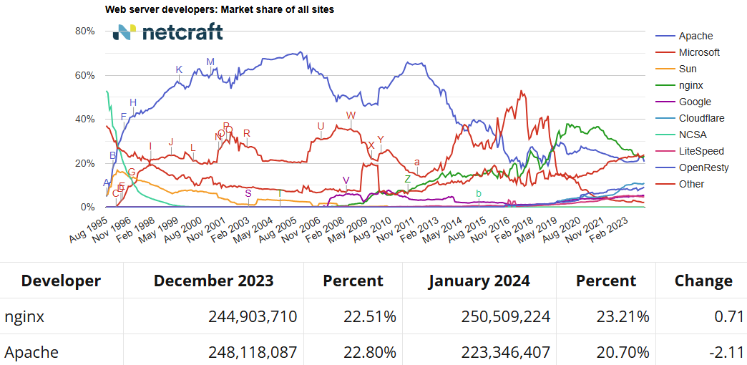
How a Web Server Works
The World Wide Web uses the Hypertext Transfer Protocol (HTTP) to define how data is passed between a web server and a web browser.
Specific web site software used to host and serve files
Apache – Most popular web server software* – Multi-platform, free & open source software (FOSS)
Microsoft Internet Information Server – Web server software from Microsoft for Windows OS’s
Nginx – Pronounced Engine X – Multi-platform, FOSS – Less features, better performance
Netcraft.com – Statistics regarding web server usage

Slide 10

How a Web Server Works
Web servers listen for requests on port 80
Secure requests occur over port 443!
Custom ports can be created for specialized uses
http://www.edinboro.edu:80
Same as http://www.edinboro.edu
https://www.edinboro.edu:443
Same as https://www.edinboro.edu
http://portquiz.net:8080
Web servers have a “web-server root directory” which dictates where files are served from in the filesystem
Different root directories can be specified for different locations or virtual hosts
Default CentOS location: /var/www/html/

Slide 11
How a Web Server Works
Connection requests are sent to a web server on one of the specified ports (80/443)
Information is returned on a randomized high port number
Ephemeral port, short lived port created by IP
Generally in the range 49152 to 65535
Connection is established between specified port on server (80/443) and random high port number on client
HTTP is a stateless protocol, so each web page request is sent independently
Multiple different connections, multiple ephemeral ports
Consistency is maintained through programming

Slide 12

Web Services
Open standards are important!
If open standards are not used, proprietary standards may create conflict between browsers…
Web servers may come in different types
Static web server – Serves only documents or pages that rarely change
CGI servers – Generate pages dynamically; typically use more CPU and memory than a static web server
Database driven – Generate each web page from information in a database; typically using templates
Multimedia servers – Includes media, such as audio and/or video. Typically high performance requirements.
Web servers come with various “flavors”
LAMP – Linux, Apache, MariaDB, PHP
LAMP – Linux, Apache, MySQL, Python
WIMP – Windows, IIS, MSSQL, Perl

Slide 13
Web Services
Monitoring web services is important!
Various different methods to monitor web services
Website uptime, hits, search terms, user locations, browser type, etc…
Service Level Agreements (SLA)
Should be set by collaboration with all involved parties
Make sure to allow for maintenance
99.999% (5 nines) sounds great, but may not be realistic
Redundancy can keep SLA high, while allowing for maintenance
Scaling
Could be considered a type of DDOS attack
Scale up web services during peak usage periods
Slashdot Effect
Scale down web services during low usage times

Slide 14
Web Services
Horizontal Scaling
A web server or service is replicated and the load is divided among the resources
Web traffic exceeds capacity of one server, so an additional server is brought online to handle the load
Web traffic load is split evenly among all servers in the web farm
Typical solution used is a load balancer
Virtual Internet Protocol (VIP) Address!
Vertical Scaling
Separate out the various subservices used in creating a web page
Keeps requests from competing with each other
Separate audio/video clips or images from web pages
Combine Scaling
Both horizontal and vertical scaling can be combined to provide the best possible systems
Analyze your traffic!

Slide 15
Understanding HTTP
HTTP v0.9 was the first documented standard in 1991
HTTP v1.0 released in 1996
HTTP v1.1 was released in 1997
All modern web browsers support version 1.1
HTTP version 2 was started in 2006, finalized in May 2015 as RFC 7540
HTTP 1.1 supports persistent connections
Allows the browser to receive multiple files in one TCP connection
Improves communication speed
A single web page can be composed of many different text and image files

Slide 16
Understanding HTTP
A web browser will send a request to a web server in the following manner:
GET /index.html HTTP/1.1
Host: www.pennwest.edu
The request above will get the index.html file from the root of the web server
The host www.pennwest.edu is specified
There could be multiple hosts on the same IP address and web server
The web client must request the page after connection!
The server will only respond to a request

Slide 17
Understanding HTTP
As an example, in a web browser you type: http://www.pennwest.edu
Web browser contacts DNS server to resolve IP address
DNS server returns IP address to browser
Web browser composes a request using IP address to port 80
Request will include host name
Port 80 is assumed if no port is specified
Port 443 is assumed if HTTPS is specified
Web server is configured to return index.html page if no page is specified (or another page depending on configuration)
Web server may return directory listing if no index.html is found, depending on configuration.
GET / HTTP/1.1
Host: www.pennwest.edu

Slide 18
Understanding HTTP
Server www.pennwest.edu responds to browser
Header contains basic page information
Page details are returned after header
Example below:
HTTP/1.1 200 OK
Server: Microsoft-IIS/8.5
Content-Type: text/html
Last-Modified: Fri, 17 May 2014 18:21:25 GMT
Content-Length: 43
<html><body>
Hello, World
</body></html>

Slide 19

Internet Information Services (IIS)
Microsoft’s proprietary web server software
IIS versions are associated with Windows versions
Windows Server 2003 – IIS 6.0
Windows Server 2008 – IIS 7.0
Windows Server 2012 – IIS 8.0
Windows server 2016 – IIS 10
IIS also supports multiple additional features
FTP and SMTP services
Named virtual hosting
Per-site bandwidth throttling
Kerberos authentication

Slide 20

Apache Web Server
Apache HTTP server first released in 1995
Latest version is 2.4.63, released January 23, 2025
Apache is the worlds most used web server software* (nginx has recently overtaken Apache)
Estimated to serve 50% of all active web sites, 37% of top servers
Apache supports many programming languages, such as Perl and PHP
Apache 2.0 added support for additional features:
Better Windows implementation
IPv6 support
Simplified configuration
Unicode support in Windows
Multilanguage error responses

Slide 21
Apache Web Server
Apache is a stable web server software package
Apache is used, backed, and supported by various major websites and organizations
Apache and many of its related components are open source
Apache works on many different platforms (Linux, Unix, Windows, etc.)
Apache is extremely flexible, configurable, and customizable
Apache is secure
Apache is proven

Slide 22
Apache Web Server
Apache initially starts with root permissions
Only root (or equivalent) can open a port below 1024
After startup, Apache gives up root rights to run as an unprivileged user
User httpd, or apache, or www-data, depending on distro and installation method
This provides extra security, preventing the web server software from acquiring root privileges and accessing any file on the system!
This is especially important for scripts, CGI-bin files, and such!
Maintaining Apache security can get confusing!
If the apache user/group cannot access a folder or file, it can’t be presented on a webpage!
Apache log files will typically give information related to permission errors.

Slide 23
Apache Installation
Apache can be installed during initial OS installation, or added later
Install Apache using the following command (as root):
dnf install httpd
Firewall must be stopped to allow traffic (as root):
systemctl stop firewalld.service
Firewall should be disabled from starting on boot (as root):
systemctl disable firewalld.service
Optionally firewall can be configured to allow specified traffic

Slide 24
Apache Installation
Start Apache with the following command (as root):
systemctl start httpd.service
Configure Apache to start on boot (as root):
systemctl enable httpd.service
By default, Apache (and most installed services) do not automatically start on boot after installation
After installation, attempt to view welcome page
VM: http://hostname.cs.edinboro.edu
Example: http://ecsc325-110.cs.edinboro.edu
Can only be accessed from CS network/VPN
Apache HTTP Server Test webpage should display!

Slide 25
Apache Commands
Operating System Apache commands (RHEL/Fedora/CentOS/etc. specific):
systemctl start httpd.service – start the Apache web service
systemctl stop httpd.service – stop the Apache web service
systemctl restart httpd.service – restart the Apache web service
Native Apache commands:
apachectl start – start the Apache web service
apachectl stop – stop the Apache web service
apachectl restart – restart the Apache web service
Many more available in manual pages:
man apachectl

Slide 26
Apache Configuration
Main Apache configuration file is located at /etc/httpd/conf/httpd.conf
Different Linux distributions may store config file in different location
Manually building and configuring Apache may result in a different config file location
Additional configuration files can be located in conf.d directory
Example: /etc/httpd/conf.d/welcome.conf
Main Apache configuration file is separated into 3 sections
Global Section – Controls server overall operation
Main Section – Configuration of default server
Virtual Hosts Section – Settings for virtual hosts
Log files are important!
Typically located within /var/log/httpd

Slide 27
Apache Configuration
Global Section
ServerRoot “/etc/httpd”
Default location of server configuration files
Listen 80
Default listening port
Can specify IP address to listen on
Include conf.d/*.conf
Allows for additional configuration files
Better and easier manageability of multiple sites
Modular ability leads to easier replication and migration
User and Group
User and group accounts for Apache to run as

Slide 28
Apache Configuration
Main Section
ServerAdmin root@localhost
E-mail address of web server administrator
Appears most often in automatically generated error pages
ServerName www.example.com:80
DNS host name of IP address of server
DocumentRoot “/var/www/html”
Root location of web pages
<Directory />
Root of server, sets strict recursive permissions
<Directory “/var/www”>
Recursively allow additional permissions to specified folder

Slide 29
Apache Configuration
Virtual Hosts
Different ports can be used to specify different web pages
www.example.com:8080 and www.example.com:8081 can be different web sites
Different IP addresses can be used on the same Apache installation
Multiple IP addresses on the same network interface
Often referred to as Virtual IP Addresses (VIP’s)
Increases flexibility and mobility of websites
Requires multiple IP addresses
Different hostnames can point to the same IP address
Use DNS A or CNAME records
Most common method of virtual website hosting

Slide 30
Apache Configuration
Virtual Hosts - Configuration example:
<VirtualHost *:80>
ServerName anotherdomain.net
DocumentRoot /home/anotherdomain/public_html
ErrorLog /var/log/httpd/anotherdomain.net_error_log
DirectoryIndex index.html index.htm index.php
<Directory /home/anotherdomain/public_html>
allow from all
AllowOverride All Options=ExecCGI,Includes,Indexes,MultiViews
</Directory>
</VirtualHost>
Alias /files /tmp/files

Slide 31
Apache Configuration
Apache’s configuration can be extended through various modules
Modules are stored in the /etc/httpd/modules directory
This is a symlink to /usr/lib64/httpd/modules/ !
Modules for Apache include items such as the following:
mod_cgid: Provides for CGI scripts
mod_wsgi: Provides Web Server Gateway Interface (Python)
mod_authnz_ldap: Provides authentication against Lightweight Directory Access Protocol (LDAP)
mod_ssl: Provides for Secure Sockets Layer (SSL) and Transport Layer Security (TLS) protocols
mod_userdir: Allows for user-specific web directories
mod_proxy: Can be used to implement various proxy, load balancing, or gateway interfaces

Slide 32

Firewall
A part of a computer system or network that is designed to block unauthorized access while permitting authorized communication.
Can block traffic coming in, going out, or both
Our servers use the FirewallD service to manage the firewall
Firewalld is a dynamic firewall manager, managing netfilter rules
Firewalld is configured with the firewall-cmd command
Add or remove rules, list services, configure zones
Firewalld uses different zones, to specify trust levels for certain connections
Local connections may be trusted more than internet connections
Home, work, public, private, school, etc. types of networks
For now, we will simply disable our firewall
We will configure it later in the semester!
Yeah yeah, this is a bad practice…

Slide 33

Server Configuration
Lets clean up our cached DNF info
dnf clean all --enablerepo=*
rm -rf /var/cache/dnf
Install DNS tools whois, dig, nslookup
dnf provides *bin/whois *bin/dig *bin/nslookup
whois-5.1.1-2.el7.x86_64 : Improved WHOIS client
bind-utils-9.9.4-51.el7_4.2.x86_64 : Utilities for querying DNS name servers
dnf install whois bind-utils
Validate packages have installed correctly!
nslookup megastuff.biz
dig a megastuff.biz
whois megastuff.biz
We did this last class!

Slide 34
Server Configuration
Install Apache
dnf install httpd
Stop and disable firewall
systemctl stop firewalld.service
systemctl disable firewalld.service
Start and enable Apache
systemctl start httpd.service
systemctl enable httpd.service
Apache log file location:
/var/log/httpd/
Error and access logs
We did this last class!

Slide 35
Server Configuration
Check website is working
VM: http://hostname.cs.edinboro.edu
Example: http://ecsc325-110.cs.edinboro.edu
Can only be directly accessed from CS network
Off-campus connection requires a proxy
VPN connection to the CS network
Apache HTTP Server Test webpage should display
If web site does not display, check:
Traffic is allowed through the firewall (firewall disabled)
Web service is running (apache status)
File permissions and ownership are correct (once we create files)
Apache user needs ability to read files and traverse directories!
/var/www/html/index.html
We did this last class!

Slide 36
Server Configuration
Update webpage configuration
Create new default index page
echo Hello ECSC-325 > /var/www/html/index.html
Refresh website
Test page should no longer display
New default index page should display
Append name to webpage
echo YOUR NAME >> /var/www/html/index.html
Ex: echo Jason Patalon >> /var/www/html/index.html
Refresh Webpage
Your name should now display in addition to previous info
Not on a separate line?
Edit the file, and put a <br> in to create separate lines!
We did this last class!

Slide 37
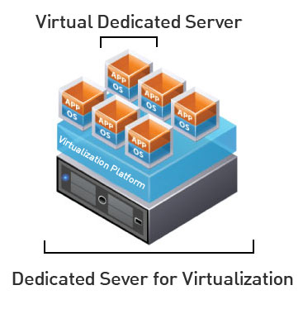
Virtual Machines
IP Address: 147.64.243.1## (01-25)
Hostname: ecsc325-1##.cs.edinboro.edu (01-25)
Alias: 31##.megastuff.biz (01-25)
1##, ##, 31##, more?
Assignment 3 tasks – Initial config – Due February 12th
Initial configs
Check script: http://jpatalon.cs.edinboro.edu/ecsc325/classfiles/assignment3check.sh
Assignment 4 tasks – Additional config – Due February 12th
Users, groups, sudoers, terminal commands, documentation…
Check script: http://jpatalon.cs.edinboro.edu/ecsc325/classfiles/assignment4check.sh
Accessing VM’s from off campus requires a connection to the CS VPN first, before opening a connection to your machine!
CS firewall prevents direct connections from other networks to our VM’s!
Once VPN is active: ssh user@ecsc325-1##.cs.edinboro.edu
We will use the aliases in the future…

Slide 38
ECSC 325.200 Web Server Administration
Spring 2025 – Week 5-2 – February 13th, 2025
Web ServeRs & Such Things
Prof. Jason Patalon

Slide 39

Connecting to our VM’s
New method of connecting to CS Network
Connect to VPN
Windows Thick Client
Windows L2TP
MacOS L2TP
Chromebook/Linux L2TP?
Untested…
EUP-CS VPN
Remote host: 147.64.2.12 (vpn.cs.edinboro.edu or vpn.ultrastuff.net)
Pre-Shared Key: <credentials.txt>
Username and password for students
Username: <credentials.txt>
Password: <credentials.txt>
Creds in credentials.txt

Slide 40
Create a VPN Connection – Windows Client
Windows – Sonicwall VPN Client
Download and install the client
https://software.sonicwall.com/GlobalVPNClient/184-011921-00_REV_A_GVCSetup64.exe
Give the connection a name: EUP-CS VPN
Remote host: 147.64.2.12 (vpn.cs.edinboro.edu or vpn.ultrastuff.net)
Pre-Shared Key: <credentials.txt>
Username and password for students
Username: <credentials.txt>
Password: <credentials.txt>
Enable the connection!
Creds in credentials.txt

Slide 41
Create a VPN Connection – Windows L2TP
Windows – Layer 2 Tunneling Protocol (L2TP/IPsec)
Start → Settings → Network & Internet → VPN
Add VPN
Give it a name: EUP-CS VPN
Server address: 147.64.2.12 (vpn.cs.edinboro.edu or vpn.ultrastuff.net)
VPN Type: L2TP/IPSec with pre-shared key
Pre-Shared Key: <credentials.txt>
Username and password for students
Username: <credentials.txt>
Password: <credentials.txt>
Connect on the VPN network!
You may need to enable the option to tunnel all traffic through the VPN…
Creds in credentials.txt

Slide 42
Create a VPN Connection – MacOS L2TP
Mac OS – Layer 2 Tunneling Protocol (L2TP/IPsec)
System Preferences → Network
Three dots in lower right corner → Add VPN Config → L2TP over IPSec
Give it a name: EUP-CS VPN
Server address: 147.64.2.12 (vpn.cs.edinboro.edu or vpn.ultrastuff.net
Pre-Shared Key: <credentials.txt>
Username and password for students
Username: <credentials.txt>
Password: <credentials.txt>
Connect on the VPN network!
You may need to enable the option to tunnel all traffic through the VPN…
Creds in credentials.txt

Slide 43
Create a VPN Connection – Chromebook L2TP/IPsec
Chromebook – Layer 2 Tunneling Protocol (L2TP/IPsec)
Settings→ Network
Add built-in VPN → Add connection
Give it a name: EUP-CS VPN
Authentication type: Pre-shared key
Server hostname: 147.64.2.12 (vpn.cs.edinboro.edu or vpn.ultrastuff.net)
Pre-Shared Key: <credentials.txt>
Username and password for students
Username: <credentials.txt>
Password: <credentials.txt>
Connect on the VPN network!
You may need to enable the option to tunnel all traffic through the VPN…
https://support.google.com/chromebook/answer/1282338?hl=en#zippy=%2Cltpipsec-vpn-support
Creds in credentials.txt

Slide 44
Connect to CS VPN with a SSH Connection
Open a command prompt terminal
In Windows, a cmd shell or powershell
In Linux, your default command line shell
SSH to the server jpatalon.cs.edinboro.edu on port 54321
You will need to use the format of username@jpatalon.cs.edinboro.edu to specify the correct username when connecting!
The username and password are contained in the credentials file within D2L
Example connection commands
ssh user@jpatalon.cs.edinboro.edu -p 54321
Creds in credentials.txt
ssh cs_student@jpatalon.cs.edinboro.edu –p 54321

Slide 45
Assignment 5
Questions about file listings/permissions/ownership/etc
Short answer questions about DNS terminology
DNS SOA/WHOIS value lookups
Classful and Classless IP address examples
DNS record examples
Due February 19th, 2025
https://jpatalon.cs.edinboro.edu/ecsc325/Assignment%205.pdf

Slide 46
Server Configuration
Install PHP
dnf install php
New php-fpm service is installed!
Main PHP configuration file located at /etc/php.ini
PHP adds a configuration file to Apache
/etc/httpd/conf.modules.d/10-php.conf
Apache needs restarted to pick up new config file!
systemctl restart httpd.service
Create a new document /var/www/html/index.php
<?php
phpinfo();
?>
Open new php web page:
VM’s: http://ecsc325-1##.cs.edinboro.edu/index.php
php-fpm service!

Slide 47
Server Configuration
Change Default Index Page
Edit apache configuration file /etc/httpd/conf/httpd.conf
Find the DirectoryIndex setting, change to below:
DirectoryIndex index.php index.html
Apache needs restarted (again) to pick up changed config file
systemctl restart httpd.service
Disable phpinfo?!
Edit /etc/php.ini file, add phpinfo to disable_functions
disable_functions = phpinfo
Restart php-fpm service
systemctl restart php-fpm
Refresh Website
Re-enable, restart php-fpm, and refresh page again
Phpinfo can be considered a security risk, but we want it enabled for now!

Slide 48
Server Configuration
MariaDB – A fork of MySQL, intended as a drop in replacement
Install MariaDB
dnf install mariadb-server
Start and enable MariaDB
systemctl start mariadb.service
systemctl enable mariadb.service
Secure the MariaDB Service
mysql_secure_installation
Set root password, remove anonymous users, disallow root remote login, remove test database, reload privileges.
Log in to MariaDB
mysql –u root –p
help;
exit;

Slide 49
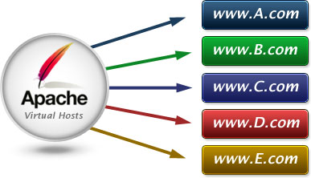
Virtual Host Configurations
Virtual hosts have been created for each student
31## Virtual hosts use a CNAME DNS records to point to student’s records
3125.megastuff.biz canonical name = ecsc325-125.cs.edinboro.edu.
1## Virtual hosts use A record to IP address
Name: 125.megastuff.biz
Address: 147.64.243.125
VM’s: http://1##.megastuff.biz and http://31##.megastuff.biz
NUMBER is 01-25 (ex: 101-125 and 3101-3125)
Ex: http://125.megastuff.biz and http://3125.megastuff.biz points to http://ecsc325-125.cs.edinboro.edu
Make note of your virtual hosts!
Remember, direct VM connections only work on CS network!
Must connect through VPN!

Slide 50
Virtual Host Configurations
Before creating virtual hosts, we need to explicitly set our default host!
Create the file /etc/httpd/conf.d/00-localhost.conf
<VirtualHost *:80>
ServerName ecsc325-1##.cs.edinboro.edu
ServerAlias 147.64.243.1##
DocumentRoot "/var/www/html"
</VirtualHost>
This will ensure that traffic to the default hostname or server IP go to the default location
Restart apache to apply new configuration file
We shouldn’t notice anything different on our website yet…
http://ecsc325-1##.cs.edinboro.edu
Replace the ## with your 2-digit number!

Slide 51
Virtual Host Configurations
Create the http://31##.megastuff.biz virtual host
Create the file /etc/httpd/conf.d/31##.conf
<VirtualHost *:80>
ServerName 31##.megastuff.biz
DocumentRoot "/var/www/31##"
</VirtualHost>
Create the 31## folder mentioned above!
mkdir /var/www/31##
Create an index page in for the new virtual host!
echo Hello Megastuff > /var/www/31##/index.html
Restart Apache and check if it worked!
Visit http://31##.megastuff.biz
Validate our old site still works – should display phpinfo!
Visit: http://ecsc325-1##.cs.edinboro.edu
Visit: http://147.64.243.1##
Replace the ## with your 2-digit number!

Slide 52
Virtual Host Configurations
Create the http://31##.megastuff.biz:81 virtual host
Create the file /etc/httpd/conf.d/31##p81.conf
<VirtualHost *:81>
ServerName 31##.megastuff.biz
DocumentRoot "/var/www/31##p81"
</VirtualHost>
Create the 31## folder mentioned above!
mkdir /var/www/31##p81
Create an index page in for the new virtual host!
echo Hey there port 81 > /var/www/31##p81/index.html
Have to add a statement to allow listening on port 81!
Details on the next slide! Yay!
Don’t forget to restart apache after changing .conf files!
systemctl restart httpd
Replace the ## with your 2-digit number!

Slide 53

Virtual Host Configurations
Create the http://31##.megastuff.biz:81 virtual host
We have to also edit our main httpd.conf file to listen on port 81!
Edit the file /etc/httpd/conf/httpd.conf and add this line below the “Listen 80” line:
Listen 81
It should look like this when done:
Restart Apache and check if it worked!
Visit http://31##.megastuff.biz:81
Validate our old sites still work – should still display phpinfo!
Visit: http://ecsc325-1##.cs.edinboro.edu
Visit: http://147.64.243.1##
Replace the ## with your 2-digit number!

Slide 54

Configure
Install nslookup, whois, and dig commands
Install Apache and create default web page
Use dig or nslookup to perform record lookups
Write data to specified /tmp/ files
Perform a long listing of files in /etc/httpd
Write data to specified /tmp/ files
Find the information for a .net TLD server
Write data to specified /tmp/ files
Update your system
Reboot
Assignment 6

Slide 55
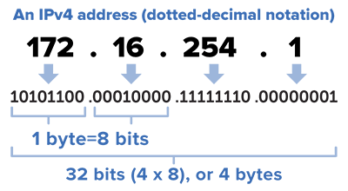
Finding IP address ranges
Consider the following CIDR mask: 147.64.242.128/23
Convert the IP address to binary
10010011.01000000.11110010.10000000
Convert netmask to binary
/23 = 255.255.254.0 = 11111111.11111111.11111110.00000000
Find the opposite binary netmask (the host portion - swap 1’s and 0’s)
11111111.11111111.11111110.00000000 → 00000000.00000000.00000001.11111111
Do bitwise AND on the binary IP and netmask to find starting IP:
IP Address: 10010011.01000000.11110010.10000000
Netmask: 11111111.11111111.11111110.00000000
Starting IP: 10010011.01000000.11110010.00000000
Convert new binary number to decimal
10010011.01000000.11110010.00000000 = 147.64.242.0
This is our starting IP address for the range!
The first IP in the range is reserved for the “Network ID”

Slide 56
Finding IP address ranges
Consider the following CIDR mask: 147.64.242.128/23
Convert the IP address to binary
10010011.01000000.11110010.10000000
Convert netmask to binary
/23 = 255.255.254.0 = 11111111.11111111.11111110.00000000
Find the opposite binary netmask (the host portion - swap 1’s and 0’s)
11111111.11111111.11111110.00000000 → 00000000.00000000.00000001.11111111
Do bitwise OR on the binary IP and opposite mask to find ending IP:
IP Address: 10010011.01000000.11110010.10000000
Netmask: 00000000.00000000.00000001.11111111
Ending IP: 10010011.01000000.11110011.11111111
Convert new binary number to decimal
10010011.01000000.11110010.00000000 = 147.64.243.255
This is our ending IP address for the range!
Put them together, we have 147.64.242.0 - 147.64.243.255
The last IP in the range is reserved for the “Broadcast address”

Slide 57

Broadcast Address
A network address which will broadcast packets to all hosts connected to that network
“The all-ones host”
The last IP address in an IP address range
EUP CS Department: 147.64.243.255/23
Only used by IPv4
IPv6 uses a “all-hosts multicast group” to accomplish similar functionality more efficiently
Data sent to a broadcast address isn’t routed
This keeps the broadcast packet within the local network
Necessary for DHCP
Often sent to IP address 255.255.255.255
Helper addresses used if DHCP server in a different subnet
Layer 2 broadcasts to MAC address FF:FF:FF:FF:FF:FF
Default Gateway
Next hop in transmitting my traffic be default

Slide 58
Understanding HTTP
As an example, in a web browser you type: http://jpatalon.ultrastuff.net
Web browser contacts DNS server to resolve IP address
That was a multi-step process…
DNS server returns IP address to browser
Web browser composes a request using IP address to port 80
Request will include host name
Web Browser assumes port 80 if no port is specified
Web server is configured to return index page if no page is specified
Web server may return directory listing if no index.html is found
GET / HTTP/1.1
Host: jpatalon.ultrastuff.net

Slide 59
Understanding HTTP
We can manually connect to a website and download webpages with telnet or a similar application
Telnet application would need installed on our VM’s
dnf provides */telnet
dnf install telnet
Open telnet connection with following command:
telnet hostname port
Ex: telnet jpatalon.ultrastuff.net 80
Watch for “Connected to” message indicating connection success
Connected to jpatalon.ultrastuff.net.
Escape character is '^]'.
Download the default webpage with the following commands:
GET / HTTP/1.1
Host: jpatalon.ultrastuff.net

Slide 60

HTTP Services
HTTP Described in RFC’s 7230-7235
HTTP versions 1.1 and 2.0 most widely used
HTTP port 80 / HTTPS port 443
Client connects to server, issues HTTP commands
GET, HEAD, POST, etc.
Filename to get, server hostname to use, port to use, additional details
Apache
Apache typically runs as user apache, group apache
The Apache user or group needs access to the files!
Additional modules provide additional functionality
SSL, authentication, CGI scripts, etc.
Apache configuration files
/etc/httpd – Main Apache directory
/etc/httpd/conf/httpd.conf – Main Apache configuration file
/etc/httpd/conf.d/ - Additional Apache configuration file directory

Slide 61
HTTP Example
Telnet to google.com on port 80
Install telnet with dnf!
dnf install telnet
telnet www.google.com 80
Issue a get command
GET / HTTP/1.1
User-Agent: Mozilla/4.0 (compatible; MSIE5.01; Windows NT)
Host: www.google.com
Accept-Language: en-us
Accept-Encoding: gzip, deflate
Connection: Keep-Alive
Enter a blank line to finish the command
Default search page HTML should be returned

Slide 62
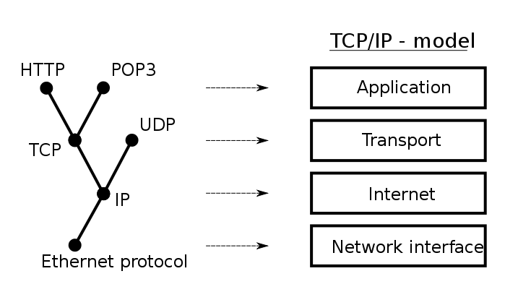
Ports
“An endpoint of communication in an operating system”
A port, combined with an IP and a protocol, creates communications session
Generally, different source and destination IP’s and ports are necessary
əˈfem(ə)rəl
Source
10.11.187.23 TCP port 57532
10.11.187.23:57532
Ephemeral port!
A short-lived port opened by the OS when a program requests a connection to a port, released after the conversation finishes. Generally in the range 49152 to 65535 (IANA Suggestion).
Sometimes in the range 1024-65535
Typically only root can open a port lower than 1024
Destination
192.168.53.79 TCP port 80
192.168.53.79:80
Defined service ports
Notes:
By Jsoon eu (talk) - I (Jsoon eu (talk)) created this work entirely by myself., CC BY-SA 3.0, https://en.wikipedia.org/w/index.php?curid=29962617

Slide 63
Ports
“An endpoint of communication in an operating system”
A port, combined with an IP and a protocol, creates communications session
Generally, different source and destination IP’s and ports are necessary
session
Multiple services cannot use the same port & protocol at the same time!
TCP and UDP ports are different, so one application can listen on TCP port 80, and another on UDP port 80.
Data is returned on the ephemeral port
NAT will maintain this connection information, to ensure return data is sent to the appropriate internal host IP address
Point of entry to a machine and service
Notes:
By Jsoon eu (talk) - I (Jsoon eu (talk)) created this work entirely by myself., CC BY-SA 3.0, https://en.wikipedia.org/w/index.php?curid=29962617

Slide 64
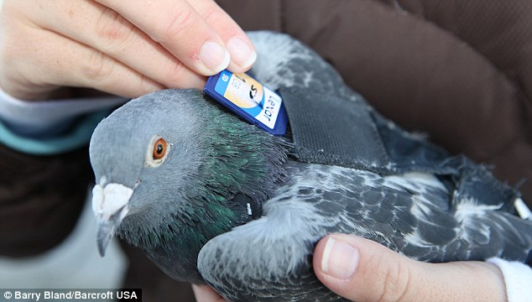
Request for Comments (RFC)
A formal document that can become the standard for an internet technology.
Some may be simply informative in nature
Document created by the Internet Engineering Task Force (IETF) and the Internet Society (ISOC)
Created by committee drafting and review by interested parties
Newer RFC’s can extend or replace previous RFC’s
RFC 1149: A Standard for the Transmission of IP Datagrams on Avian Carriers
RFC 2549: IP over Avian Carriers with Quality of Service
RFC 6214: Adaptation of RFC 1149 for IPv6

Slide 65
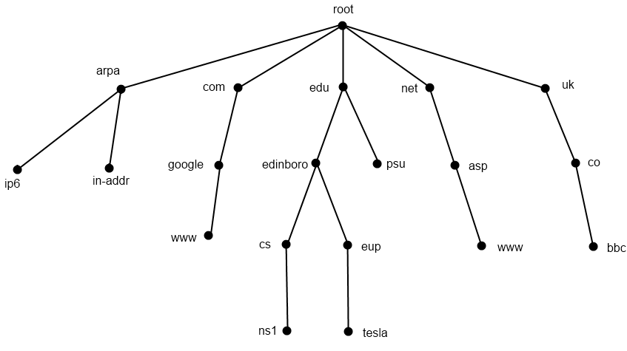
DNS - Hierarchical View
13 root nameserver maintainers!
Notes:
13 Root nameservers maintainers, such as verisign, nasa & U of Maryland
259 total root servers (as of 11/30/11)
273 TLD’s
63 characters per level
127 levels max
253 characters per FQDN

Slide 66
Root Hints vs. DNS Forwarders
When the recursive DNS server can't resolve a query using its cache or database, it will send a query to a root DNS server; this would be an iterative query.
The root server will respond with information containing the addresses of the DNS servers authoritative for the TLD (top-level domain, such as .com or .net) in the original query.
The TLD DNS servers will then respond with the information for the Second Level Domain.
This process will continue until an authoritative answer to the query can be given.
DNS forwards will instead do this work on behalf of your DNS server, providing a response to your DNS server which will then return the result to you.
Instead of your server recursively querying the root, TLD, and SLD servers, another server does this for you
Potential for abuse?!
DNS Forwarders!
Root Hints!

Slide 67
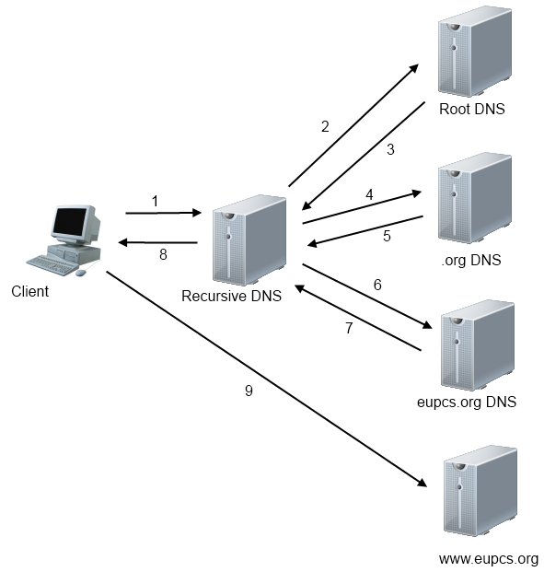
Recursive DNS Transaction
Root Hints!

Slide 68
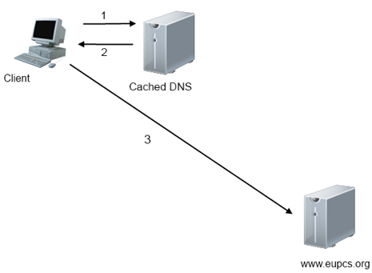
Cached DNS Transaction

Slide 69
Literal Recursive DNS Transaction
First, we need to know the IP addresses of the root nameservers
These are called Root Hints, maintained on a recursive DNS server
dig ns .
Ask the Root nameservers for the nameservers for the .edu Top Level Domain
dig ns edu @a.root-servers.net
Ask the .edu nameservers for the nameservers for the edinboro.edu domain
dig ns edinboro.edu @a.edu-servers.net
Ask the edinboro.edu nameservers for the cs.edinboro.edu nameservers
dig ns cs.edinboro.edu @dmz-host.edinboro.edu
Ask the cs.edinboro.edu nameservers for the ecsc325-125.cs.Edinboro.edu IP address
dig a ecsc325-125.cs.edinboro.edu @ns1.cs.edinboro.edu
Root Hints!

Slide 70

Whois Records
More detailed information specifically about the domain
whois eupcs.org
Registrant ID:CR36875534
Registrant Name:Jason Patalon
Registrant Organization:Edinboro University Computer Science Club
Registrant Street1:Doucette Hall Room 200
Registrant Street2:215 Meadville St.
Registrant Street3:
Registrant City:Edinboro
Registrant State/Province:Pennsylvania
Registrant Postal Code:16444
Registrant Country:US
Registrant Phone:+1.8147322000
Registrant Phone Ext.:
Registrant FAX:
Registrant FAX Ext.:
Registrant Email:jpatalon@edinboro.edu
This is an old example…

Slide 71
DNS Versions
The version of a DNS server can be queried with the following command:
dig @nameserver version.bind txt chaos
Ex: dig @ns1.megastuff.biz version.bind txt chaos
;; QUESTION SECTION:
;version.bind. CH TXT
;; ANSWER SECTION:
version.bind. 86400 CH TXT "Salt-master"
Ex: dig @edinborodc02.edinboro.edu version.bind txt chaos
;; QUESTION SECTION:
;version.bind. CH TXT
;; ANSWER SECTION:
version.bind. 1476526080 IN TXT "Microsoft DNS 6.1.7601 (1DB15D39)"

Slide 72
Source-Based DNS (Geo-Location)
DNS servers can be configured to give different responses depending on the querying source
Internal vs. External
Internally, you may be able to resolve DNS address that you don’t want to expose externally
Different nameservers for different query sources
Only expose certain records to certain sources
Internal server records only exposed internally
Geo-location based DNS responses – provide a different response based on your location
Geo-restrictions or geo-blocking
Can force users of specific locations to use specific DNS services
Services like SmartDNS and Unblock-us provide workarounds at a cost
You use these services as your DNS resolver, it looks up addresses on your behalf from a different geographic location
Edinboro uses source-based DNS to provide different responses internally vs. externally
Lookup the NS records for edinboro.edu from on campus and also from off campus…
Split-Brain DNS or Split-Horizion

Slide 73
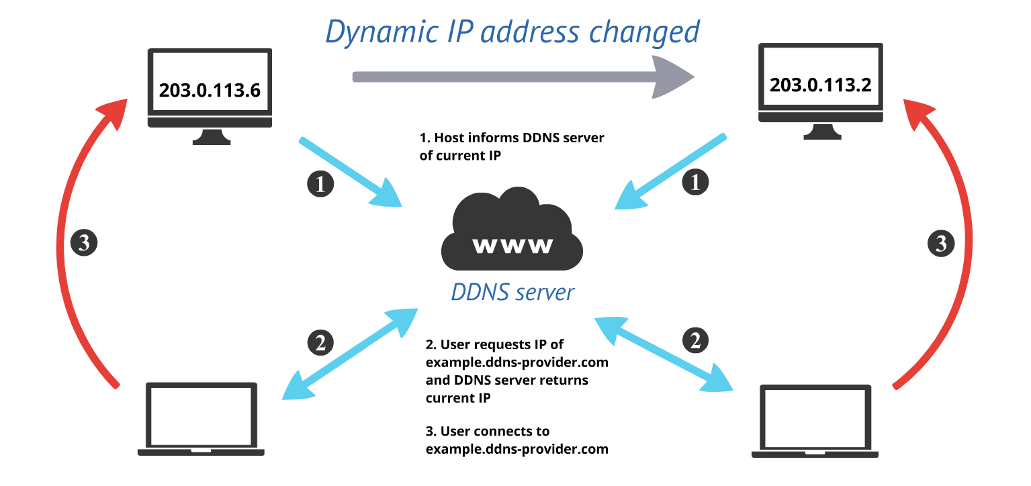
Dynamic DNS (DDNS)
Automatically updating a DNS record in real-time
Often used with DHCP
DHCP server hands out an IP address, and updates the DNS server with the new name/IP record
Company desktops or laptops that may receive different IP addresses
Users connect to company desktops or laptops by hostname
Commercial solutions can provide Dynamic DNS services to consumers
Your home IP address may change at the whim of the ISP
An application can be configured to provide IP updates to a service provider
DynDNS or similar providers
Some services are free to non-commercial users!
Make sure I can always connect to my house, no matter what my IP address is!

Slide 74
Apache Installation
Apache can be installed during initial OS installation, or added later
We will install Apache manually
Firewall must be stopped to allow traffic!
By default our firewall is blocking traffic to our web server ports!
Firewall needs to be disabled from starting on boot!
Optionally firewall can be configured to allow specified traffic
We would allow ports 80 and 443, for http and https traffic, respectively.
We already installed Apache and did the necessary initial configurations

Slide 75
Apache Commands
Operating System Apache commands (RHEL/Fedora/CentOS/etc. specific):
systemctl start httpd.service – start the Apache web service
systemctl stop httpd.service – stop the Apache web service
systemctl restart httpd.service – restart the Apache web service
systemctl status httpd.service – check the status of the Apache web service
Native Apache commands:
apachectl start – start the Apache web service
apachectl stop – stop the Apache web service
apachectl restart – restart the Apache web service
apachectl status – check the status of Apache
Many more available in manual pages:
man apachectl

Slide 76
Apache Configuration
Main Apache configuration file is located at /etc/httpd/conf/httpd.conf
Different Linux distributions may store config file in different location
Manually building and configuring Apache may result in a different config file location
Additional configuration files can be located in conf.d directory
Example: /etc/httpd/conf.d/welcome.conf
Main Apache configuration file is separated into 3 sections
Global Section – Controls server overall operation
Main Section – Configuration of default server
Virtual Hosts Section – Settings for virtual hosts
Apache needs to be restarted when modifying configuration files!
systemctl restart httpd.service

Slide 77
Apache Configuration
Virtual Hosts - Configuration example:
<VirtualHost *:80>
ServerName anotherdomain.net
DocumentRoot /home/anotherdomain/public_html
ErrorLog /var/log/httpd/anotherdomain.net_error_log
DirectoryIndex index.html index.htm index.php
<Directory /home/anotherdomain/public_html>
allow from all
AllowOverride All Options=ExecCGI,Includes,Indexes,MultiViews
</Directory>
</VirtualHost>
Alias /files /tmp/files

Slide 78
Firewall
A part of a computer system or network that is designed to block unauthorized access while permitting authorized communication.
Can block traffic coming in, going out, or both
Our servers use the FirewallD service to manage the firewall
Firewalld is a dynamic firewall manager, managing netfilter rules
Firewalld is configured with the firewall-cmd command
Add or remove rules, list services, configure zones
Firewalld uses different zones, to specify trust levels for certain connections
Local connections may be trusted more than internet connections
Home, work, public, private, school, etc. types of networks
For now, we will simply disable our firewall
We will configure it later in the semester!
Yeah yeah, this is a bad practice…
*cringe*

Slide 79
Virtual Host Configurations
Virtual hosts have been created for each student
31## Virtual hosts use a CNAME DNS records to point to student’s records
3125.megastuff.biz canonical name = ecsc325-125.cs.edinboro.edu.
1## Virtual hosts use A record to IP address
Name: 125.megastuff.biz
Address: 147.64.243.125
VM’s: http://1##.megastuff.biz and http://31##.megastuff.biz
NUMBER is 01-25 (ex: 101-125 and 3101-3125)
Ex: http://120.megastuff.biz and http://3120.megastuff.biz points to http://ecsc325-120.cs.edinboro.edu
Make note of your virtual hosts!
Remember, you must log on to CS VPN first!
SOCKS proxy SSH tunnel workaround available…

Slide 80

All-In-One Network Devices
Linksys E2500
Router
Separates two distinct networks
Network Switch
Allows multiple computers to be connected to the same network
DHCP Service
Dynamic Host Configuration Protocol
Allows clients to automatically be assigned IP addresses
DNS Forwarding Service
Allows for permitted clients to use device as a DNS server
NAT Device
Allows for a private internal network to share a public IP address

Slide 81
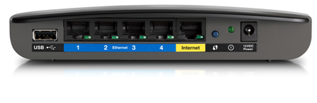
All-In-One Network Devices
Linksys E2500
Firewall and port forwarding
Allows for opening and forwarding of specific ports for specific services
Ex: Anyone coming in from the internet on port 80 should go to local IP 192.168.0.187 port 8080
Wireless Access Point
Provides both 2.4GHz and 5GHz radios
Allows for 802.11a/b/g/n connections
Various wireless security settings
Guest wireless networks
QoS Traffic Management
USB Connection
Can provide NAS-like network storage
Much More!

Slide 82

LAMP Stack
Linux Operating System
CentOS 9 in our class
Apache Web Server
MySQL Database Services
We replaced with MariaDB
PHP, Perl, Python
We installed PHP
We can optionally install others
Web Applications
Top layer running on our LAMP Stack

Slide 83

Systemctl Service Commands
systemctl <command> <service>
Command can be one of many, such as:
start, stop, restart, reload, status
enable, disable, is-enabled, is-active
Examples
systemctl start httpd.service
systemctl status httpd.service
systemctl restart httpd.service
systemctl enable httpd.service
You can omit the trailing .service…
Services can be listed with:
systemctl list-unit-files

Slide 84

Megastuff.biz Domain
Purchased from Google Domains (registrar)
Previously I used megastuff.online, but it cost too much to renew
I got megastuff.biz now.
I also moved from GoDaddy to Google Domains, saved some more money. Now moved to Squarespace…
Configured to use existing personal DNS servers
Set NS records at Registrar
Create A and AAAA records for NS servers at Registrar
These are the glue records!
Create A and AAAA records for megastuff.biz domain
Used existing DNS servers
Create CNAME and A records for student Virtual Hosts
##.megastuff.biz A record
1##.megastuff.biz A record
31##.megastuff.biz CNAME record
Not the case anymore…

Slide 85
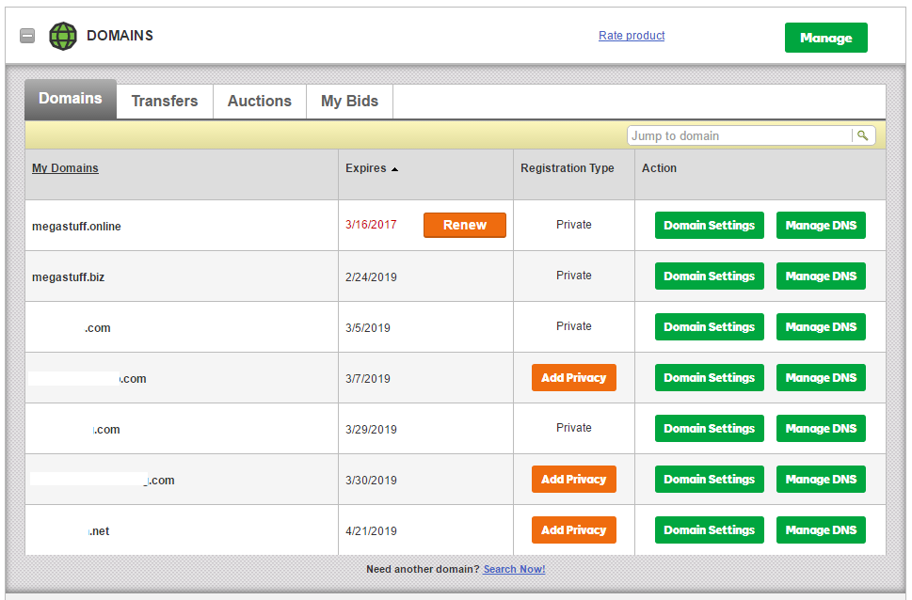
Megastuff.biz Domain - GoDaddy
Domains list at GoDaddy

Slide 86
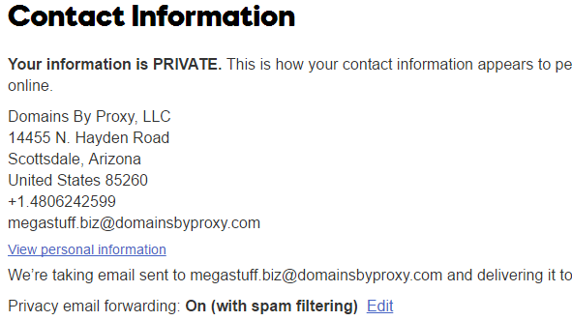
Megastuff.biz Domain - GoDaddy
WHOIS record information at GoDaddy

Slide 87
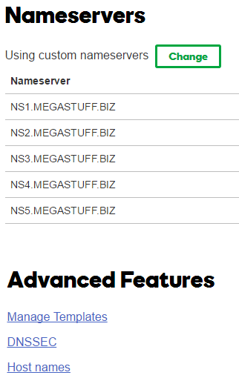
Megastuff.biz Domain - GoDaddy
Nameservers Section at GoDaddy
These are NS records at parent!

Slide 88
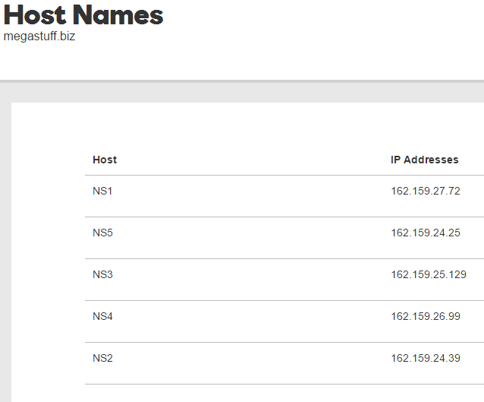
Megastuff.biz Domain
Host Names Section at GoDaddy
These are glue records at parent!

Slide 89
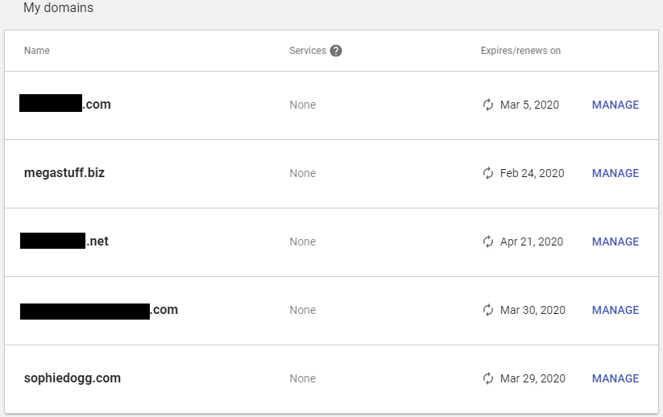
Megastuff.biz Domain
Domains List at Google

Slide 90
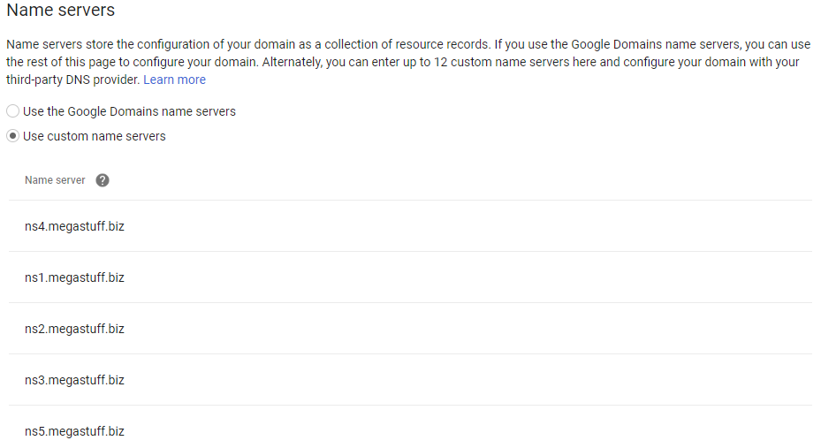
Megastuff.biz Domain
Nameservers Section at Google
These are NS records at parent!

Slide 91
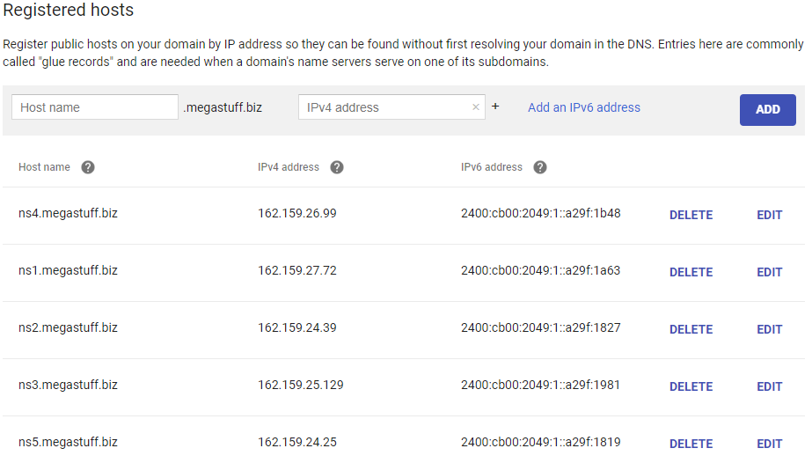
Megastuff.biz Domain
Hosts Section at Google
These are glue records at parent!

Slide 92

Virtual Hosts – Megastuff.biz DNS
$ORIGIN megastuff.biz.
$TTL 3600 ; 1 hour
@ IN SOA ns1.megastuff.biz. admin.megastuff.biz. (
2018000000 ; serial number
140 ; refresh (14400-43200)
36 ; update retry (3600-?)
120960 ; expiry (1209600-2419200)
300 ) ; nxdomain ttl (300-86400)
IN NS ns1.megastuff.biz.
IN NS ns2.megastuff.biz.
IN MX 10 mail.megastuff.biz.
IN MX 20 mail2.megastuff.biz.
IN TXT "v=spf1 mx ?all"
IN A 167.88.8.165
mail IN A 66.228.37.203
mail2 IN A 66.228.37.203
ns1 IN A 162.159.27.72
ns2 IN A 162.159.24.39
ns1 IN AAAA 2400:cb00:2049:1::a29f:1a63
ns2 IN AAAA 2400:cb00:2049:1::a29f:1827
ipv4 IN A 66.228.37.203
ip4 IN CNAME ipv4
m IN CNAME megastuff.biz.
www IN CNAME megastuff.biz.
gallery IN CNAME megastuff.biz.
home IN A 10.11.187.1
Notice the trailing periods!

Slide 93
Virtual Hosts – Megastuff.biz DNS
ns5 IN A 10.0.0.1
ns5 IN AAAA 2400:cb00:2049:1::a29f:1819
ipv4 IN A 66.228.37.203
ip4 IN CNAME ipv4.megastuff.biz.
m IN CNAME megastuff.biz.
www IN CNAME megastuff.biz.
gallery IN CNAME megastuff.biz.
01 IN A 147.64.243.101
02 IN A 147.64.243.102
…
25 IN A 147.64.243.125
101 IN A 147.64.243.101
102 IN A 147.64.243.102
…
125 IN A 147.64.243.125
3101 IN CNAME ecsc325-101.cs.edinboro.edu.
3102 IN CNAME ecsc325-102.cs.edinboro.edu.
…
3125 IN CNAME ecsc325-125.cs.edinboro.edu.
Notice the trailing periods!

Slide 94
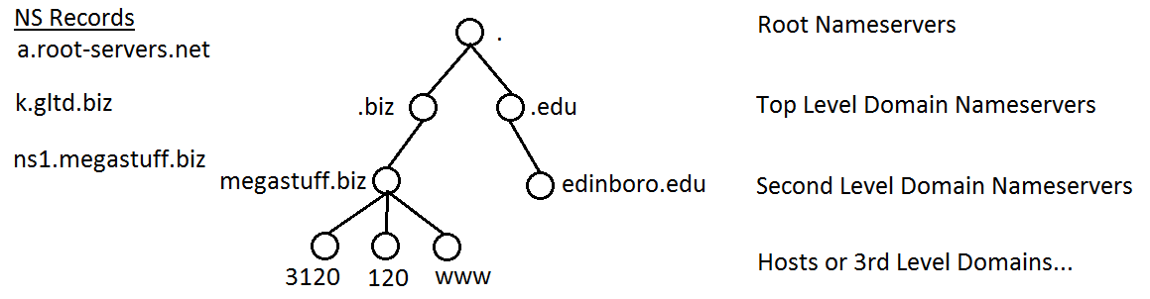
DNS Hierarchy
Notes:
There are 13 root nameserver maintainers, a.root-servers.net through m.root-servers.net. Each maintainer has multiple servers in a redundant and fault tolerant setup providing root DNS services.

Slide 95
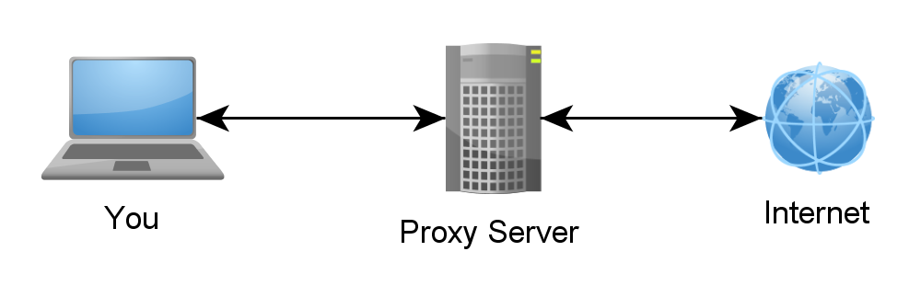
SSH Tunnels
SSH Tunnels are secure and encrypted between endpoints!
Local port forwarding
Similar to port forwarding on a router
ssh –L source_port:destination_host:destination_port user@host.tld
Ex: ssh –L 5454:ecsc325-125.cs.edinboro.edu:22 jpatalon@cslab100.cs.edinboro.edu
This command opens an encrypted tunnel between my local machine and ssh server cslab100.cs.edinboro.edu
Traffic sent to localhost port 5454 is redirected to ecsc325-125.cs.edinboro.edu port 22

Slide 96
SSH Tunnels
SOCKS (Dynamic) Proxy
Allows for website proxying
Can be used to allow connections around firewalls
Connect to your ecsc325 web server from anywhere through an intermediate host
ssh –D port user@host.tld
Ex: ssh –D 55555 jpatalon@cslab100.cs.edinboro.edu
This command opens an encrypted tunnel between my local machine and ssh server cslab100.cs.edinboro.edu
Web SOCKS traffic is sent through port 5555 to server cslab100.cs.edinboro.edu, where it is then forwarded to the destination

Slide 97
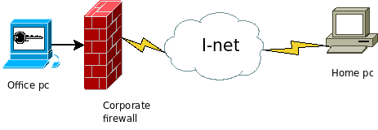
SSH Tunnels
Reverse SSH Tunnel
Initiate a connection from within a network to a remote location, allowing reverse traffic
Notes:
Reverse SSH images from toic.org

Slide 98
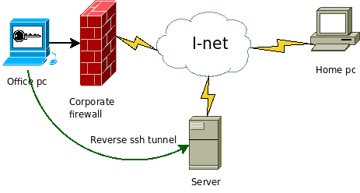
SSH Tunnels
Reverse SSH Tunnel
Initiate a connection from within a network to a remote location, allowing reverse traffic
Reverse SSH tunnel opened from office PC to outside server
Notes:
Reverse SSH images from toic.org

Slide 99
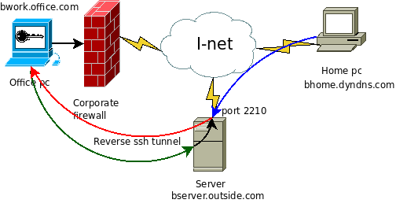
SSH Tunnels
Reverse SSH Tunnel
Initiate a connection from within a network to a remote location, allowing reverse traffic
Reverse SSH tunnel opened from office PC to outside server
Outside server now has encrypted path inside corporate firewall
Notes:
Reverse SSH images from toic.org

Slide 100
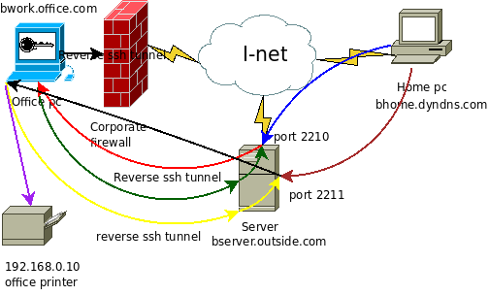
SSH Tunnels
Reverse SSH Tunnel
Initiate a connection from within a network to a remote location, allowing reverse traffic
Reverse SSH tunnel opened from office PC to outside server
Outside server now has encrypted path inside corporate firewall
Traffic can now be routed through the office pc to the internal network, bypassing firewall and security measures
Server bserver.outside.com is hiding true source of bhome.dyndns.com
Many corporate firewalls block outbound traffic for this reason!
Notes:
Reverse SSH images from toic.org

Slide 101
Documentation Expectations
Documentation expectations examples:
Edit the network configuration file /etc/sysconfig/network-scripts/ifcfg-bond0
Updated the following information in the network configuration file:
IPADDR=147.64.243.115
HOSTMASK=255.255.254.0
DNS1=147.64.242.100
DNS2=147.64.242.101
Restarted the network services to apply configuration changes
systemctl restart network
Added entry to /etc/fstab file for persistent mount
147.64.243.115:/data /data nfs bg,rw,sync,hard,intr 0 0
Updated and rebooted the system
dnf -y update; reboot

Slide 102
Linux Commands
ls
cd
chmod
chown
chgrp
ssh
nslookup
dig
whois
dnf
reboot
vi
nano
joe

Slide 103

Key Terms and Items
CLI
File Permissions
File Ownership
SSH tunnels
DNS
Root domain
Top Level Domain (TLD)
Second Level Domain
TTL
FQDN
Subnetting
Host Masks
DNS Record Types
IPv4
IPv6
Glue Records
Root Hints
DNS Server Types
Whois Records
DNS Best Practices
DNS Checks

Slide 104

For Next Week
Life is like riding a bicycle. In order to maintain balance, you must keep moving
Textbook:
Chapter 5 – Managing Users & Groups
Chapter 6 – Booting & Shutting down
Chapter 18 – Apache
Chapter 19 – SMTP
Assignment 5
Due Feb 19th, 2025
Next week topics…
More web server configs and some email stuff

