Slide 1
ECSC 325.200
Web Server Administration
Spring 2025 – Week 9.1 – March 11th, 2025
E-Mail Reviews and File Transfer Services
Prof. Jason Patalon

Slide 2

Objectives
E-Mail Review & Implement
  Protocols and definitions
  Install E-Mail services
File Transfer Services
  File Transfer Protocol (FTP)
    History and Usage
    FTP & FTPS
    Commands and Examples
  Secure Copy (SCP)
    SFTP
    Rsync
  Server Message Block Protocol (SMB)
    CIFS
File System Table
  F Stab (f-s-tab)
File Serving Devices
  NAS
  File Server
  Appliance/Device
FTP Server Configuration
  VSFTPD Installation
  FTP Tests

Slide 3

Weekly Info
Nothing can be called a service until it is monitored!
  Monitor, measure, improve!
Attendance…
Assignment 8 due this week…
  WordPress & templates & phpMyAdmin & some webpage stuff
Assignment 9 due next week…
  Email
Good of the class
  Coronavirus
    Stay safe, wash your hands, don’t touch me, quit putting stuff in your mouth

Slide 4

Recap and Review
The next few weeks…
  File transfer services
  Security and authentication
  Network Services
  Monitoring and performance tuning
  Cloud
Corrections, updates, etc.
  Update to our configs – coming later!
  Cs.Edinboro.edu domain gone?!
Questions from previous classes?

Slide 5
Remaining Semester Topics*
File Transfer Services
  FTP
  SCP, SFTP, RSync
  NFS, CIFS, SMB
Network Functions
Security
  HTTP Authentication
  HTTPS/SSL
  Firewall
  SELinux
  Public Key Cryptography
Monitoring
Backups
Performance Tuning
Cloud
Documentation and Config Management
Work Time?
Final Exam
  Hands on portion?
* Exact topics may change

Slide 6

Midterm Review

Slide 7
Assignment 6 Review
Install the packages necessary to perform dns queries using the nslookup, dig, and whois commands. (4 points)
  yum -y install whois bind-utils
Install the apache service httpd. Start the apache service, and configure the apache service to start automatically on boot. Also stop and disable the firewalld service. (5 points)
  yum -y install http
  systemctl start httpd; systemctl enable httpd
  systemctl stop firewalld; systemctl disable firewalld
Create a default index.html page with the phrase “Hello ECSC-325!” and your name on a separate line at your default ecsc325-1## website. (4 points)
  echo "Hello ECSC-325<br>" > /var/www/html/index.html
  echo "Professor J" >> /var/www/html/index.html

Slide 8
Assignment 6 Review
Look up the A records for the google.com domain against an on campus resolver. List this information in the file /tmp/assignment6-1.txt (3 points)
  dig a google.com @147.64.32.6 > /tmp/assignment6-1.txt
  dig a google.com @147.64.243.160 > /tmp/assignment6-1.txt
    This will only work from within the campus network (and maybe not at all?)!
Look up the A records for the google.com domain against an off campus resolver. List this information in the file /tmp/assignment6-2.txt (3 points)
  dig a google.com @101.102.103.104 > /tmp/assignment6-2.txt
Perform a long listing of the /etc/httpd directory, showing all files and information in human readable form. Put the output from this command in the file /tmp/assignment6-3.txt (3 points)
  ls -lah /etc/httpd > /tmp/assignment6-3.txt
Find a name server for the .NET Top-Level-Domain. Put this information in the file /tmp/assignment6-4.txt (3 points)
  dig ns net > /tmp/assignment6-4.txt

Slide 9
Assignment 7 Review
Install PHP, and create a default index.php webpage displaying the output of the phpinfo() command at your ecsc325-1## website. (6 points)
  yum -y install php
  echo "<?php phpinfo(); ?>" > /var/www/html/index.php
Change the default directory index setting to prefer files in the order index.php before index.html. (6 points)
  sed -i 's/DirectoryIndex .*/DirectoryIndex index.php index.html/g' /etc/httpd/conf/httpd.conf
  systemctl restart httpd
Install the MariaDB service mysqld, start the mysqld service, configure the mysqld service to start on boot, and secure the new mysqld server installation. (6 points)
  yum -y install mariadb-server
  systemctl start mariadb; systemctl enable mariadb
  mysql_secure_installation

Slide 10
Assignment 7 Review
Create a /etc/httpd/conf.d/00-localhost.conf apache configuration file, configured for your IP address and ecsc325-1##.cs.edinboro.edu server webpage. (6 points)
  Create the file /etc/httpd/conf.d/00-localhost.conf
    <VirtualHost *:80>
    ServerName ecsc325-1##.cs.edinboro.edu
    ServerAlias 147.64.243.1##
    DocumentRoot "/var/www/html"
    </VirtualHost>
  This will ensure that traffic to the default hostname or server IP go to the default location
  Restart Apache to apply new configuration file
    systemctl restart httpd.service

Slide 11
Assignment 7 Review
Create a /etc/httpd/conf.d/31##.conf apache configuration file, configured for your 31##.megastuff.biz server webpage. Create a “Hello Megastuff” index.html webpage for this virtual host. 6 points)
  Create the file /etc/httpd/conf.d/31##.conf
    <VirtualHost *:80>
    ServerName 31##.megastuff.biz
    DocumentRoot "/var/www/31##"
    </VirtualHost>
  Create the 31## folder mentioned above!
    mkdir /var/www/31##
  Create an index page in for the new virtual host!
    echo Hello Megastuff > /var/www/31##/index.html
Restart Apache!

Slide 12

Assignment 7 Review
Create a /etc/httpd/conf.d/31##p81.conf apache configuration file, configured for your 31##.megastuff.biz:81 server webpage. Create a “Hey there port 81” index.html webpage for this virtual host. Note that this is on port 81! (6 points)
  Create the file /etc/httpd/conf.d/31##p81.conf
    <VirtualHost *:81>
    ServerName 31##.megastuff.biz
    DocumentRoot "/var/www/31##p81"
    </VirtualHost>
  Create the 31## folder mentioned above!
    mkdir /var/www/31##p81
  Create an index page in for the new virtual host!
    echo Hey there port 81 > /var/www/31##p81/index.html
    Edit the file /etc/httpd/conf/httpd.conf and add this line below the “Listen 80” line:
      Listen 81
      It should look like this when done:
    Restart Apache

Slide 13
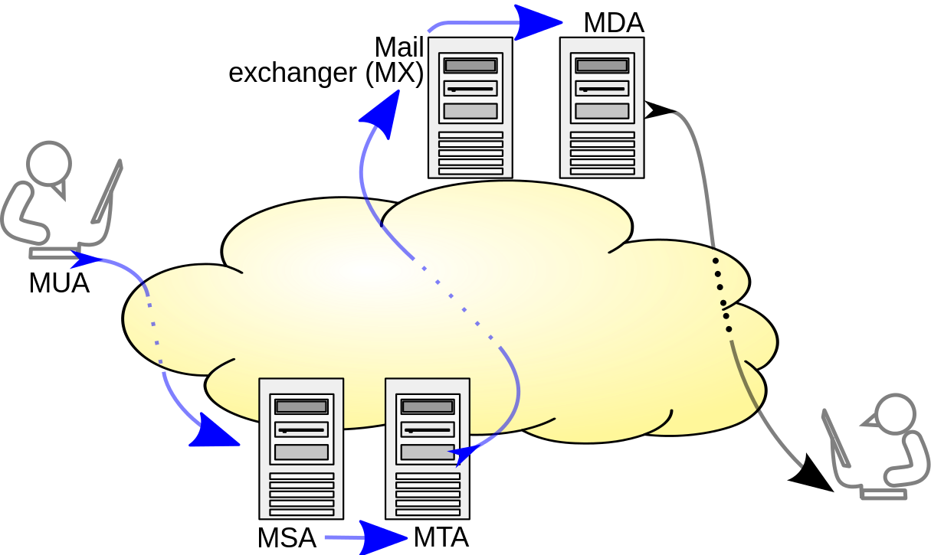
E-Mail System Terminology
MDA – Mail Delivery Agent
  Delivers E-Mail from server to MUA (inbox)
  Integrated with Sendmail, Postfix
MTA – Mail Transfer Agent
  Accepts E-Mail from clients and sends to another MTA for delivery
  Indicated my MX DNS records
  Sendmail, Postfix
MSA – Mail Submission Agent
  Provides address resolution services
  Determines appropriate server to send email to for specified email address
  Looks up MX records for a domain
MUA – Mail User Agent
  E-Mail client
  Outlook, pine, Gmail, SquirrelMail
Multiple functions
can be combined!
Notes:
By Ale2006-from-en - Own work, CC BY-SA 3.0, https://commons.wikimedia.org/w/index.php?curid=10583999
Blue arrows indicate SMTP

Slide 14

E-Mail System Terminology
Open E-Mail Relay
  Allows for sending of E-Mail to an intermediate mail server, before the message is sent to its destination
  May allow for anyone to send email as anyone to anyone else
  Open relay’s will accept email for any domain and attempt to deliver
  Should not be allowed on the Internet, can easily be abused for spamming
  Typical E-Mail relay only allows authorized clients to connect
    Email servers should only accept email that is TO or FROM its users.
Masquerading
  Replacing your actual host name with the email domain name
  Ex: instead of smtp.gmail.com, just gmail.com
Spammers
  Jerks who send unsolicited E-Mail to sell something or trick users

Slide 15
DNS for E-Mail
Example E-Mail DNS Records (MX Records)
First MX record indicates mail server spamblock.edinboro.edu
  Priority is 5
  IP address (A record) is 147.64.32.99
Second MX record indicates mail server spamblock2.edinboro.edu
  Priority is 10
  IP address (A record) is 147.64.32.98
edinboro.edu. 3600 IN MX 5 spamblock.edinboro.edu.
edinboro.edu. 3600 IN MX 10 spamblock2.edinboro.edu.
spamblock.edinboro.edu. 3600 IN A 147.64.32.99
spamblock2.edinboro.edu. 7200 IN A 147.64.32.98
These records are old…

Slide 16
DNS for E-Mail
Example E-Mail Sender Policy Framework (SPF) Records (TXT Records)
SPF record starts with a v=spf1, indicating the version of SPF to use
Following the version is a list of IP addresses allowed to send email as edinboro.edu
  IP addresses 216.119.103.65, 147.64.32.99, 66.151.109.0/24, etc…
Include allows you to authorize hosts outside of your domain to send email
Last item indicates how failures are handled
  -all = anything not matching will hard fail
  ~all = anything not matching will soft fail
edinboro.edu. 7200 IN TXT "v=spf1 a ip4:216.119.103.65 ip4:147.64.32.99 ip4:147.64.32.204 ip4:147.64.32.205 ip4:147.64.32.206 ip4:34.194.230.233 ip4:34.230.107.215 ip4:66.151.109.0/24 ip4:147.64.32.227 include:spf.dynect.net include:hobsonsmail.com -all"
These records are old…

Slide 17
E-Mail Protocols
Simple Mail Transfer Protocol (SMTP)
  Used to send E-Mail messages
    Port 25: Legacy SMTP relaying port
    Port 587: Current formalized SMTP submission port – Can be encrypted or not encrypted
Post Office Protocol 3 (POP3)
  Used to retrieve E-Mail from a server – messages removed from server
    Port 110: Default non-encrypted port
    Port 995: Encrypted POP3 port
Internet Message Access Protocol (IMAP4)
  Used to retrieve E-Mail from a server – messages remain on server
    Port 143: Default non-encrypted port
    Port 993: Encrypted IMAP port

Slide 18
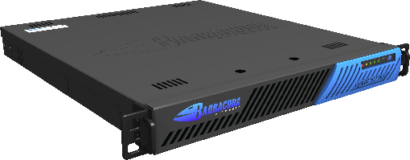
E-Mail Security
E-Mail servers are accepting messages from the internet at large…
What programs are being triggered?
  What permissions does the user running those programs have?
Spamblocking through software or appliances
  Barracuda Spam Filter – Appliance with sophisticated software
  Apache SpamAssassin – Free software that can be loaded into email stream
  Anti-spam definitions can be updated by vendor
  Bayesian logic can be used to evaluate and score suspicions items
    Nonstandard characters, frequent spam sources, suspect phrases
  Realtime Blackhole Lists (RBL’s)
    Frequently updated lists of known spam source IP addresses
    Spamhaus, SpamCop, SURBL, etc.
    Also the possibility for white lists!
Service
accounts!

Slide 19

E-Mail Services Check
Create E-Mail forward for user jpatalon
  Edit the file /home/jpatalon/.forward
  Enter on one line by itself, email address to forward to
    jpatalon@pennwest.edu
Send an email from Roundcube to user jpatalon@##.megastuff.biz
  Email will be sent to local account and forwarded. Include your name in the email message!
Send email to your username@##.megastuff.biz from Roundcube
  Email should show up in your Roundcube Inbox!
  Don’t delete it!
Run assignment 9 check script
  http://jpatalon.cs.edinboro.edu/ecsc325/classfiles/assignment9check.sh
  Don’t forget to set script executable before running!

Slide 20

File Transfer Services
File transfer services are used to transfer files between hosts
  Server to server
  Server to client
  Client to server
  Client to client
Pull-based transfers
  Files transfers are initiated from destination
  Downloading from a website
Push-based transfers
  File transfers are initiated from source
  Streaming

Slide 21
File Transfer Protocol
The File Transfer Protocol (FTP) specification was originally published in 1971
FTP is the original method of transferring files
FTP is a Client-Server model
  A client will connect to an FTP server to upload or download files
FTP servers can run in active or passive modes
  Active: FTP server will establish data channel connection as source
    Requires inbound FTP connection from server to client, often blocked by firewalls
    Requires port 21 open on server, multiple additional client ports open
  Passive: FTP server tells client what port to use for data channel
    Client opens second connection to server on specified passive port
    Server must accept incoming passive port connections
    Requires port 21 open on server, multiple additional server data ports open (port 20)
FTP connections are over TCP!
Control Port: 21/TCP
Data Port: 20/TCP
Notes:
The FTP protocol has changed little since the 1970’s

Slide 22
File Transfer Protocol
FTP is command driven
  Interact directly with FTP server from command line
  GUI applications perform same functionality as command line
    FileZilla, WinSCP, web browsers and plugins
FTP Servers may allow for anonymous access
  Accounts can also be created for specific users
FTP Services are not secure by default!
  Commands are data are transmitted in plain text!
  Usernames and passwords can be easily viewed on the network
  Encryption methods can be inconsistent
We will implement VSFTPd – Very Secure FTP
  It is still inherently insecure by design…
Control Port: 21/TCP
Data Port: 20/TCP

Slide 23
File Transfer Protocol
Multiple different methods exist to secure FTP
  FTPS adds TLS/SSL encryption to existing FTP
  SFTP uses secure SSH protocol to perform FTP actions
FTPS has two modes, implicit and explicit
  Implicit: control and data channels must be encrypted
  Explicit: client can decide what to encrypt at any time
Why not use encryption?
  Files that are not sensitive
  Files are transferred through an encrypted means (VPN, SSH tunnel, etc)
  Firewalls or NAT devices may block communication
    Implicit, explicit, active, passive, custom configurations…
  Explicit encryption denial of service attack
    Repeatedly turning encryption on/off
Control Port: 21/TCP
Data Port: 20/TCP

Slide 24
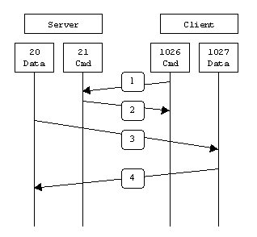
File Transfer Protocol
Active Transfer Example
  Client connects from a random unprivileged port (N > 1023) to the FTP server's command port, port 21.
  Client listens on port N+1 and sends the FTP command PORT N+1 to the FTP server.
  Server then connects back to the client's specified data port from its local data port, which is port 20.
  Client connects from port N+1 to server port 20 to complete file transfers.
  Requires open ports:
    Server port 21 inbound from ports > 1024
    Server port 21 outbound to ports > 1024
    Server port 20 inbound from ports > 1024
    Server port 20 outbound to ports > 1024
    Client ports > 1024
Notes:
An ephemeral port is a short-lived endpoint that is created by the operating system when a program requests any available user port. The operating system selects the port number from a predefined range, typically between 1024 and 65535, and releases the port after the related TCP connection terminates.

Slide 25
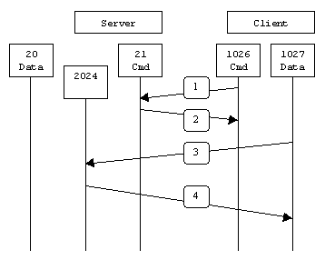
File Transfer Protocol
Passive Transfer Example
  Client connects from a random unprivileged port (N > 1024) to the FTP server's command port, port 21.
  Client sends command PASV, server returns random unprivileged port (P > 1024). Server opens port P for incoming connections.
  Client connects from port N+1 to port P on server to create data connection.
  Server then connects back to clients port N+1 from port P
  Requires open ports:
    Server port 21 inbound from ports > 1024
    Server port 21 outbound to ports > 1024
    Server ports > 1024 inbound from ports > 1024
    Server ports > 1024 outbound to ports > 1024
    Client ports > 1024
Notes:
An ephemeral port is a short-lived endpoint that is created by the operating system when a program requests any available user port. The operating system selects theport number from a predefined range, typically between 1024 and 65535, and releases the port after the related TCP connection terminates.

Slide 26
File Transfer Protocol
Passive Transfer Example
  Client connects from a random unprivileged port (N > 1024) to the FTP server's command port, port 21.
  Client sends command PASV, server returns random unprivileged port (P > 1024). Server opens port P for incoming connections.
  Client connects from port N+1 to port P on server to create data connection.
  Server then connects back to clients port N+1 from port P
  Requires open ports:
    Server port 21 inbound from ports > 1024
    Server port 21 outbound to ports > 1024
    Server ports > 1024 inbound from ports > 1024
    Server ports > 1024 outbound to ports > 1024
    Client ports > 1024
Firewalls typically allow return established/related traffic!
Notes:
An ephemeral port is a short-lived endpoint that is created by the operating system when a program requests any available user port. The operating system selects theport number from a predefined range, typically between 1024 and 65535, and releases the port after the related TCP connection terminates.

Slide 27
File Transfer Protocol
FTP Commands
Command | Description | Example
ftp host | Opens FTP client and initiates a connection to FTP server | ftp 192.168.0.100
open host | Once the FTP client has been started, opens a connection | open 192.168.0.100
close | Closes the connection but does not exit the FTP client | close
quit or bye | Closes the connection and exits the FTP client | bye
ls filenames | Displays filenames and can use wildcards | ls *.rpm
dir filenames | Displays the long listing of files and their properties, such as the size and date the file was created | dir *.rpm

Slide 28
File Transfer Protocol
FTP Commands
Command | Description | Example
binary | Transfer files in binary mode | binary
ascii | Transfer files in text mode | ascii
get filename | Downloads a single file | get test.rpm
put filename | Uploads a single file | put testapp.zip
mget filenames | Downloads multiple files; used with wildcards | mget sendmail*.rpm
mput filenames | Uploads multiple files; used with wildcards | mput *.tif
prompt no | Stops prompting for each file when used before you use mget or mput | prompt no
prompt | Starts prompting | prompt

Slide 29
File Transfer Protocol
FTP Commands
Command | Description | Example
hash | Displays a hash symbol as files are being downloaded | hash
cd directory | Moves to another directory on the FTP server | cd /software
lcd directory | Moves to another directory on the client | lcd /docs
pwd | Displays the current directory on the server | pwd
help command | Finds very brief help on FTP commands; if used without a reference to a command, it will give you a list of commands available | help mget
!command | Allows you to execute commands on the local FTP client | !cd /home/user

Slide 30

Secure Copy
SCP – A means of transferring files securely between hosts
  Based on SSH protocol – It just uses SSH to transfer files!
  Can be used to push or pull files
  Example: scp SourceFile user@remotehost:/directory/TargetFile
    Copies local SourceFile to remote host at location /directory/TargetFile
  Example : scp user@remotehost:/directory/SourceFile TargetFile
    Copies remote /Directory/SourceFile to local host TargetFile
  Recursively copy directories with “-r” option
    Ex: scp -r /directory user@host:/directory
  SCP uses SSH port 22, specify custom port with “-p ####” option
    Ex: scp -p 2345 -r /directory user@host:/directory

Slide 31
Secure Copy
Rsync – Remote Synchronize
  Used to keep files in in sync between hosts
  Can use SSH for encrypted communications
    Some systems use SSH as default for rsync, some don’t
    Force ssh with -e “ssh”
  Supports multiple options
    -a : Archive mode – Copy recursively, preserve links/permissions/ownership/timestamps
    -v : Verbose – Show what files are being copied and where
    -z : Compression – Compress data being transferred
    -h : Human-readable – Display numbers in human-readable format
  Note the trailing slash!
    A trailing slash indicates just the contents of the directory!
  Ex:
    rsync -avzh /data/Blockland/ 10.11.186.146:/opt/Blockland/

Slide 32

Network File Systems (NFS)
Network File Systems are a way of sharing files and applications across the network.
  Native to Linux/Unix systems
  Comparable to Windows file sharing (SMB/CIFS)
  Client/Server model
    Clients mount remote file systems from a server
  Remote Procedure Calls (RPCs) handle the requests between the client and server
Usages
  Shared drives (like a mapped P:\ drive in Windows)
  Home profile folders on a server instead of a local machine
    Redundancy, backups, maintenance at a server level instead of a desktop level
  Auto-mounting
  Hosting programs

Slide 33

Server Message Block (SMB)
SMB, also sometimes called CIFS – Common Internet File System
Can operate over TCP directly on TCP port 445
May run under NetBIOS API
  UDP ports 137 & 138
  TCP ports 127 & 139
Initially added to Windows in Windows for Workgroups 3.1
  Windows for Workgroups was an extended version of Windows
  Intended for use among clients with no centralized server
SMB Connections made to servers and shares
  Ex: \\hostname\share
  Ex: \\hostname.fqdn.tld\share

Slide 34
Server Message Block (SMB)
Samba provides SMB/CIFS services to many non-windows operating systems
  Unix, Linux, AIX, OSX, BSD, etc.
Samba can support many Active Directory and Server functions
  Allow clients to join AD
  Host shares to Windows clients
  Connect to shares on Windows hosts
  Provide Distributed File System (DFS) services
  Allow for printing to Shared windows printers
  Share printers with Windows hosts

Slide 35
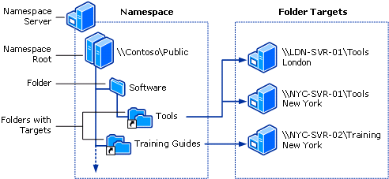
Distributed File Systems (DFS)
A Distributed File System makes it possible to create a single directory tree that links together multiple file servers and their files
Provides a common view of a centralized file system that is distributed among various servers
  Even though files are stored on different servers, to the user they appear on the same server
  Allows for replication among DFS servers
  Allows for the movement of files physical
  storage location without affecting any
  user or application usage
  System can be reconfigured as needed
  to alleviate performance issues
  System can be easily expanded if necessary,
  without any impact to existing users

Slide 36

File Systems Table - FSTab
A system configuration file that contains the mount and partition information for various disks
Specifies five key pieces of information necessary to mount disks
  Source Volume
    Can be label, UUID, VolumeGroup/LogicalVolume, or just path to disk & partition
  Location within directory tree to mount the file system
  Type (format) of disk
  Disk options
  Backup and Disk Check Values
      /dev/mapper/centos-root / xfs defaults 0 1
      UUID=a515c601-96bc-45f5-b66d-b0c2a855688a /boot xfs defaults 0 0
      /dev/mapper/centos-swap swap swap defaults 0 0
      /dev/sdb2 /data ext4 defaults 0 0
      LABEL=INFO /info ntfs defaults 0 0
      147.64.243.125:/share /share nfs bg,rw,sync,hard,intr 0 0

Slide 37
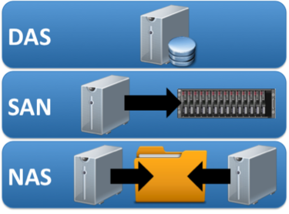
Storage
Direct Attached Storage (DAS)
  Storage devices connected directly to server hardware
Storage Area Network (SAN)
  Separate network for storage traffic
  Typically fiber-optic connections
  Gigabit speeds (8Gbit/s+)
  Replaces internal server storage
  Provides redundant access to large storage devices
Network Attached Storage (NAS)
  Storage available across traditional Ethernet (TCP/IP) network
  Intended for serving shared files to multiple clients
  Appears as network shares

Slide 38

Umask
Umask specifies the default set of permissions given to a file when created
  Umask can be set per-system and also per-user
  See the current umask value by running the command umask
  Typically set with octal modes
    Octal modes are the digits, ex: umask 0022
    Symbolic modes use letters
  Umask specifies what should be subtracted from file or folder permissions
    Folders start with 0777, files start with 0666
    If my umask is 0022, new folders are created with permissions 0755, files with 0644
      0755 = rwxr-xr-x
      0644 = rw-r--r--
      I like umask 0027 = 0750 or 0640 or rwxr-x--- or rw-r-----
  User and group ownership is set by user creating the file
    Settings can be different per user
    Settings can be different depending on how files/folders are created!

Slide 39
ECSC 325.200
Web Server Administration
Spring 2025 – Week 9.2 – March 13th, 2025
FTP Installs, System Info, Monitoring, Backups, and Tuning…
Prof. Jason Patalon

Slide 40

Objectives
FTP server installs and tests
Easy System and Database Backups
  Various options, restores, testing, automation
Monitor Operating Systems
  Tools and technologies used
Monitor Web Statistics
Monitor Servers
  Some Examples
Server Analysis & Optimization Tools
Notes:
Easy may be relative…

Slide 41
Weekly Info
“Go as far as you can see, and you will see further.” - Zig Ziglar
Attendance
Assignment 8 due March 12th, 2025
Assignment 9 due March 19th, 2025
Assignment 10 due March 26th, 2025?
Assignment 11 due April 2nd, 2025?
Assignment 12 due April 9th, 2025?
Good of the class
Stuxnet Virus Video?!
  https://www.youtube.com/watch?v=J07N1KXOyfk
    10 Minute runtime
Final Exam
  300 Points
  April 29th, 2025, 5PM-7PM
  Written and hands-on
Notes:
Lunch sometime between 12:00 - 2:00 pm

Slide 42
Recap and Review
The next few weeks…
  Security and Authentication
  Firewalls and Filters
  Network Services
  Cloud
  Final Exam!
Corrections, updates, etc.
Review of previous assignments
  Assignments 8 and 9 review next week…
Questions from previous classes?
  Feel free to ask during class, after class, email, office hours…
Etcetera

Slide 43
Semester Grades Review
Grades are assessed according to the following breakdown:
Description Percentage Total Points Graded points Remaining Points
Midterm Exam 21.42% 300 300 0
Final Exam 21.42% 300 0 300
Attendance 15-28 6.00% 84 42 42
Assignments 8-14 51.14% 716 281 435
Total 100.0% 1400 623 777
  Assignment 14 – 140 Points, more detail & input expected!
  Final – 300 Points – Hands on configuration portion, mostly 2nd half content
  Not including this weeks attendance points

Slide 44
Changes Requested
Senior Subject Matter Experts (SME) – Engineering Configuration Update
  Postfix config changes:
    File: /etc/postfix/main.cf
        inet_interfaces = all
        inet_protocols = ipv4
        mynetworks = 127.0.0.0/8, 147.64.242.0/23
  Roundcube mail config change: set your identity
    Log in to roundcube webpage: http://roundcube.##.megastuff.biz
      Settings → Identities
      Display Name: Your first name
      Username@##.megastuff.biz (YOUR USERNAME!!!)
      Send another email to jpatalon@10.megastuff.biz from your Roundcube email!
        Also send an email to user@10.megastuff.biz
Update the Roundcube!
This is part of assignment 10!

Slide 45

Network File Systems (NFS) Client Install
Mapping a NFS share to a local mount point
  Install NFS Client tools (should already be installed)
    dnf -y install nfs-utils
  Create the local folder to mount at:
    mkdir /share
  Add network mount to filesystem configuration file /etc/fstab
    147.64.243.110:/share /share nfs bg,rw,sync,hard,intr 0 0
  Mount any missing filesystems from /etc/fstab file
    systemctl daemon-reload; mount -a
  Check that filesystem has been mounted
    df -h /share
      147.64.243.110:/share 50G 2.7G 48G 6% /share
  Manually unmount and remount network file system
    umount /share
    mount 147.64.243.110:/share /share

Slide 46
Vsftpd Installation
Install vsftpd server and ftp client
    dnf install vsftpd ftp -y
Edit vsftpd configuration file - add to end of file: /etc/vsftpd/vsftpd.conf
    anonymous_enable=YES
    anon_upload_enable=YES
    anon_root=/var/ftp
    anon_umask=022
Set permissions on anonymous upload directory
    chown -R root:ftp /var/ftp/pub
    chmod -R ug+rwX,o+rX,o-w /var/ftp/pub
    ls -lah /var/ftp
Start vsftpd service and enable to run on system startup
    systemctl enable vsftpd.service
    systemctl start vsftpd.service

Slide 47
Vsftpd Test 1
As root user, create test file /root/test.txt
  cd /root
  echo This is a test > /root/test.txt
Log in to FTP server as anonymous and upload file
  ftp localhost
  anonymous user, no password
  pwd
  ls
  cd pub
  put test.txt
  ls
  exit

Slide 48
Vsftpd Test 1
Upload a file as anonymous user
ftp
ftp> open localhost
Trying ::1...
Connected to localhost (::1).
220 (vsFTPd 3.0.5)
Name (localhost:root): anonymous
331 Please specify the password.
Password:
230 Login successful.
Remote system type is UNIX.
Using binary mode to transfer files.
ftp> pwd
257 "/"
ftp> !pwd
/root
ftp> ls
229 Entering Extended Passive Mode (|||59138|).
150 Here comes the directory listing.
drwxrwxr-x 2 0 50 6 Apr 10 14:51 pub
226 Directory send OK.
ftp> cd pub
250 Directory successfully changed.
ftp> pwd
257 "/pub"
ftp> ls
229 Entering Extended Passive Mode (|||45535|).
150 Here comes the directory listing.
226 Directory send OK.
ftp> !ls
anaconda-ks.cfg Documents initial-setup-ks.cfg Music Public test.txt
Desktop Downloads localhost.conf Pictures Templates Videos
ftp> put test.txt
local: test.txt remote: test.txt
229 Entering Extended Passive Mode (|||49941|).
150 Ok to send data.
226 Transfer complete.
15 bytes sent in 1.5e-05 secs (1000.00 Kbytes/sec)
ftp> ls
229 Entering Extended Passive Mode (|||15289|).
150 Here comes the directory listing.
-rw-r--r-- 1 14 50 15 Apr 10 14:54 test.txt
226 Directory send OK.
ftp> quit
221 Goodbye.

Slide 49
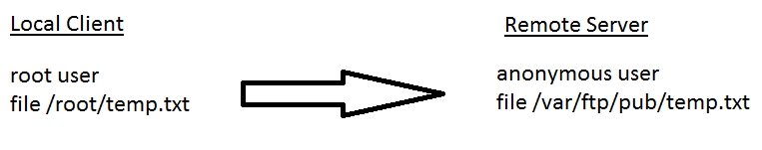
Vsftpd Test 1

Slide 50
Vsftpd Configuration
Remove anonymous access and change local umask
  Edit vsftpd config file /etc/vsftpd/vsftpd.conf, change following values:
    anonymous_enable=NO
    local_umask=027
Restart vsftpd to apply configuration changes
  systemctl restart vsftpd.service
Attempt to log in as anonymous user again
  ftp localhost
  anonymous user, no password
  Should receive “530 Login incorrect.”
  quit

Slide 51
Vsftpd Test 2
Verify anonymous FTP disabled
ftp localhost
Trying ::1...
Connected to localhost (::1).
220 (vsFTPd 3.0.5)
Name (localhost:root): anonymous
331 Please specify the password.
Password:
530 Login incorrect.
Login failed.
ftp> quit
221 Goodbye.

Slide 52
Vsftpd Test 3
Download file as user
ftp localhost
Trying ::1...
Connected to localhost (::1).
220 (vsFTPd 3.0.5)
Name (localhost:root): jpatalon
331 Please specify the password.
Password: password
230 Login successful.
Remote system type is UNIX.
Using binary mode to transfer files.
ftp> cd /var/ftp/pub
250 Directory successfully changed.
ftp> lcd /tmp
Local directory now /tmp
ftp> ls
229 Entering Extended Passive Mode (|||59574|).
150 Here comes the directory listing.
-rw-r--r-- 1 14 50 15 Apr 10 14:54 test.txt
226 Directory send OK.
ftp> get test.txt
local: test.txt remote: test.txt
229 Entering Extended Passive Mode (|||61002|).
150 Opening BINARY mode data connection for test.txt (15 bytes).
226 Transfer complete.
15 bytes received in 3.2e-05 secs (468.75 Kbytes/sec)
ftp> !ls
test.txt
ftp> quit
221 Goodbye.
ls -lah /tmp/test.txt
-rw-r--r--. 1 root root 15 Mar 24 14:10 /tmp/test.txt
cat /tmp/test.txt
This is a test

Slide 53
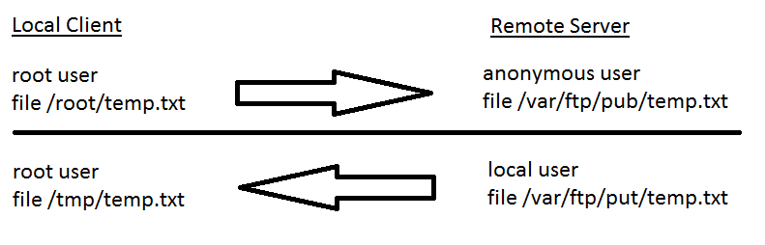
Vsftpd Test 3

Slide 54
Vsftpd Test 4
Upload file as local user
ftp localhost
Trying ::1...
Connected to localhost (::1).
220 (vsFTPd 3.0.2)
Name (localhost:root): jpatalon
331 Please specify the password.
Password: password
230 Login successful.
Remote system type is UNIX.
Using binary mode to transfer files.
ftp> pwd
257 "/home/jpatalon"
ftp> !pwd
/root
ftp> lcd /tmp
Local directory now /tmp
ftp> put test.txt
local: test.txt remote: test.txt
229 Entering Extended Passive Mode (|||50062|).
150 Ok to send data.
226 Transfer complete.
15 bytes sent in 1.8e-05 secs (833.33 Kbytes/sec)
ftp> ls
229 Entering Extended Passive Mode (|||59858|).
150 Here comes the directory listing.
drwx------ 8 1000 1000 4096 Apr 03 16:22 Maildir
-rw-rw-r-- 1 1000 1000 31 Mar 27 17:02 index.html
-rwx------ 1 1000 1000 2636 Mar 31 20:59 test.sh
-rw-r----- 1 1000 1000 15 Apr 10 15:08 test.txt
-rwxrw-r-- 1 1000 1000 3915 Apr 05 21:04 week12check.sh
226 Directory send OK.
ftp> quit
221 Goodbye.
ls -lah ~jpatalon/test.txt
-rw-r--r--. 1 jpatalon jpatalon 15 Mar 24 14:15 /home/jpatalon/test.txt
cat ~jpatalon/test.txt
This is a test

Slide 55
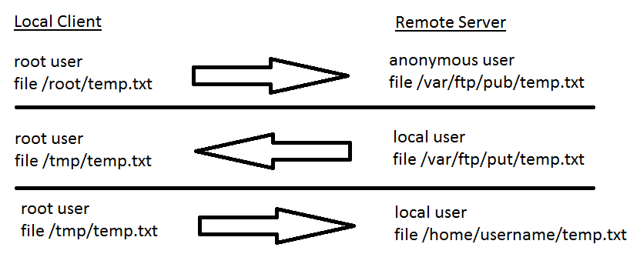
Vsftpd Test 4

Slide 56
FTP Services Check
Files should be in the following locations after all tests:
  /root/test.txt
  /tmp/test.txt
  /var/ftp/pub/test.txt
  /home/username/test.txt
  File ownership must be correct, based on how file was copied!
Assignment 10
  Add an NFS mount
  Install and configure the FTP services
  Transfer files using FTP
  Brief write-up of what you did and why!
    Different documentation assignment!

Slide 57
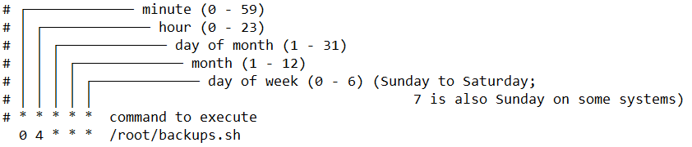
Core System Services - Logging & Cron
Rsyslog service - Provides a standardized way to perform logging
  Can specify what priority of logs are written where
    Emergency messages may be logged to the console screen!
  Can classify log messages as different types (facility)
    Messages may come from mail subsystem, or authentication subsystem, etc.
  Logging details specified within rsyslog configuration files
    Templates available for custom log creation
Cron - Schedule a program to run at a specific time
  Cron service runs, reading cron configuration files, running commands at the appropriate times
  Commands can be set to run on a schedule, or only run once
  Crontab files edited with the crontab -e command

Slide 58
Crontab Editing
crontab -e – Edit your crontab entry with your default editor
  Your default editor is vi
  Change your default editor to nano with the following command:
    export EDITOR=nano
    This is not persistent! Add that command to your ~/.bashrc file to make permanent!
The crontab file is a space separated list of scheduled commands
  Commands are scheduled by minute, hour, day of month, month, and day of week
System crontab files - /etc/cron*
  Can be set to run as a user

Slide 59

Alias
See currently defined aliases
  Alias
Add to your .bashrc file to make an alias permanent
  This file will be executed when you log in, and the alias command will be run
  Examples:
    alias ssh_home='ssh -D 55555 user@server.domain.tld'
    alias rm='rm -i'
Can be used to create command shortcuts for commonly used features
  alias ls='ls --color=auto'

Slide 60
Secure Copy - Rsync
Rsync - Remote Synchronize
  Used to keep files in in sync between hosts
  Can use SSH for encrypted communications
    Some systems use SSH as default for rsync, some don’t
    Force ssh with -e “ssh”
  Supports multiple options
    -a : Archive mode - Copy recursively, preserve links/permissions/ownership/timestamps
    -v : Verbose - Show what files are being copied and where
    -z : Compression - Compress data being transferred
    -h : Human-readable - Display numbers in human-readable format
    --delete: Delete – Delete files in the target that don’t exist in the source
    Many more options available! Check the man pages!
  Ex:
    rsync options source destination
    rsync -avzh /data/Blockland/ 10.11.186.146:/opt/Blockland/
    rsync -avh --delete /root /backups/
    rsync -avh --delete /var/log/ /backups/var/log/
Make note of your trailing slashes / !!!

Slide 61

MySQL Dump
mysqldump - Create an output file containing all the data within a database
  -a, --create-options Include all specific create options in CREATE statements.
  -A, --all-databases Dump all the databases.
  -p[passwd] The password to use when connecting to the server. Omit the password to be prompted.
    Entering your password on the command line is bad practice!
  -u name The MariaDB user name to use when connecting to the server.
Examples:
  mysqldump -u root -p --create-options --databases temperature > /tmp/temperature.sql
    Dump the data from the temperature database to the file /tmp/temperature.sql, creating the database if necessary.
  mysqldump -u root -p -a --databases wordpressdb > /tmp/wordpressdb.sql
    Dump the wordpressdb database to the wordpressdb.sql file, with create options.
  mysqldump -u root -p --create-options -A > /tmp/databases.sql
    Dump all databases to the /tmp/databases.sql file, creating the databases if necessary.

Slide 62
MySQL Performance Tuning
innodb_buffer_pool_size
  InnoDB maintains a storage area called the buffer pool for caching data and indexes in memory.
key_buffer_size
  A cache mechanism used to keep the most frequently accessed table blocks in memory, minimizing disk I/O.
innodb_log_file_size
  A log file of transactions, used to replay data entries after a system crash. Larger values mean less disk I/O due to less flushing checkpoint activity, but also slower recovery from a crash.
Basic recommendations (may differ depending on exact platform configuration!)
  innodb_buffer_pool_size: Roughly 80% of system RAM
  key_buffer_size: 32M for 1GB RAM, 96M for 2GB RAM, 256M for 4GB RAM and 768M for 8GB RAM
  innodb_log_file_size: 64-128M
Percona Tools (https://tools.percona.com) can create a custom configuration (account required, free)
Notes:
Many additional tools available for database tuning!

Slide 63
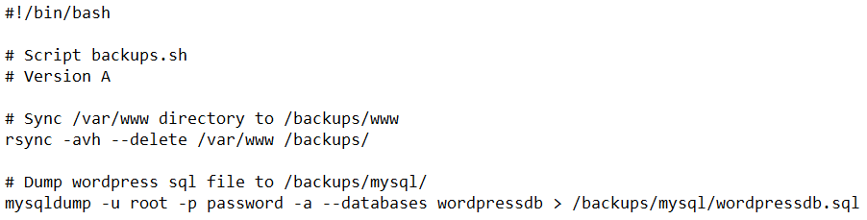
Create Backups
Make Backup Directories
  mkdir -p /backups/mysql
Install rsync!
  dnf -y install rsync
Synchronize specific directories
  rsync -avh --delete /var/www /backups/
Use mysqldump to create a backup of your WordPress database
  mysqldump -u root -p -a --databases wordpressdb > /backups/mysql/wordpressdb.sql
You can optionally put these commands into a script, and call the script with cron
  Script: (somewhere like /root/backups.sh)
If you enter your password
at a command prompt,
it is visible in your history!

Slide 64
Modify settings for performance
Create your own mysql configuration file
  New File: /etc/my.cnf.d/custom.cnf
      [mysqld]
      key-buffer-size = 256M
      innodb-buffer-pool-size = 2048M
      innodb-log-file-size = 128M
  Stop MariaDB and flush the innodb log files
    systemctl stop mariadb
      mv /var/lib/mysql/ib_logfile[0-1] /tmp/
      systemctl start mariadb
  Optionally, you can configure additional settings as required by your workload
    Various memory and system optimizations can be configured in /etc/systemctl.conf
    Per-user/per-group/system resource limits configured in /etc/security/limits.conf
Create specific DB settings with tools.Percona.com!

Slide 65
Simple Bash Scripting
A bash script in its simplest form is just a bunch of commands to do some tasks
  Scripts can get more complicated, similar to programming (if, loop, variables, functions, etc.)
  Different languages can be used for scripting; python is popular
To create a simple bash script
  Open a new file in your favorite text editor
  Enter the path to your shell interpreter on the first line
  Follow up with the commands!
  Don’t forget to comment!
  You can also use the output of
  commands as input within
  other commands in your script!
  Our standard command line arguments
  are available as well!

Slide 66
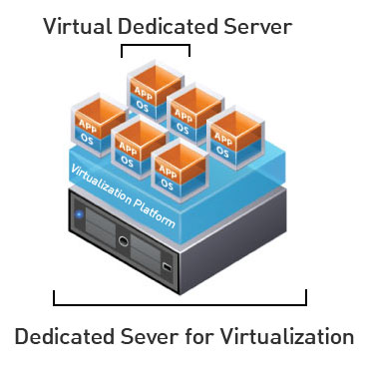
Virtual Machine Info
IP Address: 147.64.243.1##/23 (01-25)
Hostname: ecsc325-1##.cs.edinboro.edu (01-25)
Aliases:
  31##.megastuff.biz, 1##.megastuff.biz, ##.megastuff.biz (01-25)
  1##.ultrastuff.net, more?
Assignment 8 due March 12th
  Check script and upload in D2L!
Accessing VM’s from off campus requires a connection to the CS VPN first,
before opening a connection to your machine!
  CS firewall prevents direct connections from other networks to our VM’s!
    Once VPN is active: ssh user@ecsc325-1##.cs.edinboro.edu

Slide 67
Virtual Hosts
http://ecsc325-1##.cs.edinboro.edu, http://147.64.243.1##
  PHP Info
http://ecsc325-1##.cs.edinboro.edu/phpmyadmin, http://147.64.243.1##/phpmyadmin
  phyMyAdmin Website
http://##.megastuff.biz
  TBD: Testing 123…
http://1##.megastuff.biz
  TBD: Testing 123…
http://1##.megastuff.biz/temp/temp.php
  Temperature Graph Website
http://31##.megastuff.biz
  index.html: Hello Megastuff Website
http://ecsc325-1##.cs.Edinboro.edu/squirrelmail
  Squirrelmail website
http://roundcube.##.megastuff.biz
  Roundcube webmail
http://1##.ultrastuff.net
  Ultra Modern Template Website
http://31##.ultrastuff.net
  WordPress Website
https://ecsc325-1##.cs.edinboro.edu/private
  Private web site!
https://a13.##.megastuff.biz
  Assignment 13 web site!
Replace the ## with your 2 digit number!!!

Slide 68

Linux Commands
dig
nslookup
ftp
scp
rsync
umask
yum
systemctl
chown
chmod
ls
ssh
mkdir
wget
cd
echo
mv
pwd
vi
nano
mysql
rm
rpm
FTP commands
  get
  put
  cd
  lcd
  pwd
  !pwd
  open
  close
  quit

Slide 69

Key Terms and Items
MTA / MSA / MDA / MUA
Open E-Mail Relay
Masquerading
MX Records
SMTP
POP3
IMAP4
Spamblocking
FTP
All In One Network Routers
Firewalls
SSH / Reverse SSH / Proxy
Pull-based transfers
Push-based transfers
Active vs. Passive FTP Transfers
FTPS vs. SFTP
Implicit vs. Explicit encription
SCP
Rsync
Server Message Block (SMB)
Common Internet File System (CIFS)
DFS
Umask
VSFTPd

Slide 70

For Next Class
“Rivers get connected so much stronger than expected...” –Red Hot Chili Peppers
Textbook:
  Chapter 18: Apache
  Chapter 19: SMTP
Next topics
  System info, monitoring, firewalls, security, cloud…
Continuing work with VM’s
  Just because all tests say OK, doesn’t mean everything is working properly!
    Sometimes my check scripts have errors…
    I don’t always check for every possible entry…

